Slide 1
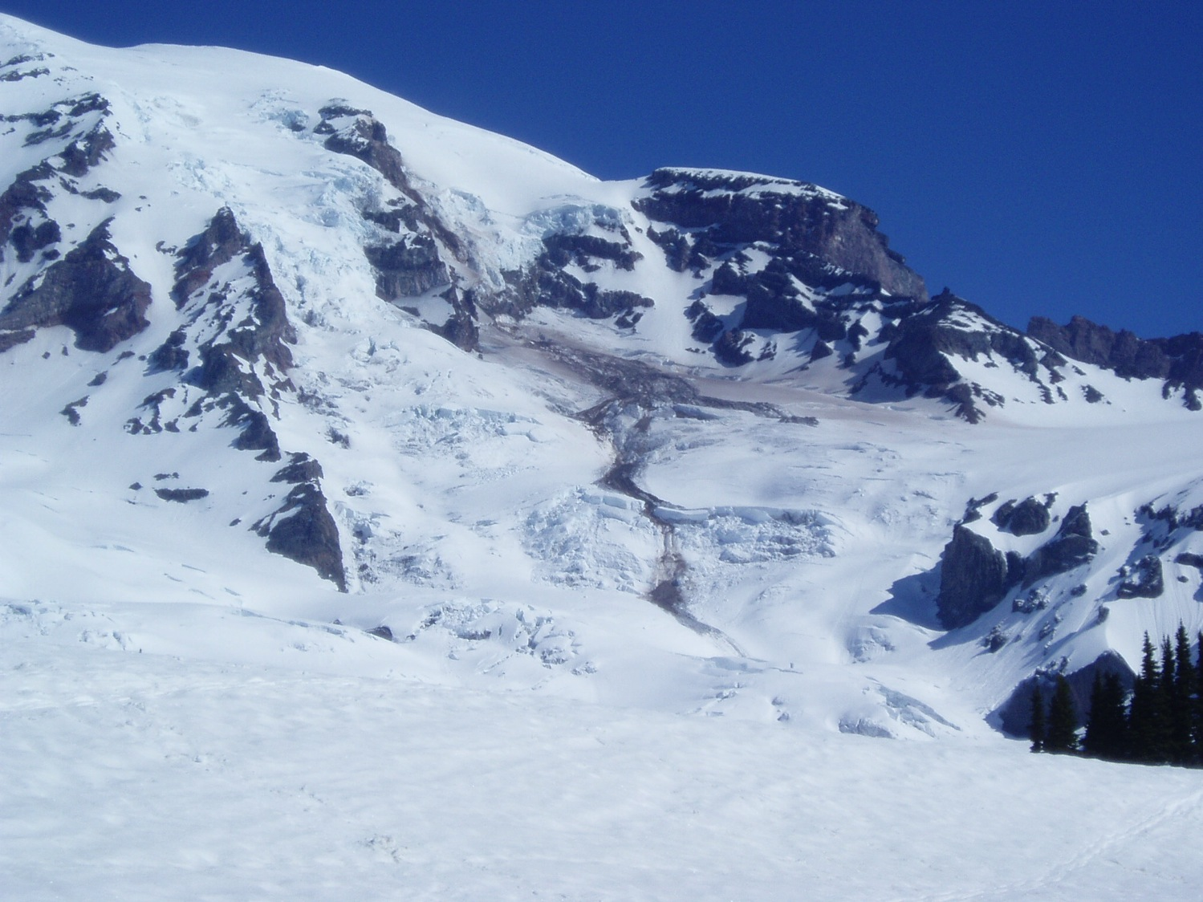


Glacier Retreat, Outburst Floods, and Kinematic Waves - Nisqually Glacier Changes Related to Climate
Max Stevens
Howard Conway, Ed Waddington, and Paul Kennard
G-Lunch
November 12, 2013

Slide 2
But first…
http://earthweb.ess.washington.edu//Glaciology/Glaciology/Home.html

Slide 3
Making your own website
Options:
  Use a text editor to write your html/CSS. Get some nerd cred.
  Adobe Dreamweaver. Feel like a pro.
  Open Source: Hop on the bandwagon.
    Kompozer, BlueGriffon
  Wordpress, etc. Let someone else do the hard work!

Slide 4
Glacier Retreat, Outburst Floods, and Kinematic Waves - Nisqually Glacier Changes Related to Climate
Max Stevens
Howard Conway, Ed Waddington, and Paul Kennard
G-Lunch
November 12, 2013

Slide 5
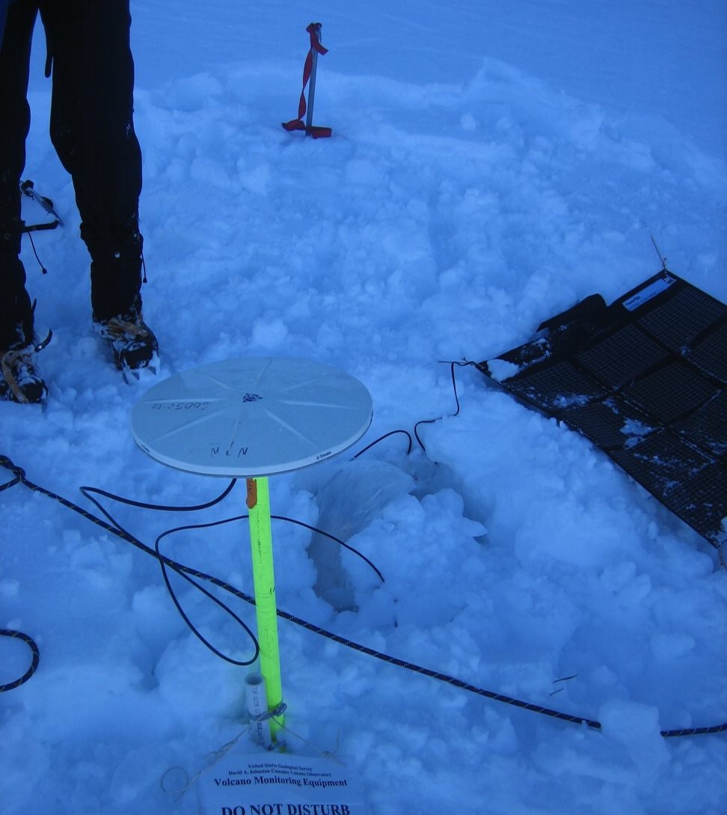
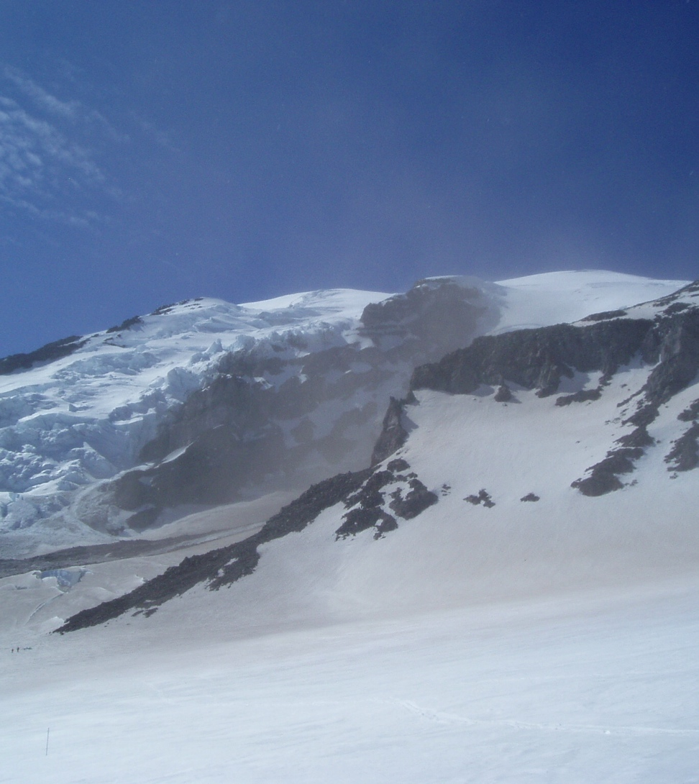
My Rainier/Nisqually Background
Oops.

Slide 6
Project Scope And Objectives
Broad Project:
  assemble and digitize Nisqually Glacier survey data
  Analyze and summarize Nisqually Glacier changes identified from transect surveys in context of:
    Mass balance
    Glacier Extent
    Ice activity
    Seasonal and long-term climate

Slide 7
Project Data
Surface Elevation Transects
Mass Balance
Surface Velocities
Climate: Snowfall, Temperature, PDO, ENSO
Terminus Position

Slide 8
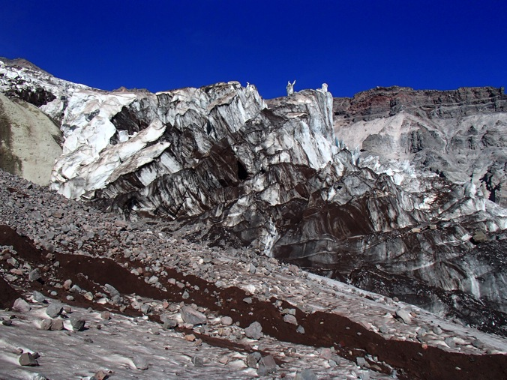
Alpine Glaciers
Interesting for…
  Climate-change indicators (?)
  Sea-level rise (small)
  Water resources (!)
  Hazards to infrastructure
Can be rather scenic
  Public interest
Glacier mass balance is an interplay between temperature and precipitation
  Maritime glacier MB is dominated by winter precipitation (Bitz and Battisti, 1999), but it is complicated.

Slide 9
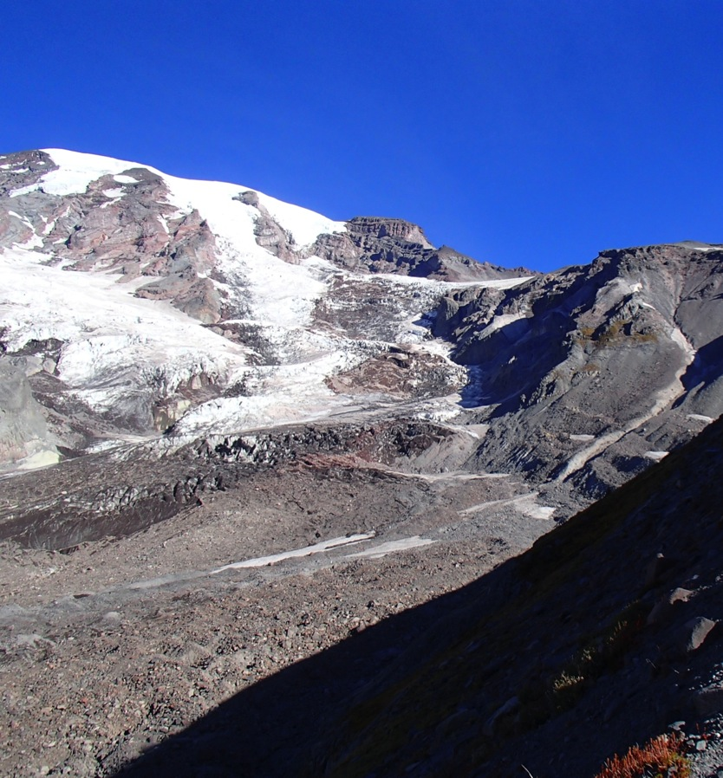
Nisqually Glacier, Mt. Rainier, WA
South-facing alpine glacier
4400 – 1500 m elevation
~ 8 km long
4.25 x 10⁶ m² surface area (Sisson et al., 2011)
2.2 x 10⁸ m³ of ice (Driedger and Kennard, 1986)
Very long measurement record
Tremendous rockfall hazard ☺

Slide 10
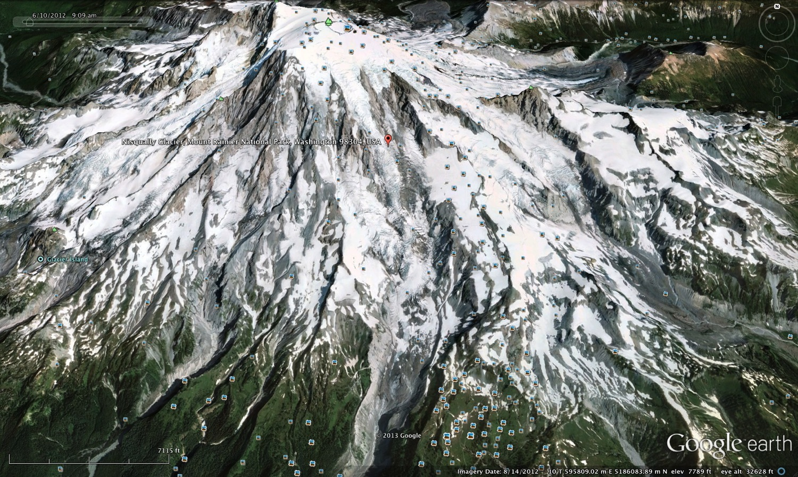
Nisqually Glacier

Slide 11
Nisqually Glacier Monitoring History
1857: Terminus first described (Lt. August Kautz)
1918: NPS begins to measure terminus position annually
1931: USGS and Tacoma City Light began annual surveys of transverse ice-surface altitude
1942 – 1960’s: Repeat photography from fixed points: Fred Veatch
1986: Ice Volume Estimates: isopachs from monopulse radar (Driedger and Kennard)
Modern: Transects (NPS), Mass Balance (NPS), LiDAR (NPS) , aerial photography/photogrammetry (Shean), velocities (NPS, Shean, Allstadt), new isopachs/radar work (C. Todd), Time Lapse (?) (Stevens, Kennard)
  See Heliker et al., 1984 for a more complete history

Slide 12
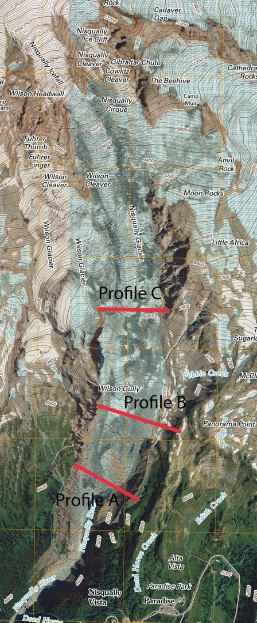
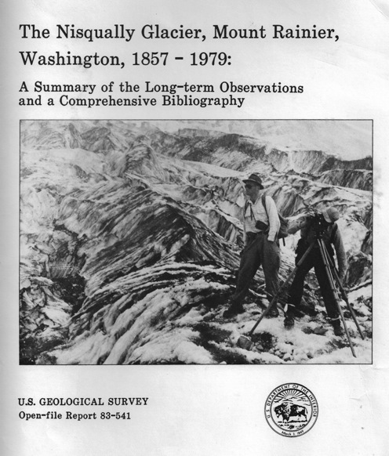
Transect Data
Measured (almost) annually since 1931
Originally were profiles 1 and 2; 3 was added in 1942
Changed to (slightly different) profiles A, B, and C in 1976
Point measurements across each profile are averaged to find the mean elevation.
Heliker et al. published data in 1984

Slide 13
Transect Data Gathering…
1931 – 1984: Heliker et al.
1991: NPS contracts surveying firm to conduct annual surveys. Raw data: missing.
2013 – future: ???

Slide 14
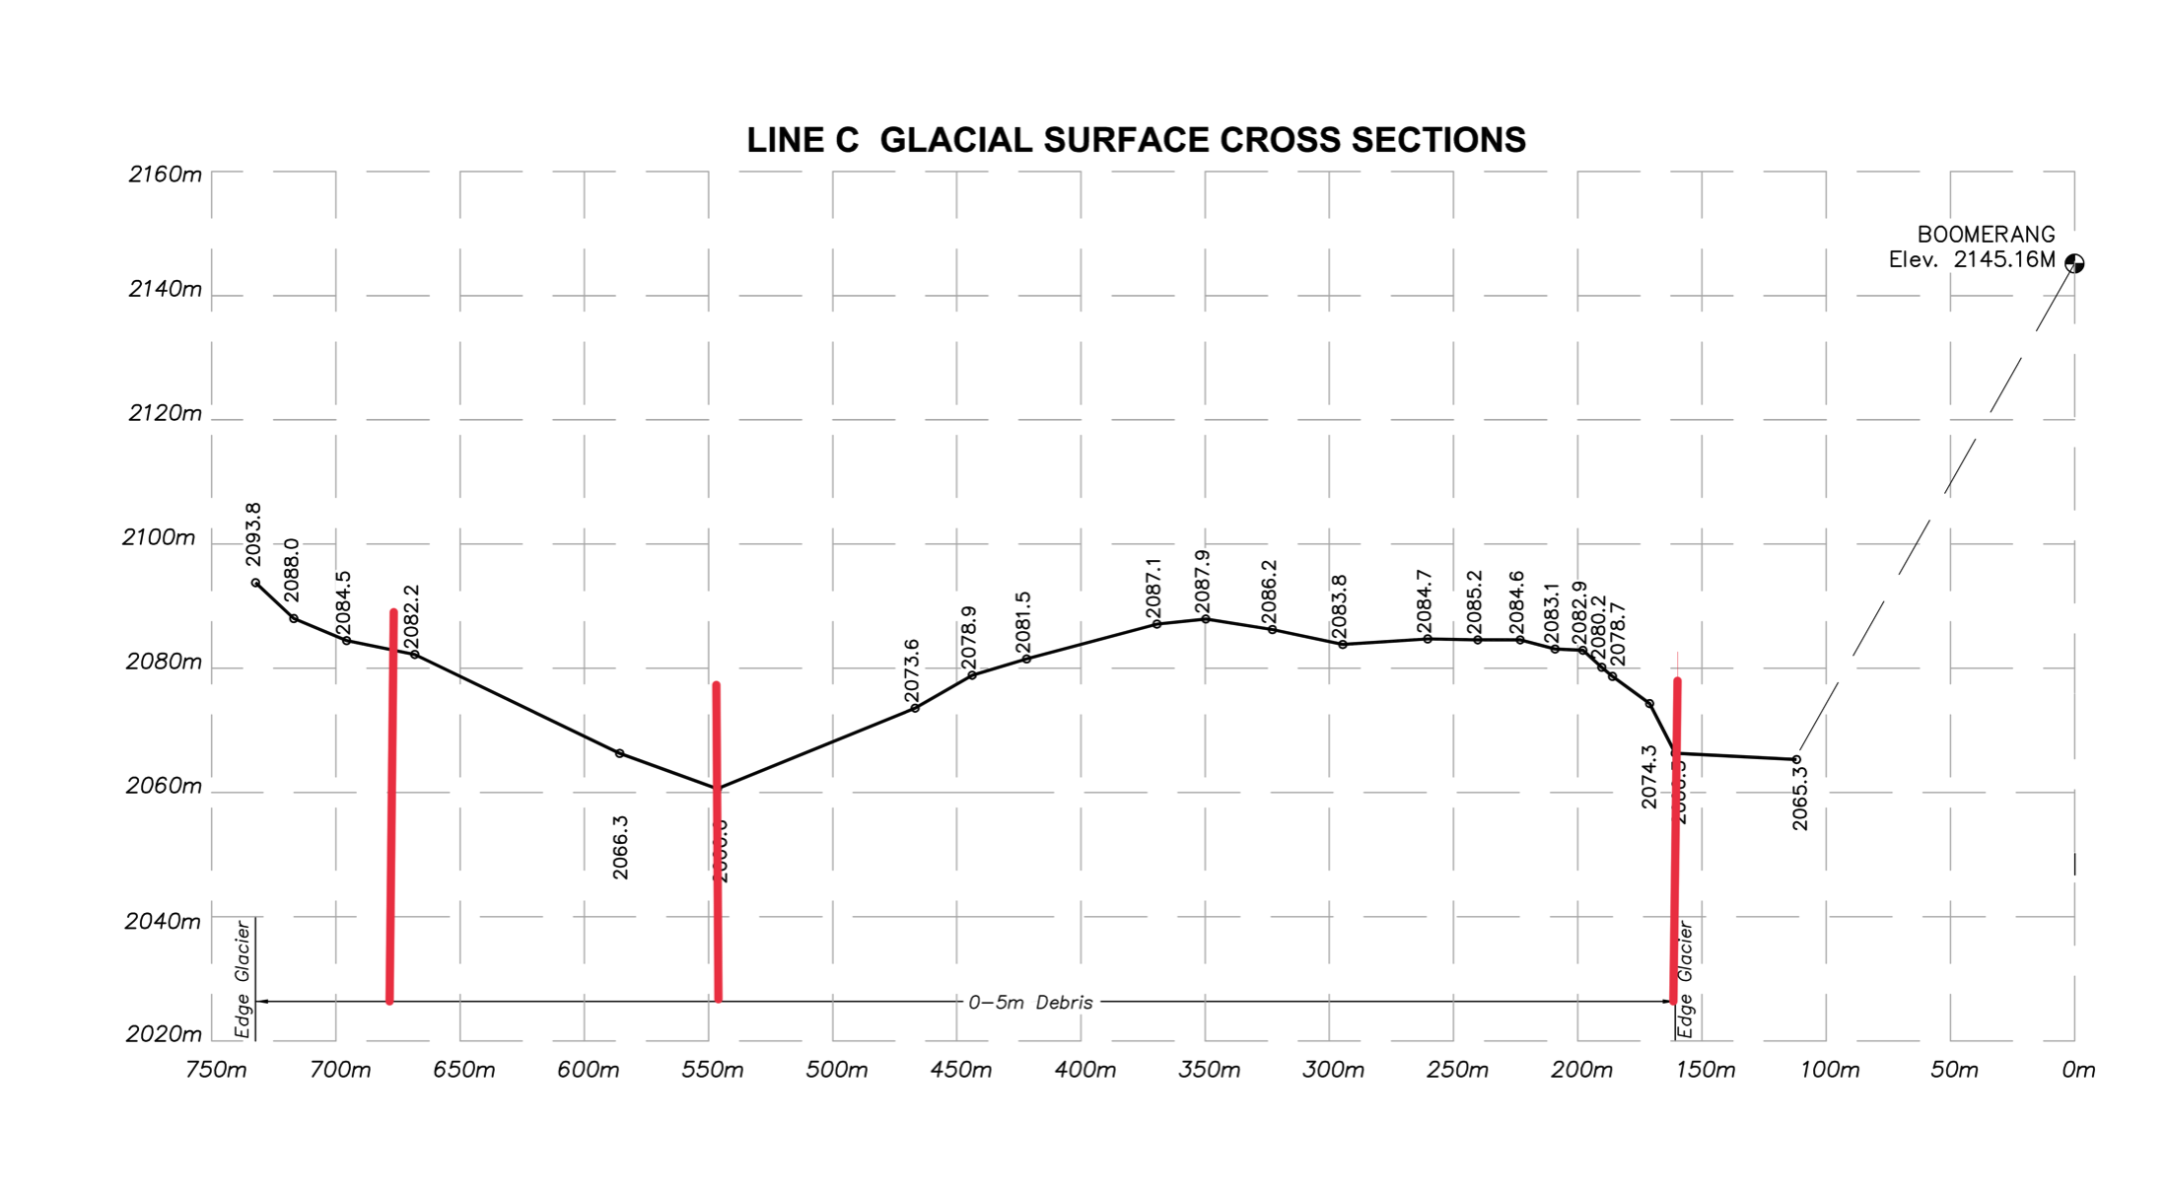
Data Challenges: Digitizing, Picking “windows” plot digitizer, standardized window

Slide 15
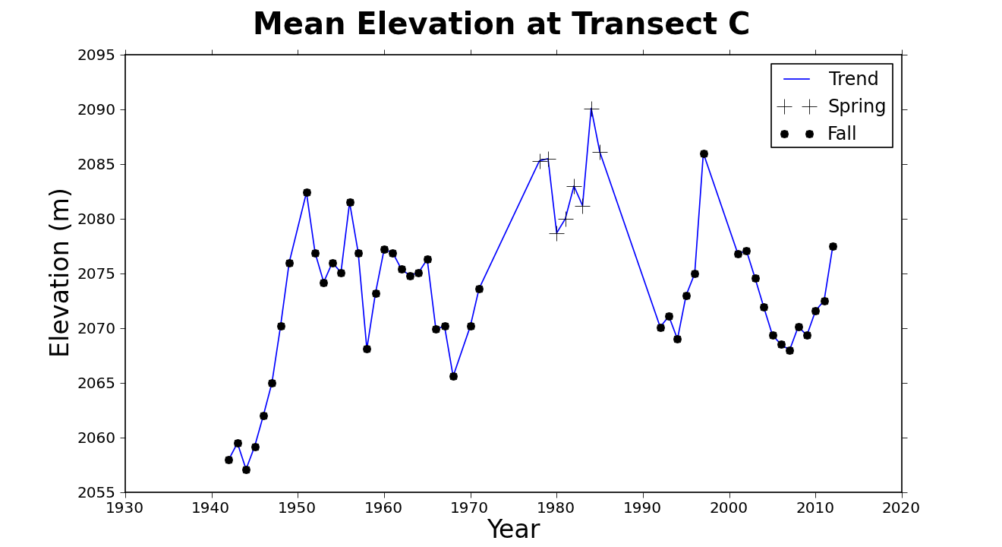

Slide 16
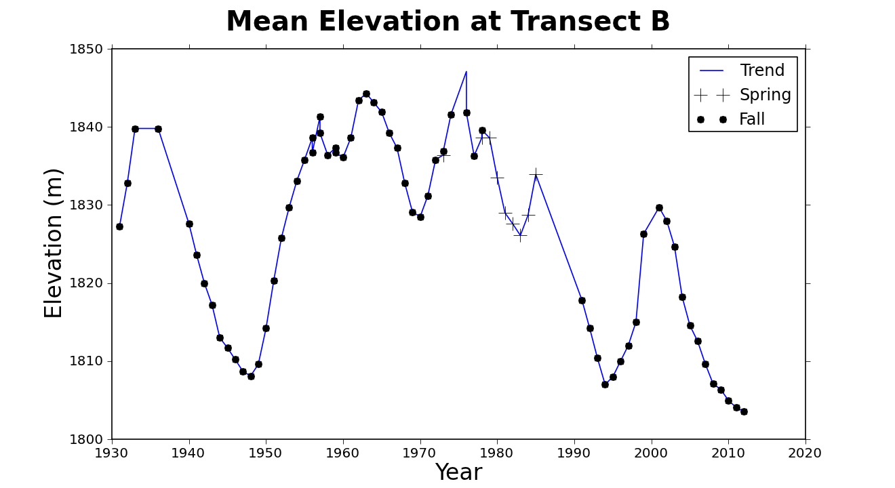

Slide 17
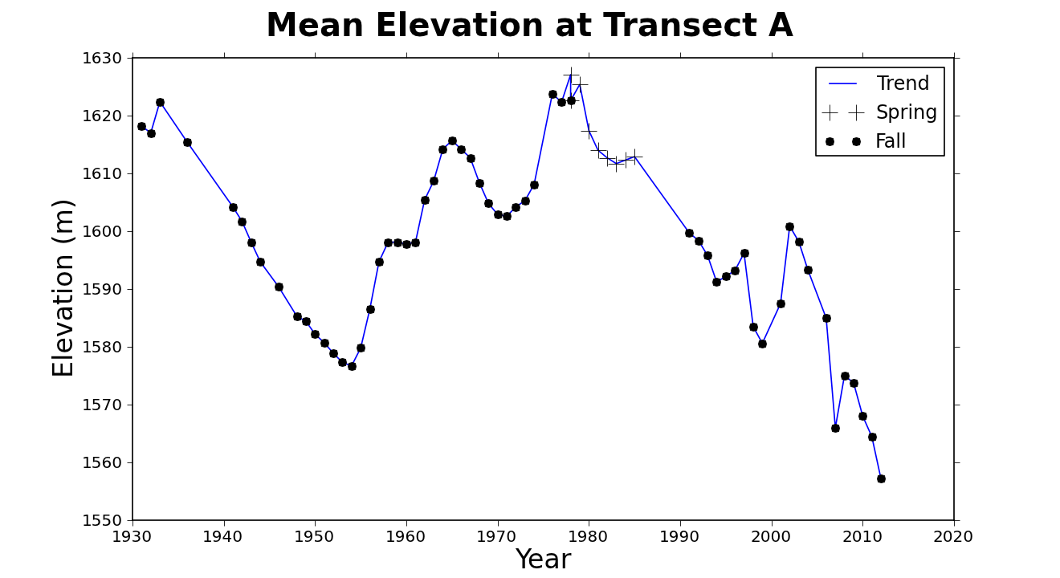

Slide 18
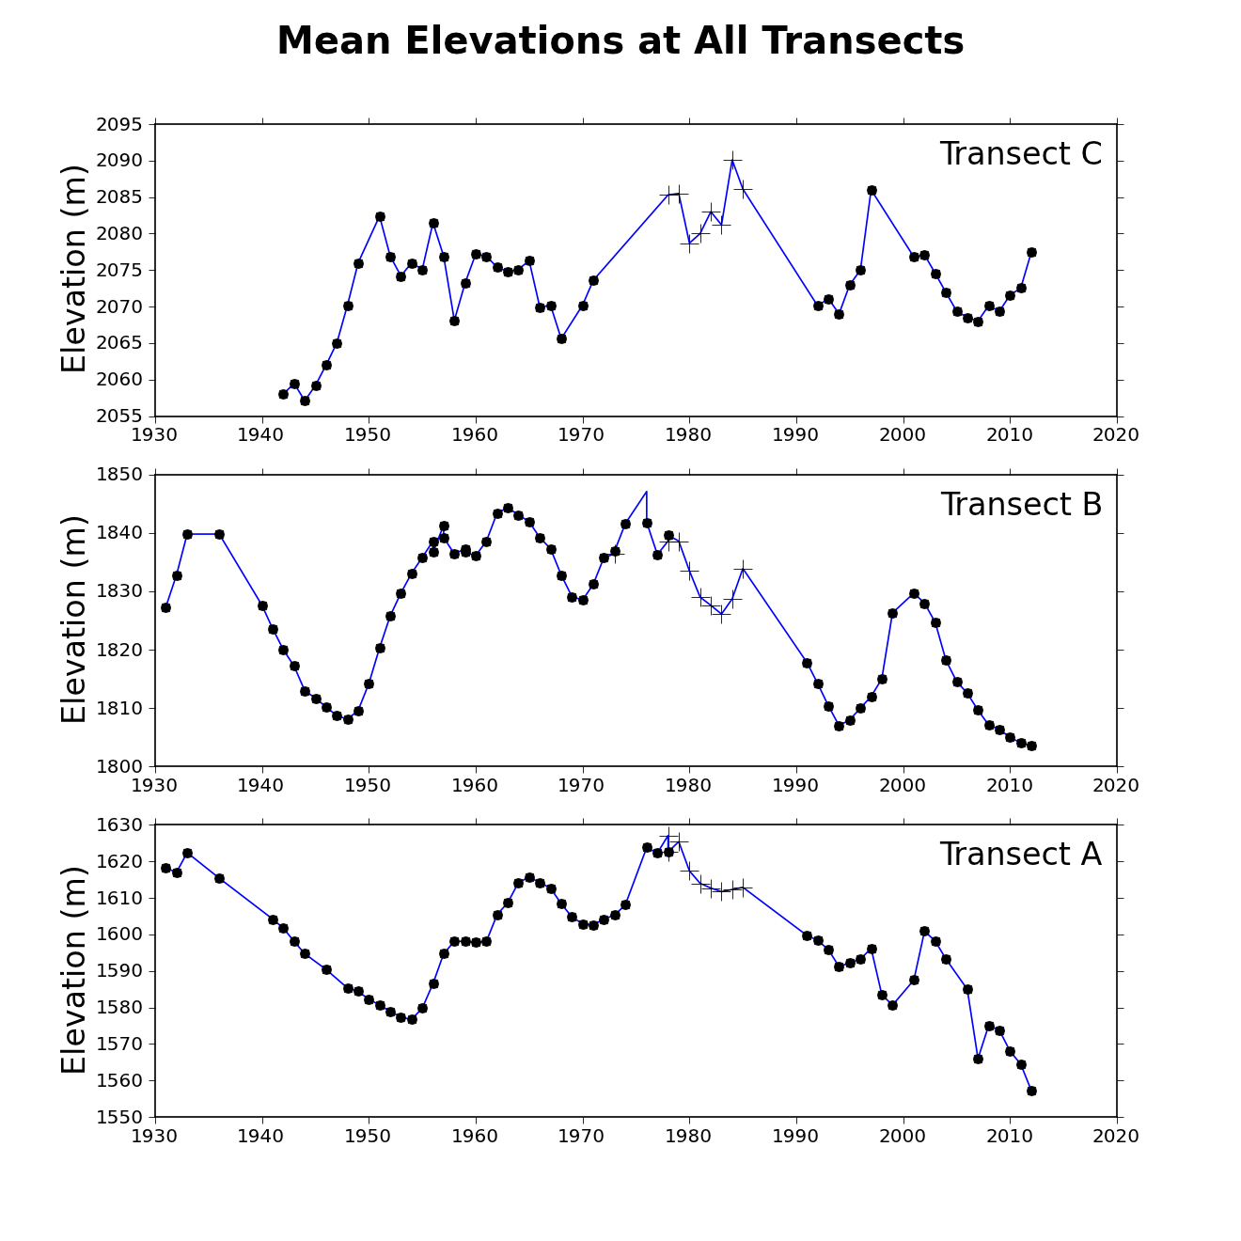
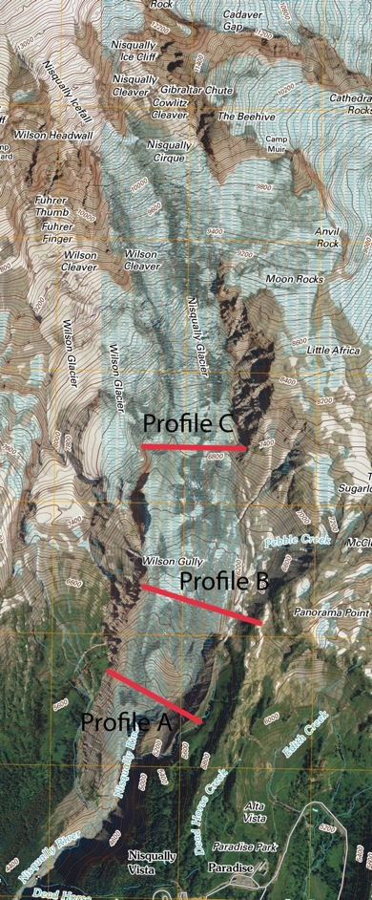

Slide 19
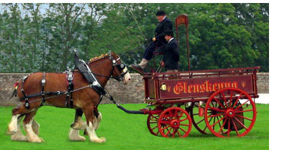
So, I have the data…
What is the question?
Glacier Retreat, Outburst Floods, and Kinematic Waves - Nisqually Glacier Changes Related to Climate

Slide 20
Initial Questions:
Are we observing kinematic waves?
  What are the climatic conditions will form a kinematic wave on the Nisqually Glacier?
How does does the Nisqually glacier respond to seasonal climatic variability?
  How to those responses manifest in surface elevation changes?
  Are observed changes due to climate change or natural variability?

Slide 21
Kinematic Wave Physics
Kinematic Waves: A wave (or bulge) of ice moving down glacier faster than the ice itself
First described (for glaciers) by Weertman and Nye in late 1950’s and 1960’s
Wave moves ~5 – 8 times faster than the glacier itself
  Vertical point velocities exaggerated, horizontal velocities increase slightly
Often results in a terminus advance

Slide 22
Kinematic Wave Physics
  Change is thickness in the glacier is proportional to the sum of an accumulation change, the rate of longitudinal strain, the speed at which the wave is travelling, and diffusion of the wave.

Slide 23
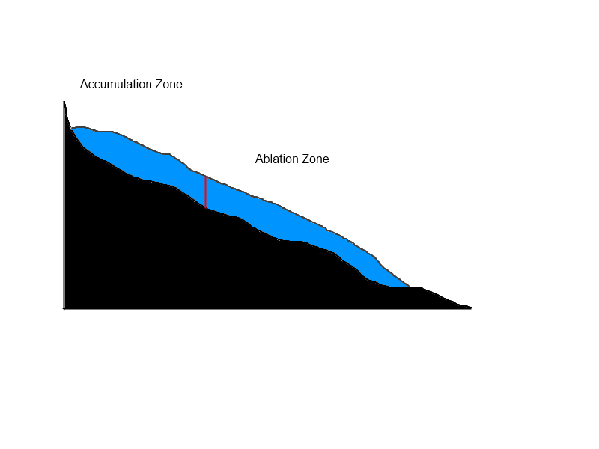
Kinematic Waves: The visual
1: Glacier is in a steady state.

Slide 24
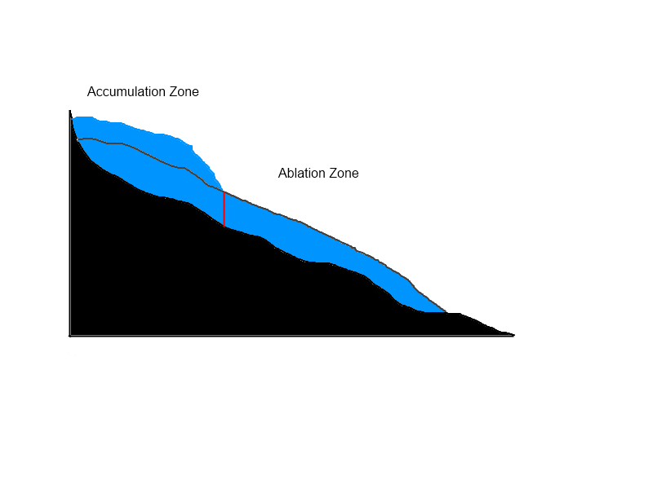
Kinematic Waves: The visual
2: Anomalous accumulation creates an area of thicker ice. Stress is greater below the thick ice.

Slide 25
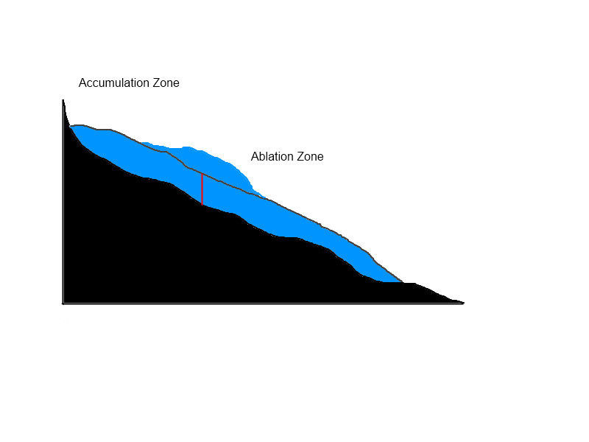
Kinematic Waves: The visual
3. The bulge moves down the glacier as a kinematic wave. It moves ~5-8 times faster than the ice flow

Slide 26

Kinematic Waves: The visual
4. The wave diffuses outward.

Slide 27
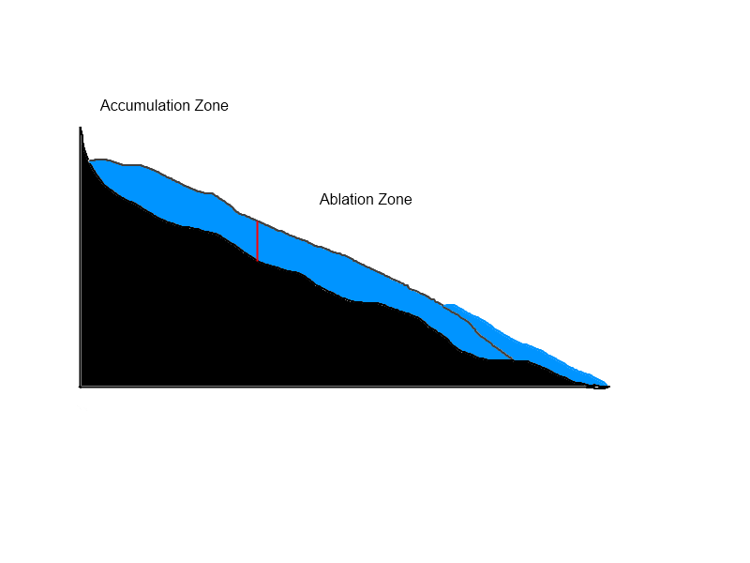
Kinematic Waves: The visual
5. The wave reaches the terminus (sometimes) and causes an advance.

Slide 28
So, do we see kinematic waves?

Slide 29
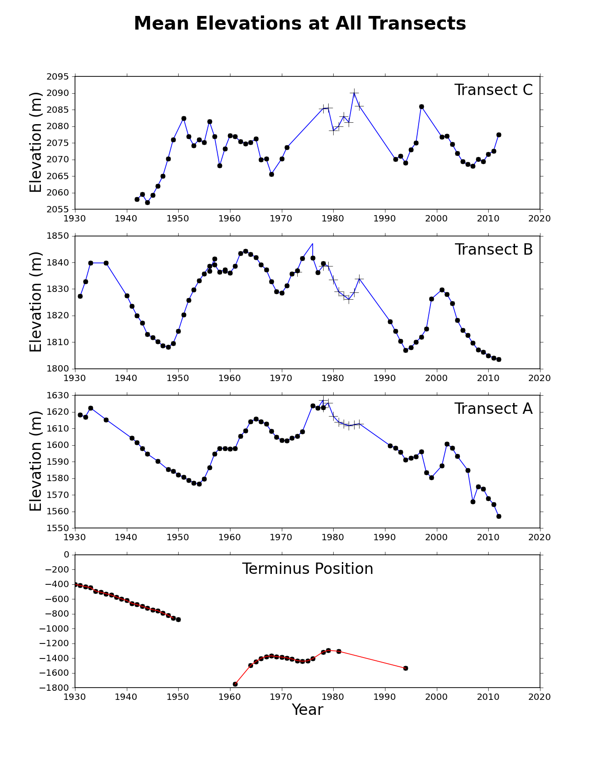
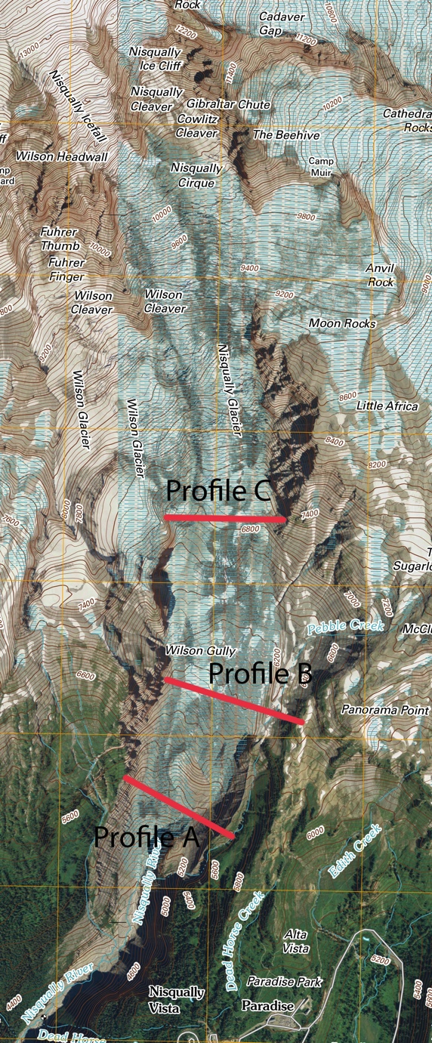

Slide 30
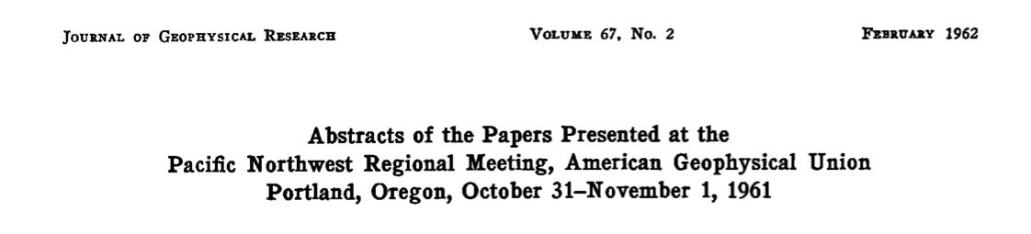
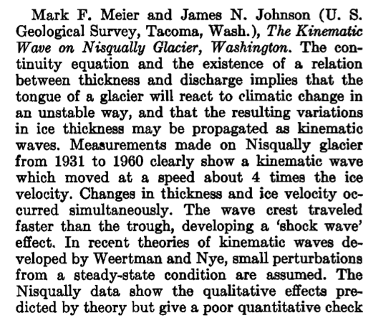
So, do we see kinematic waves?

Slide 31
So, do we see kinematic waves?

Slide 32
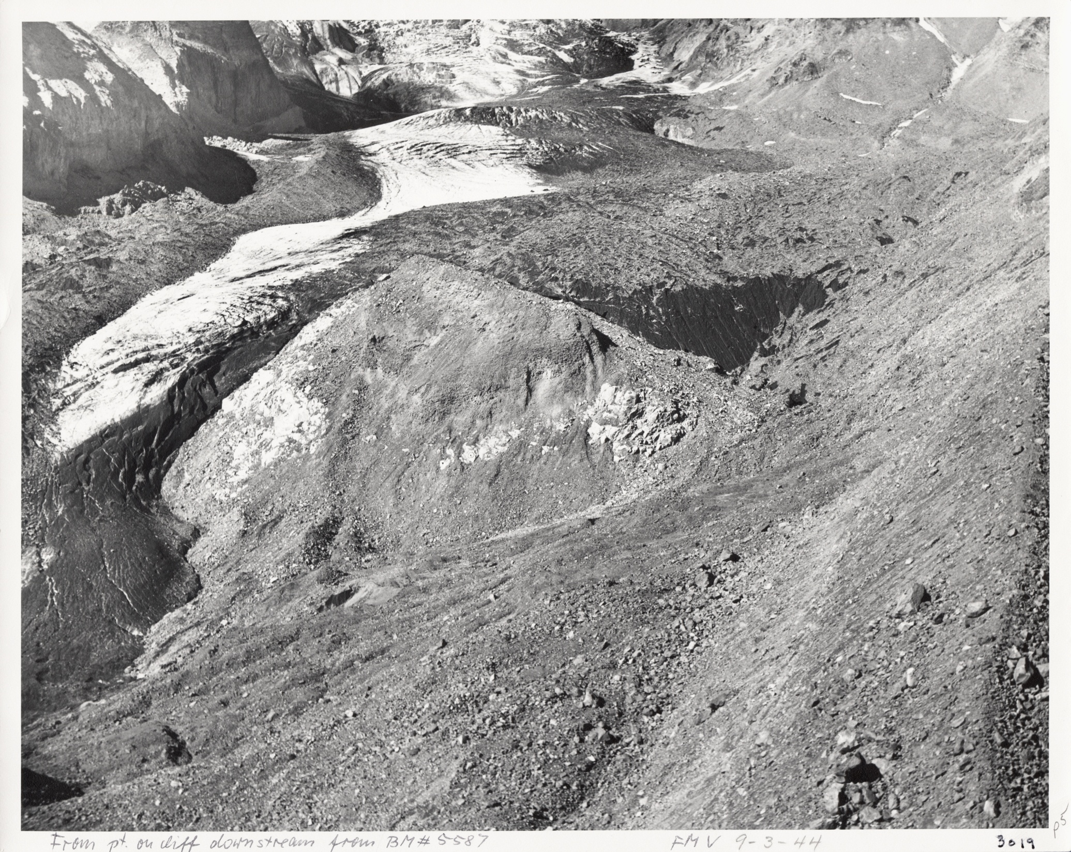
1944
From Veatch, 1969

Slide 33
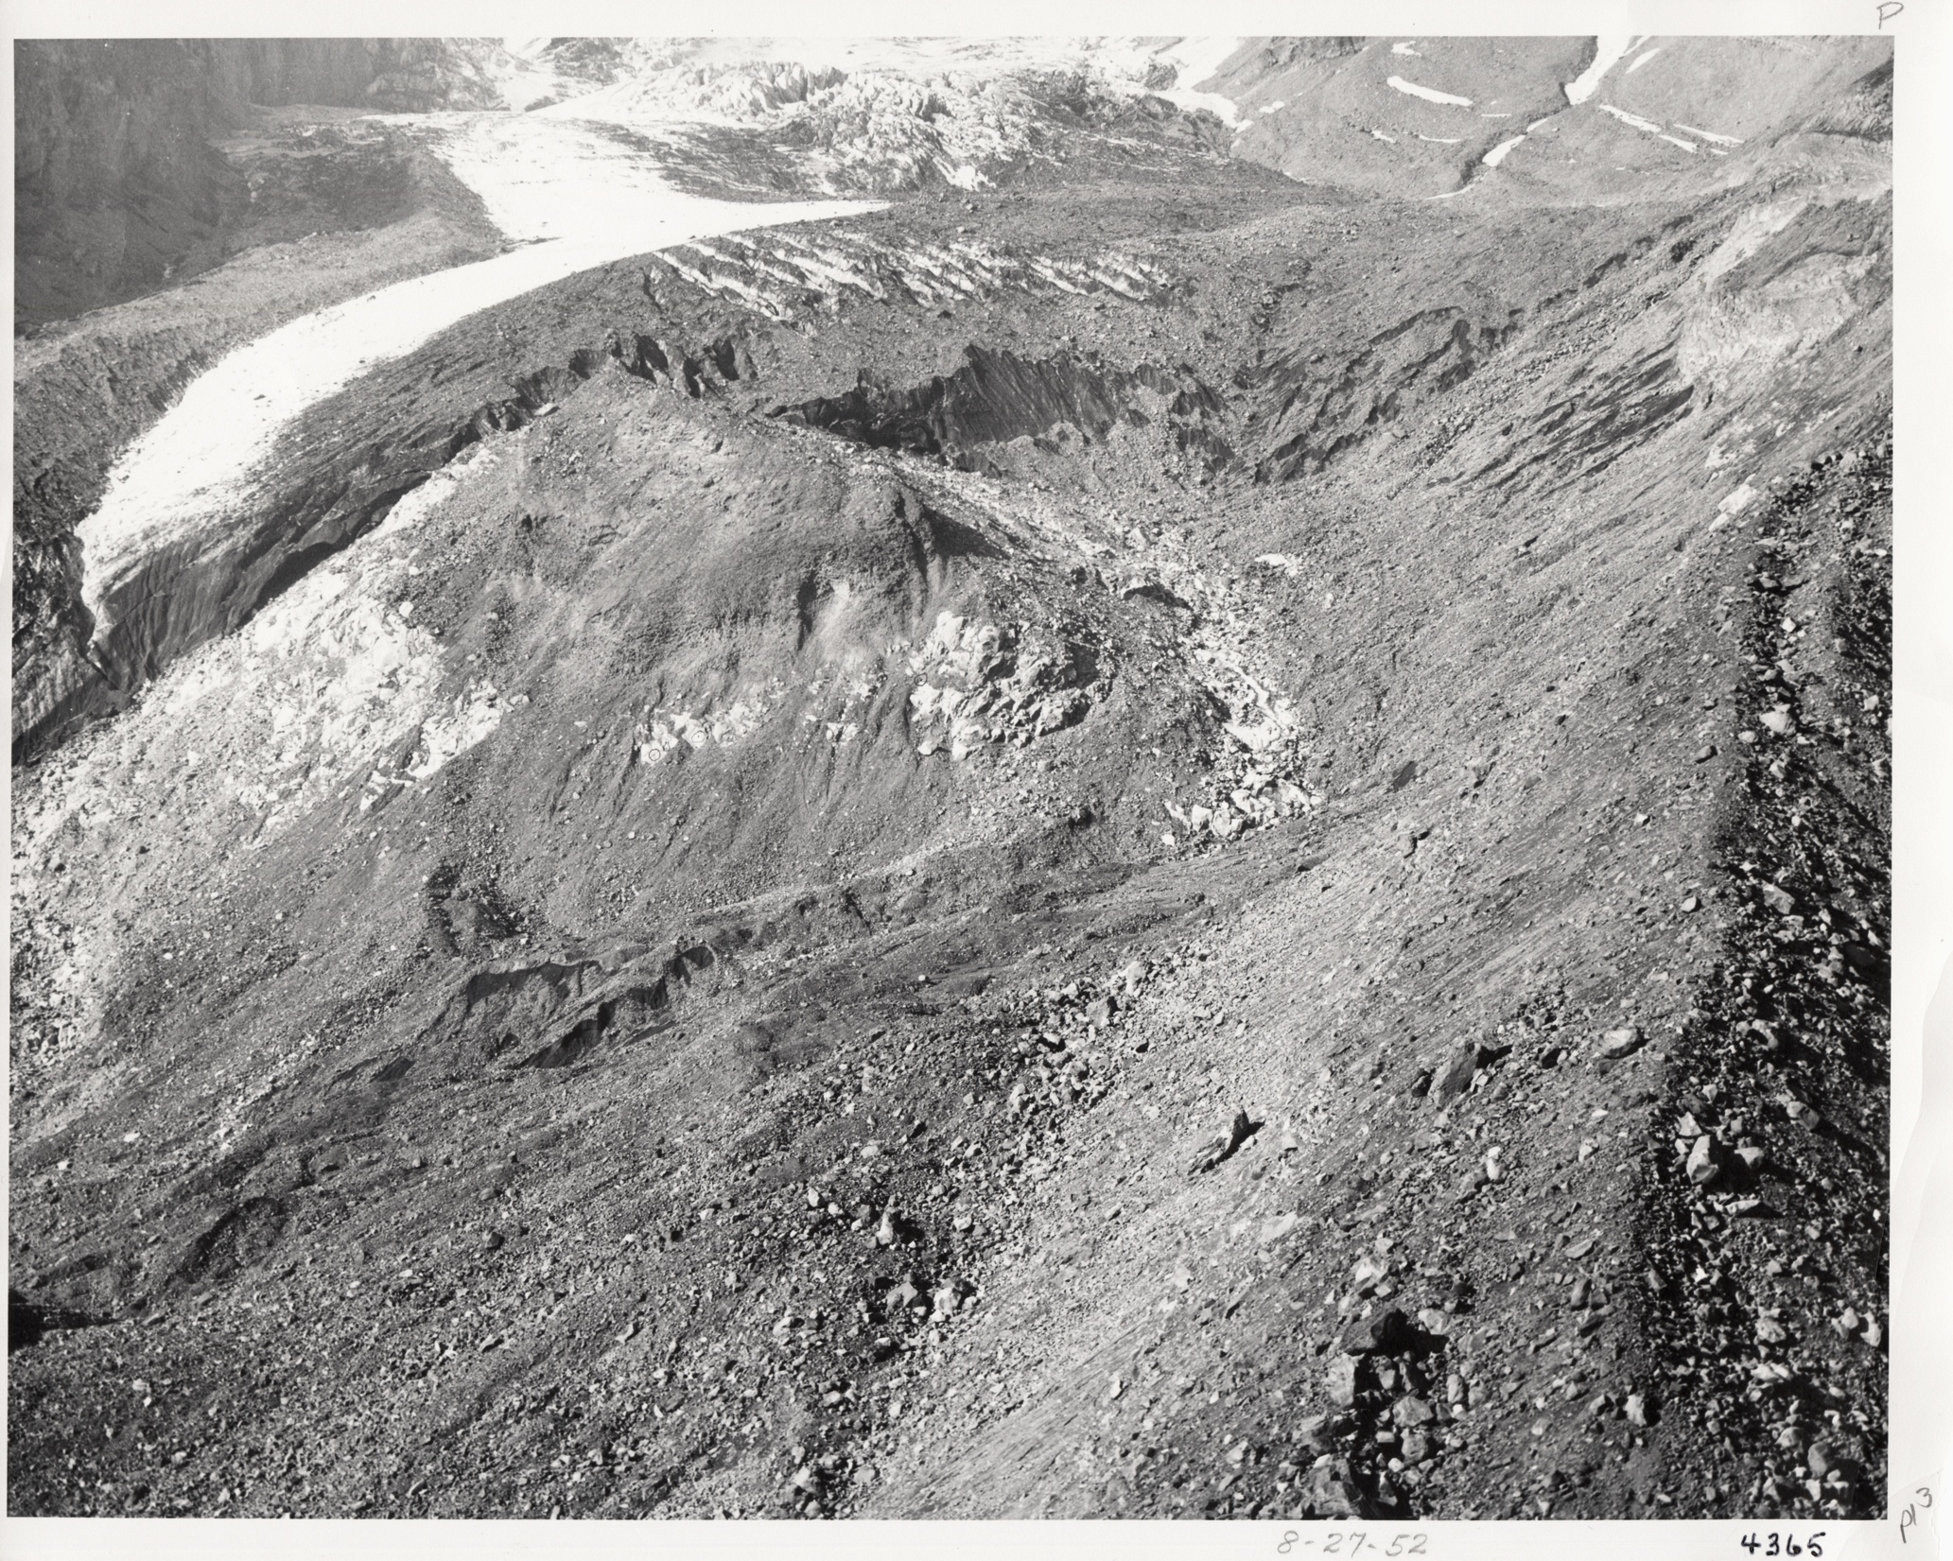
1952
From Veatch, 1969

Slide 34
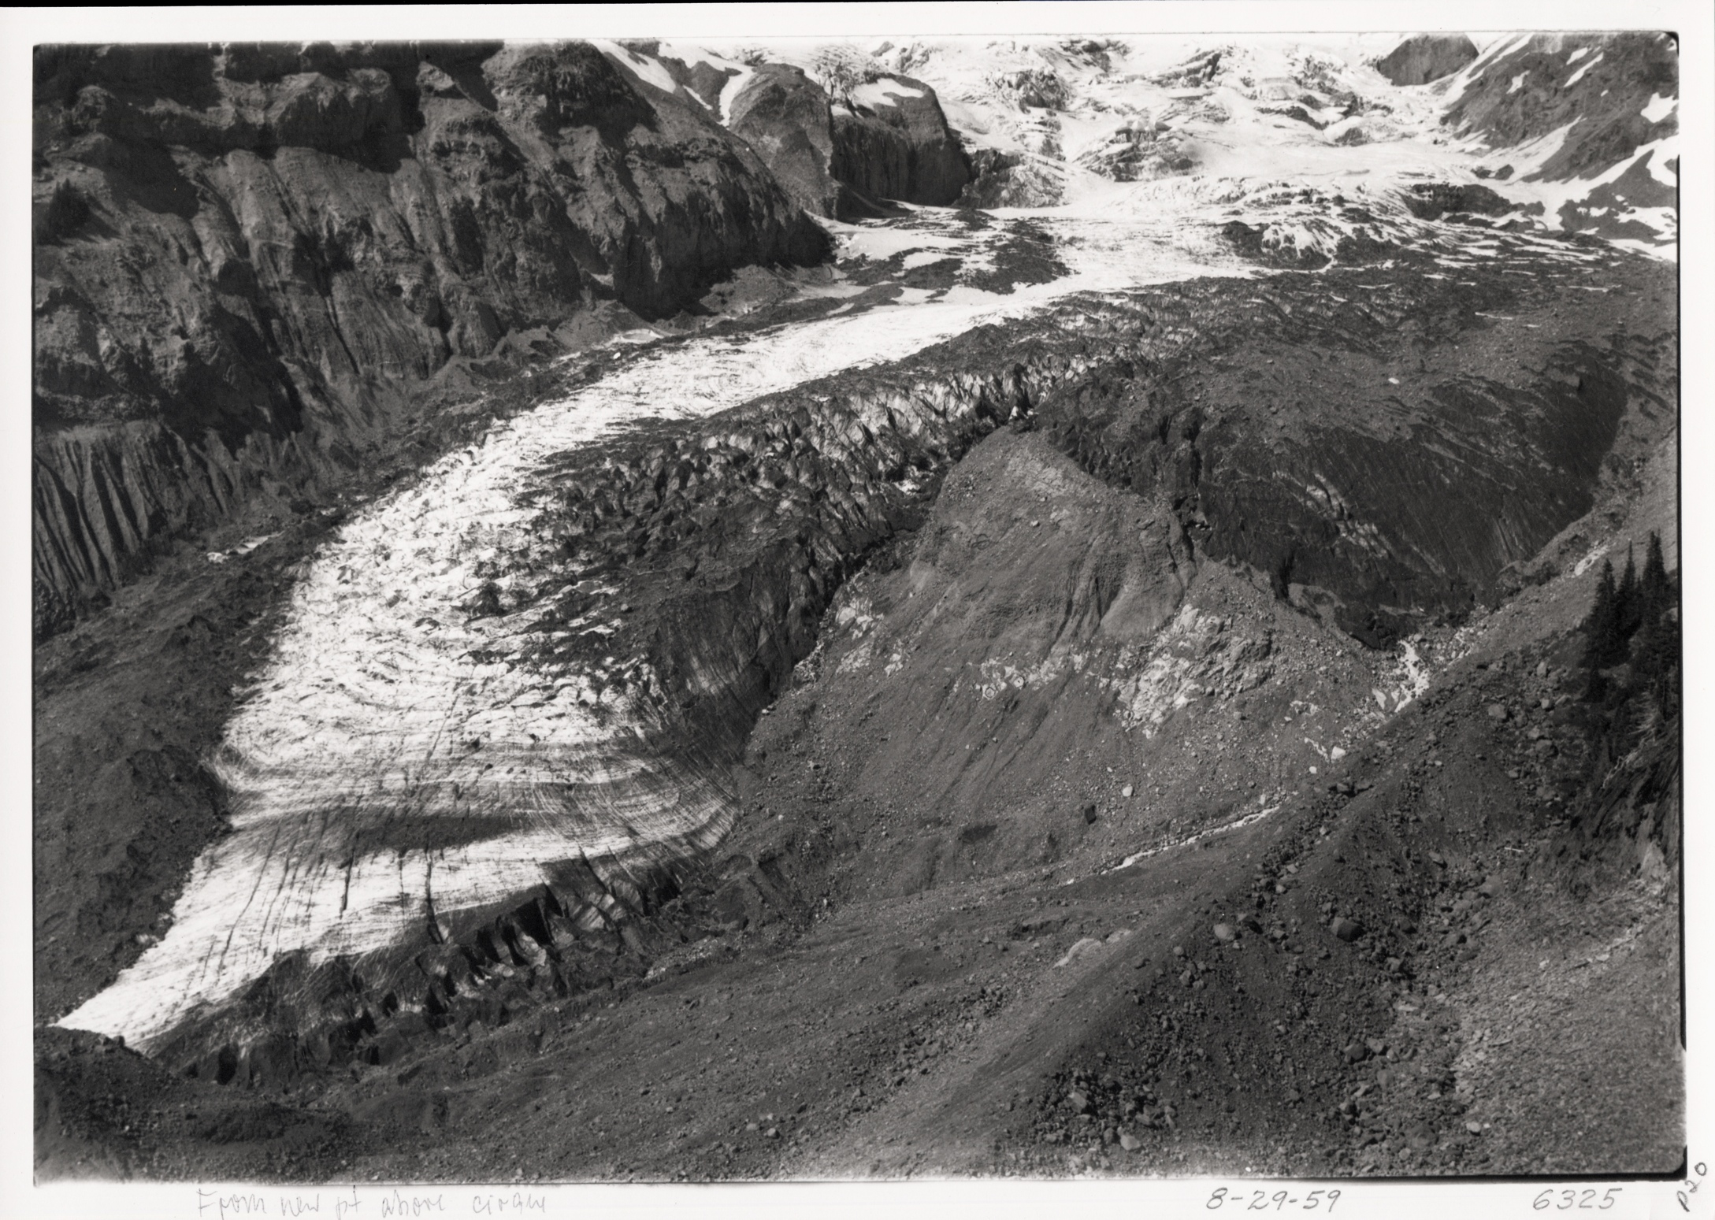
1959
From Veatch, 1969

Slide 35
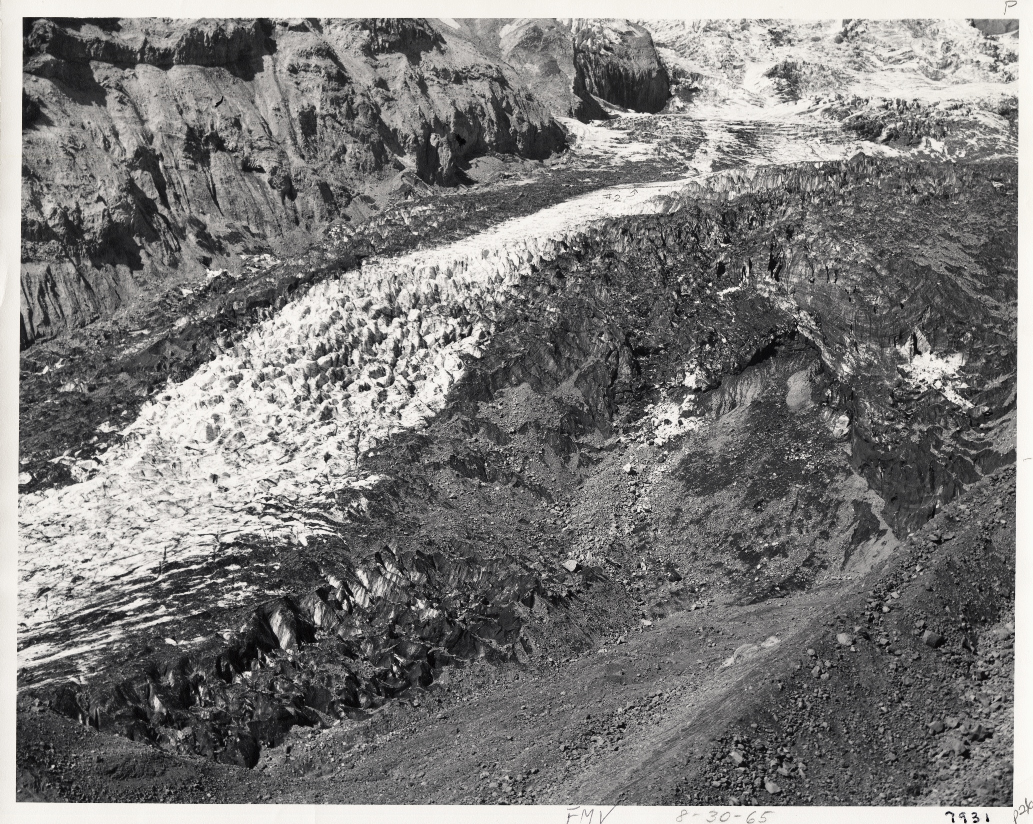
1965
From Veatch, 1969

Slide 36
So, do we see (other) kinematic waves?

Slide 41
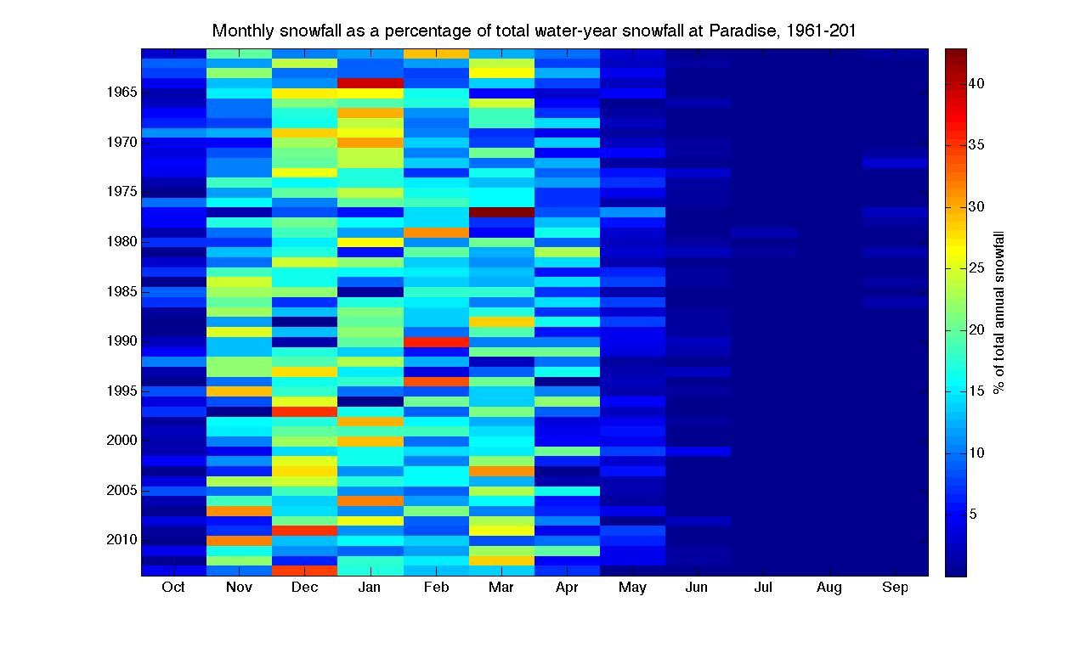

Slide 42
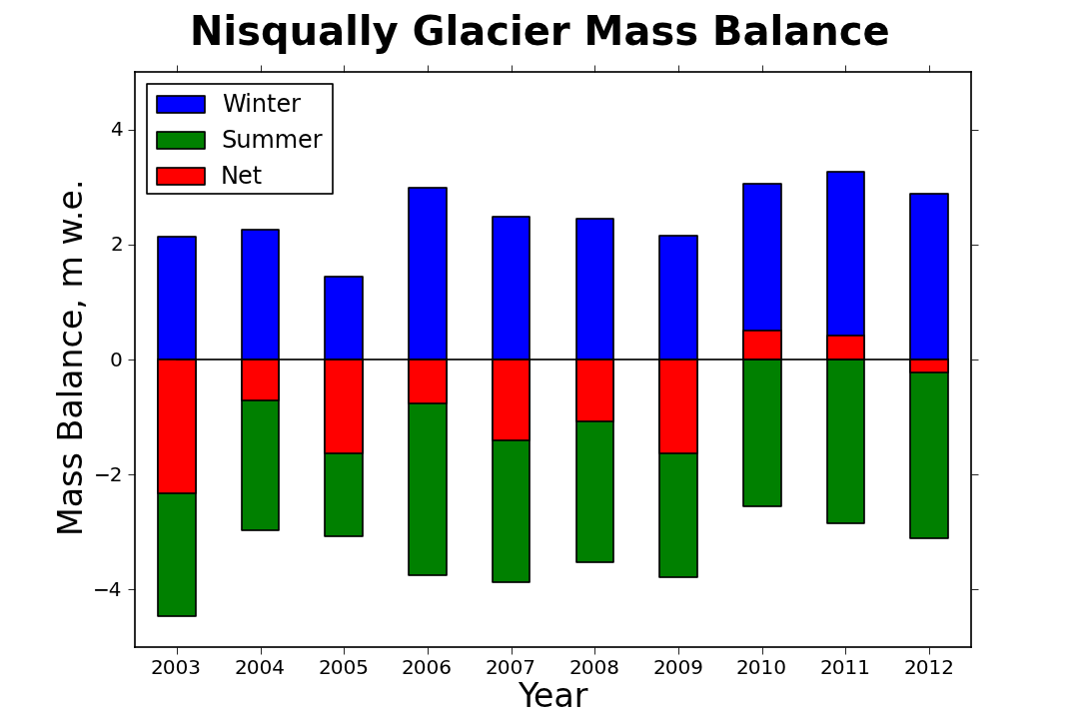
Data from Jon Riedel and Rebecca Lofgren, NPS

Slide 43
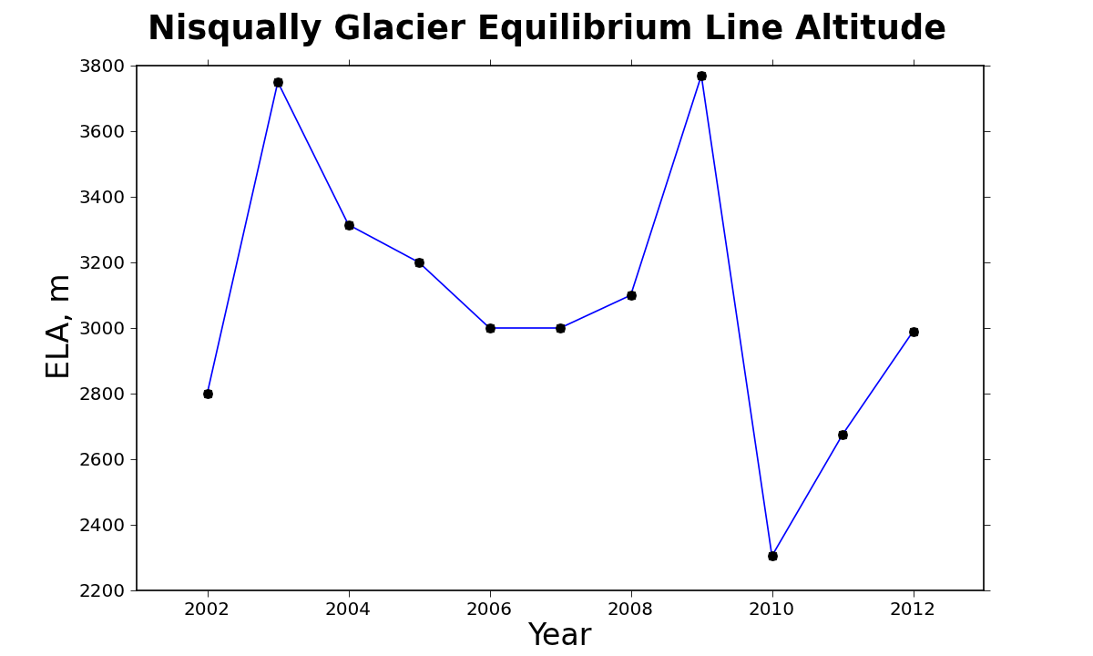
Data from Jon Riedel and Rebecca Lofgren, NPS

Slide 45
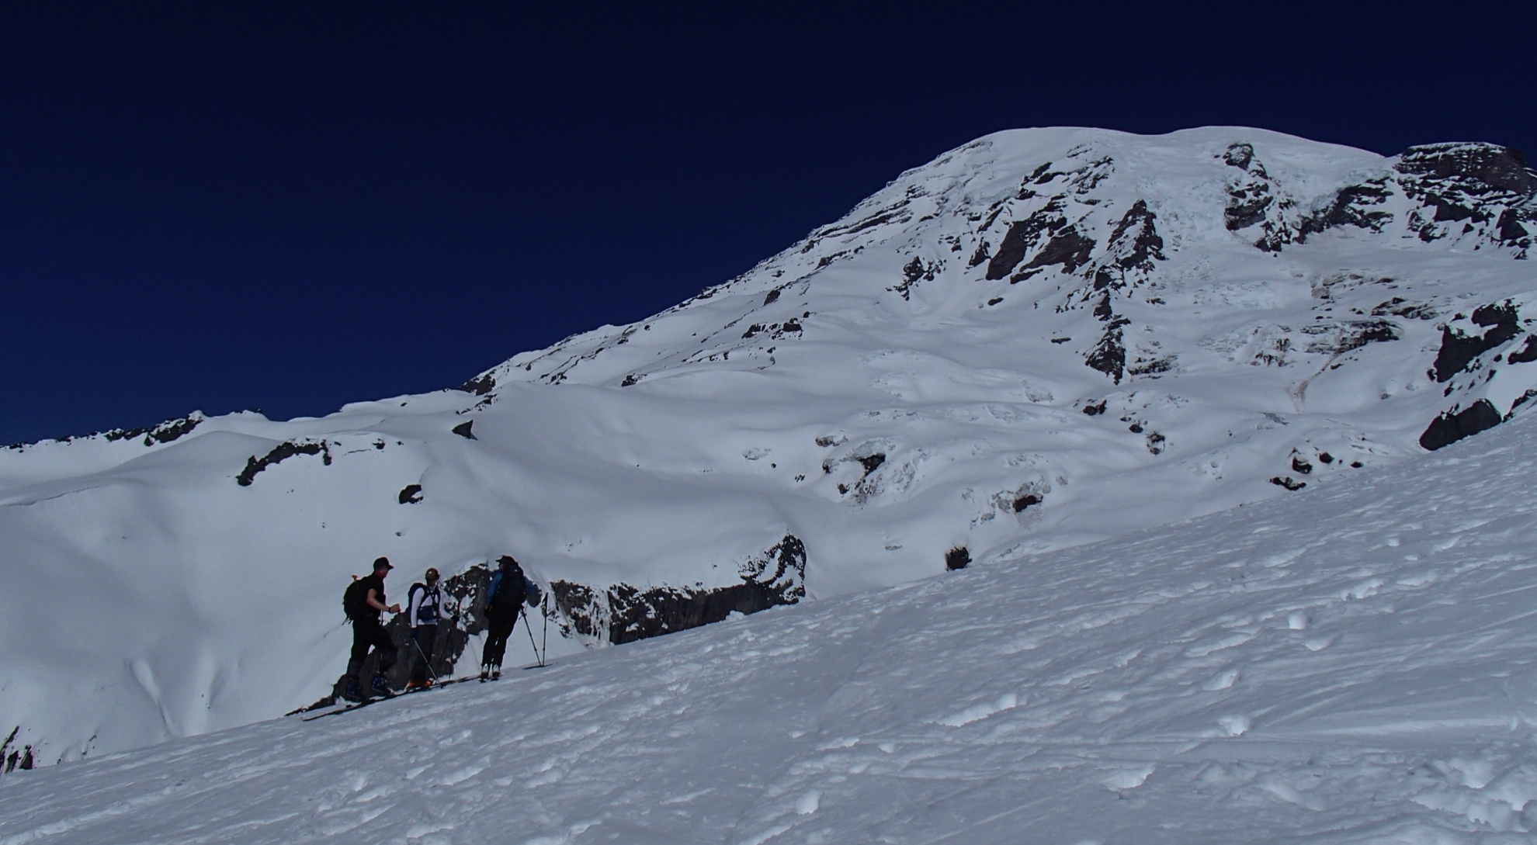
Switching Gears…

Slide 46
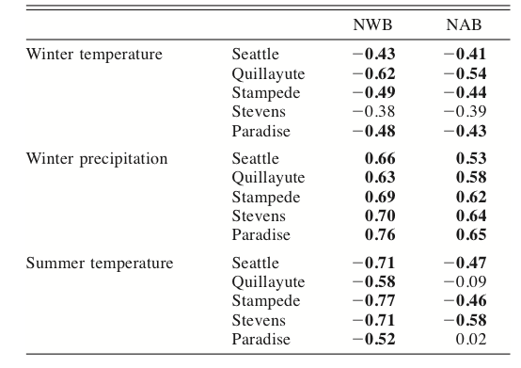
Bitz and Battisti, 1999
Examined the relationship between mass balance and weather anomalies for 6 glaciers (Washington, Canada, Alaska)

Slide 47
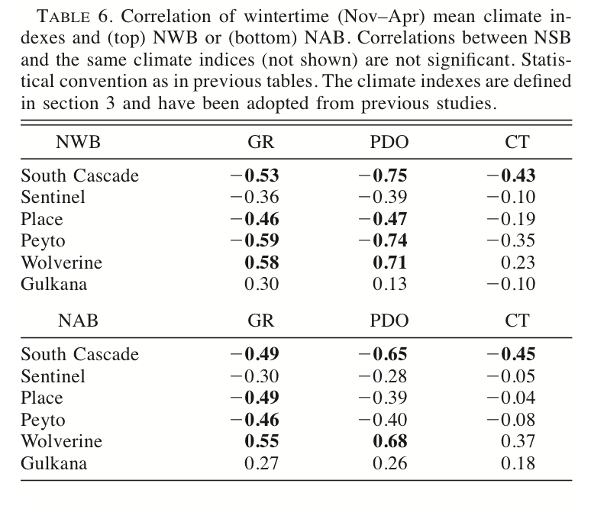
Bitz and Battisti, 1999

Slide 48
Correlation between Paradise Weather and Various Climate Indices
 | Maximum Snow Depth | Total Snow | Total Precipitation | Mean Winter Temp
ENSO Multivariate | -0.25 | -0.46 | -0.27 | 0.42
Artic Oscillation | 0.16 | 0.27 | 0.43 | -0.08
ENSO 1+2 | -0.01 | -0.17 | -0.18 | 0.28
ENSO 3 | -0.16 | -0.40 | -0.33 | 0.40
ENSO 4 | -0.28 | -0.43 | -0.27 | 0.41
ENSO 3+4 | -0.22 | -0.45 | -0.32 | 0.42
Bivariate ENSO (BEST) | -0.17 | -0.49 | -0.27 | 0.43
North Pacific | 0.25 | 0.44 | 0.17 | -0.46
Oceanic Nino | -0.23 | -0.47 | -0.32 | 0.42
PDO | -0.34 | -0.45 | -0.35 | 0.37
Pacific-North American | -0.38 | -0.45 | -0.26 | 0.54

Slide 49
Correlations Between Mass Balance and Weather Anomalies
 | Net Mass Balance | Winter Mass Balance | Summer Mass Balance | Equilibrium Line Altitude
Total Snow | 0.20 | 0.61 | N/A | 0.01 ☺
Winter Temp | -0.48 | -0.69 | N/A | 0.30
Summer Temp | -0.43 | N/A | -0.39 | 0.47

Slide 50
Correlation between Multivariate ENSO and Nisqually Glacier Mass Balance (11-year record)
 | Correlation | P-value
Net MB | -0.29915 | 0.4011
Winter MB | -0.40698 | 0.24311
Summer MB | 0.032865 | 0.92818
ELA | -0.2635 | 0.46197
Other climate indices are about the same…

Slide 51
Conclusions
Wealth of Nisqually Glacier data in existence
  Transect elevations since 1931
  What do these data tell us about Nisqually health?

Slide 52
Moving Forward on this bit…
More time looking at velocity data and terminus data
Correlations with climate
Use climate data to pull out expected surface anomalies: residuals may be kinematic wave? (Thanks, Al)
Modeling work: monkeying around with Gerard’s 1-D flow model.
  Bed poorly constrained
  Some surface velocities

Slide 53
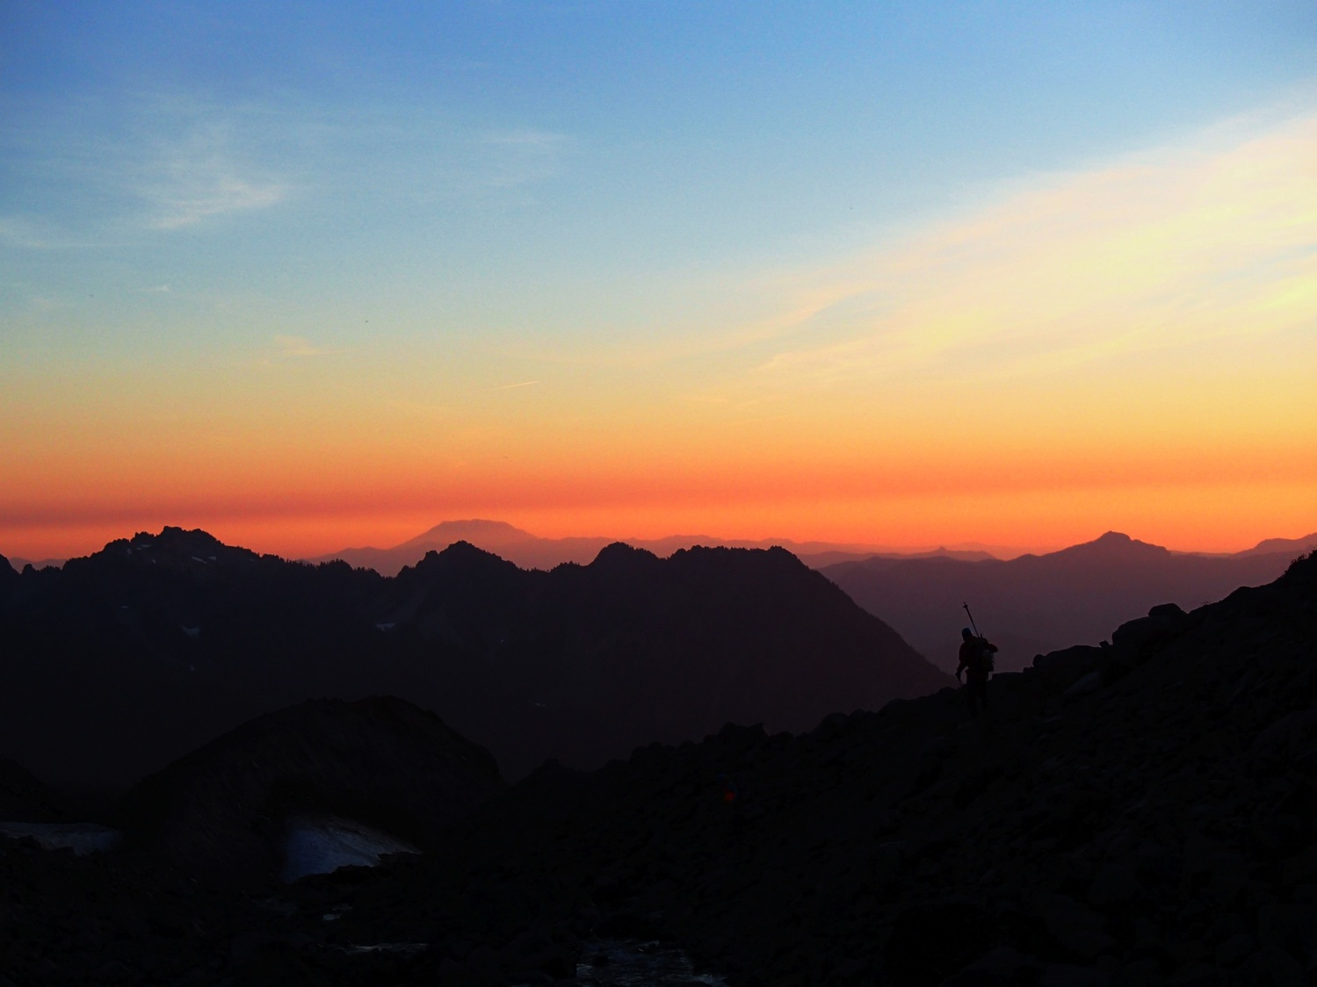
Thanks!

