Slide 1
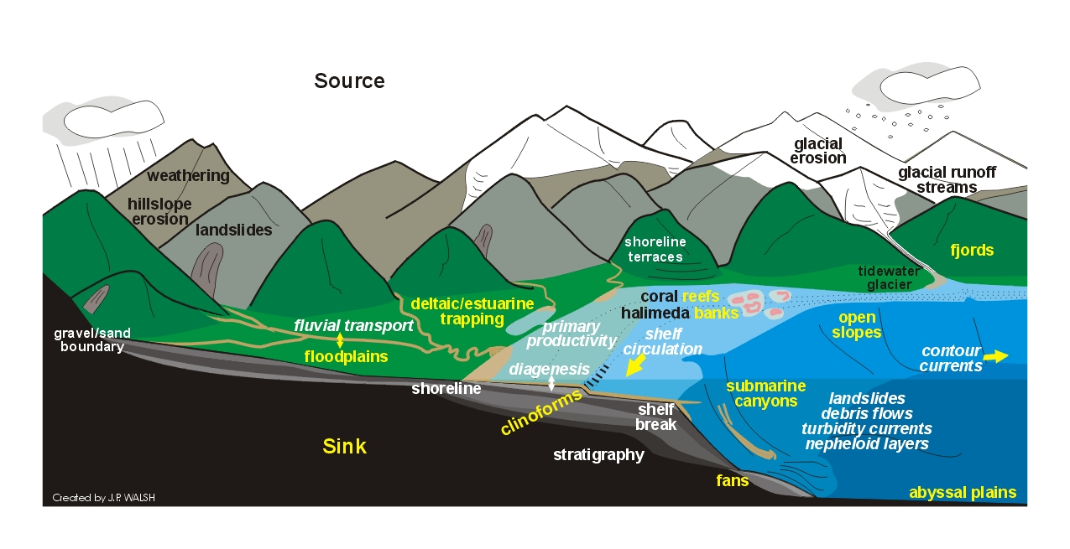
Erosion
moving away from the source…

Slide 2
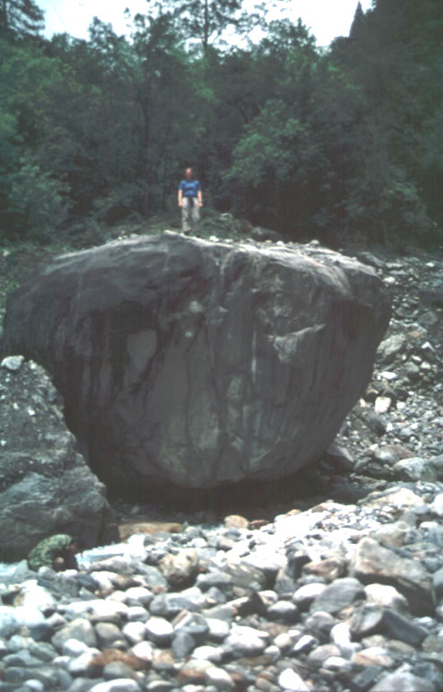
Weathering, soil & erosion…
Sediment regime: amount, size, characteristic sediment transport style in a river is governed by the amount and size of material delivered from both hillslopes and upstream
This, in turn, depends on
  erosional processes (today’s lecture)
  weathering rates & style
  rock properties
  soil properties

Slide 3
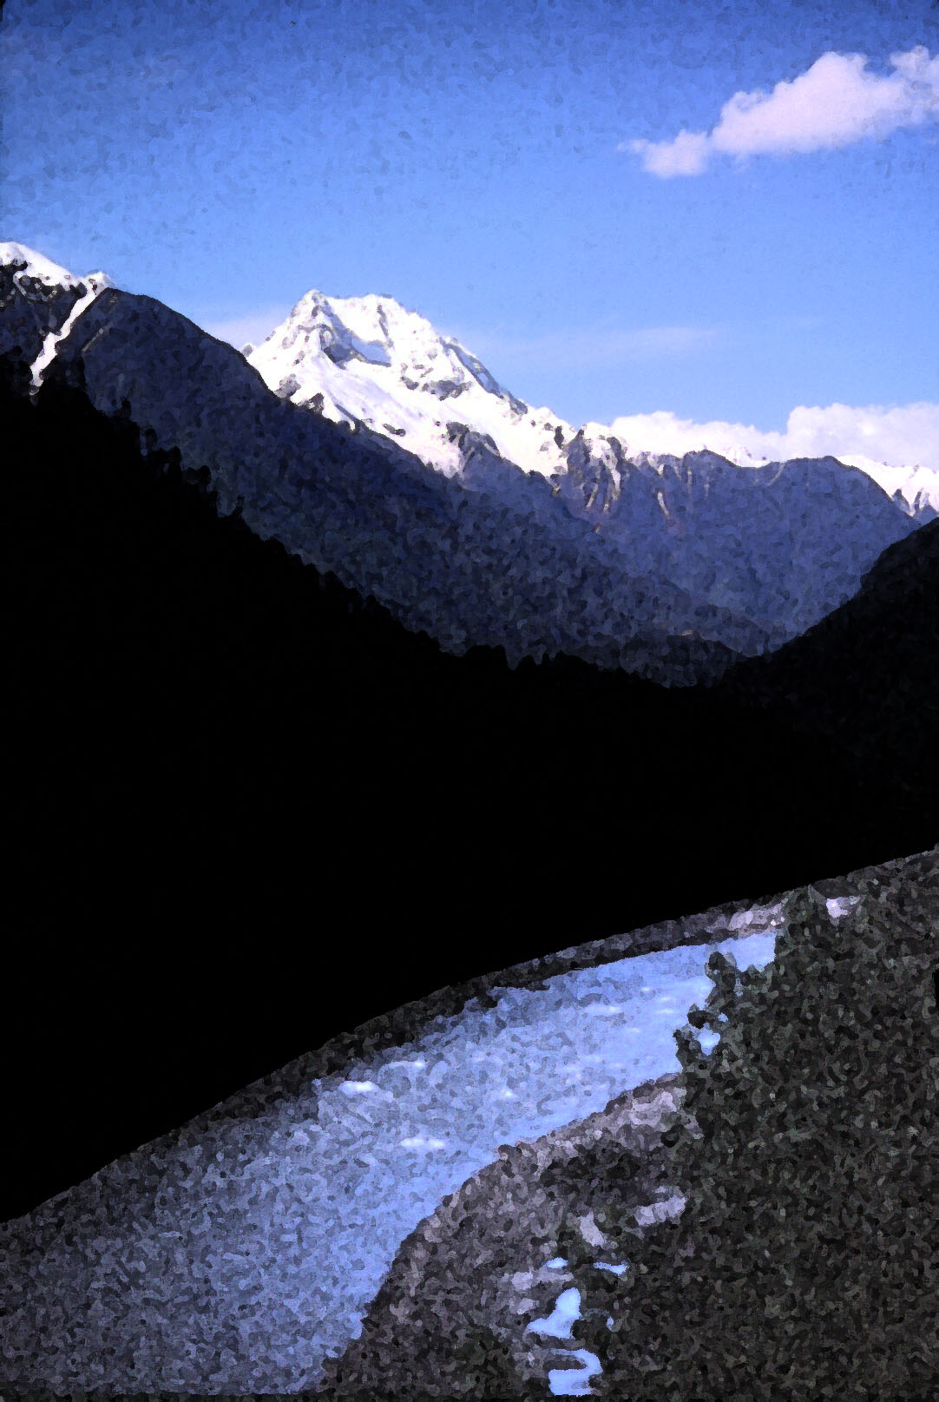
Sediment Budget
along a stream reach:
I - O = ΔS
Landsliding
Sediment inputs from upstream and across channel banks are balanced by either downstream sediment transport or changes in sediment storage.
Soil Creep
Upstream
Input
Stream Reach
Downstream
Output
Bank Erosion
Notes:
Sediment budgets in streams important because this is telling us what is getting transported downstream, the characteristic travel times and styles of sediment, before they reach the oceans, deltas etc.

Slide 4
Erosional Processes
Soil “creep”
Overland flow
Landslides
Glaciers
River incision into bedrock
Bank erosion

Slide 5
Erosional Processes
Soil “creep”
Overland flow
Landslides
Glaciers
River incision into bedrock
Bank erosion
Soil creep is the gradual, non-catastrophic downslope movement of weathered material under the influence of gravity (i.e., not by flowing water).

Slide 6
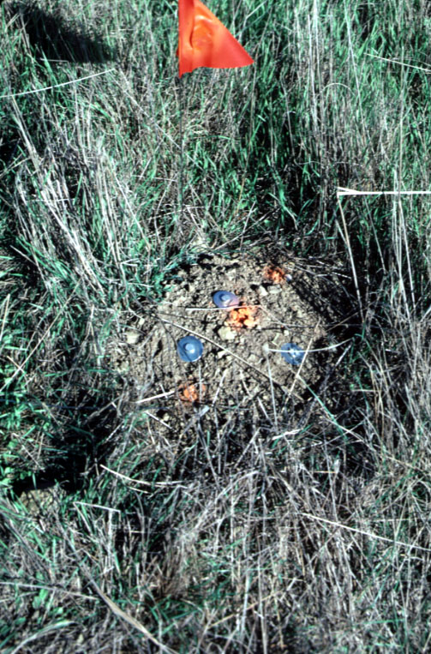
Ways to move soil:
The burrowing activity of animals results in a net downslope transport of material that in some environments can be the dominant sediment transport process.

Slide 7
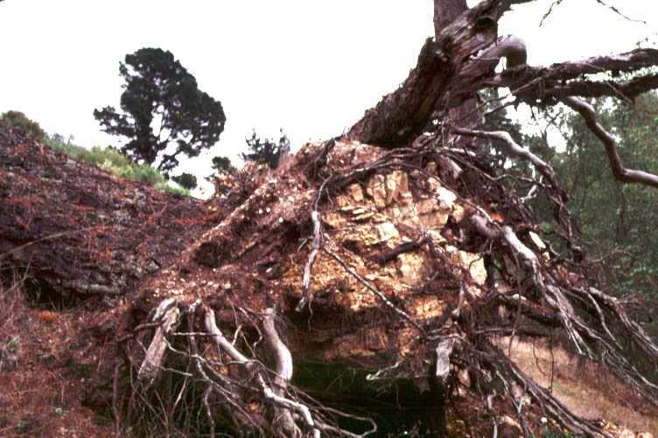
Ways to move soil:
Tree-throw can uproot rocks and also typically results in a net downslope transport of soil and broken rock.

Slide 8
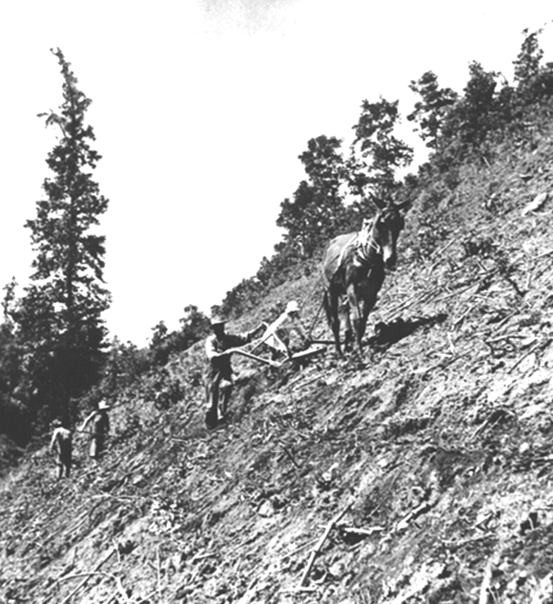
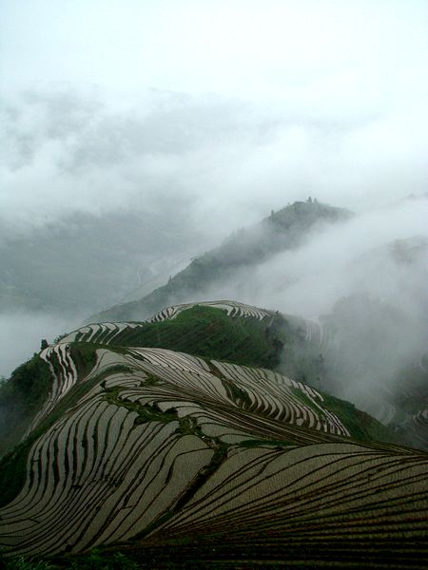
Ways to move soil:
Plowing a hillslope, ca. 1935
human modifications…
National Archives: RG083 G 36711

Slide 9
Soil Creep
Slow, steady input of material across channel banks, or delivered to valley bottom.
Typical rates of 0.1 to 1 mm yr⁻¹.
Landsliding
Soil Creep
Upstream
Input
Stream Reach
Downstream
Output
Bank Erosion

Slide 10
Erosional Processes
Soil “creep”
Overland flow
Landslides
Glaciers
River incision into bedrock
Bank erosion
Erosion by overland flow occurs once enough flow accumulates to overcome the erosion resistance of the ground surface.

Slide 11
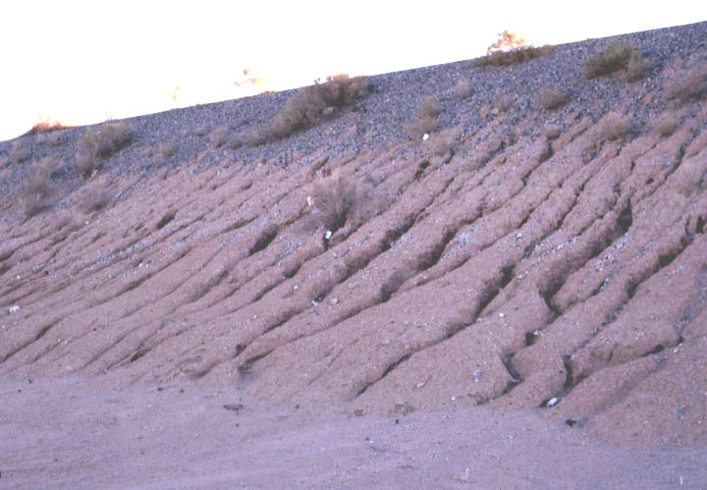
Precipitation that runs off as overland flow can cause substantial erosion once enough flow accumulates to incise the ground surface.
X_{c}
X_{c} is the critical distance needed to incise a channel.

Slide 12
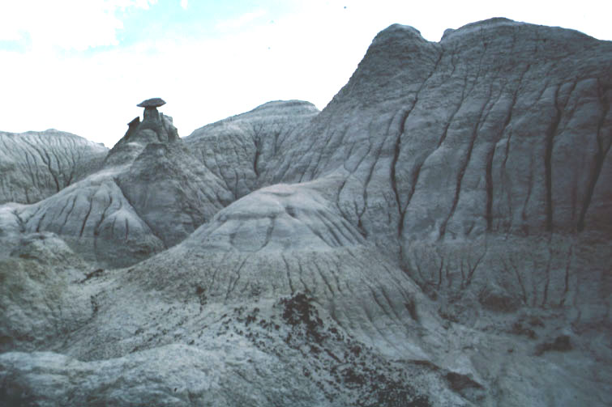
Badlands environments are an extreme example where Xc may be just centimeters

Slide 13
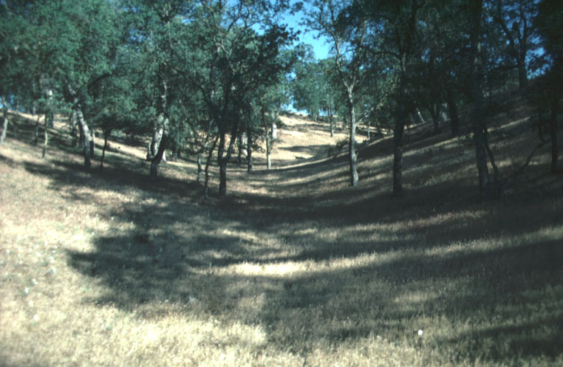
Unchanneled valleys occur where the erosion resistance of the ground surface is high relative to the amount of overland flow → Xc is very large.

Slide 14
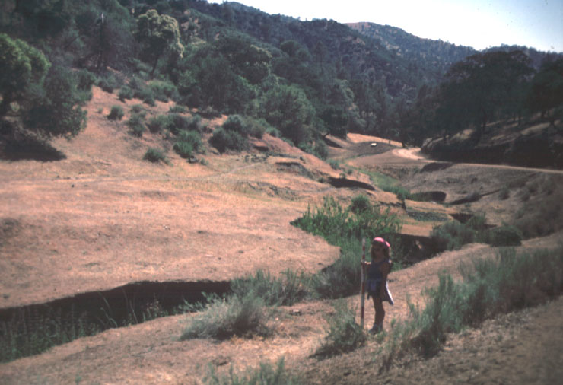
Entrenched channels and gullies can develop in landscapes where overgrazing decreases the erosion resistance of the valley floor
Xc was large, became smaller…

Slide 15
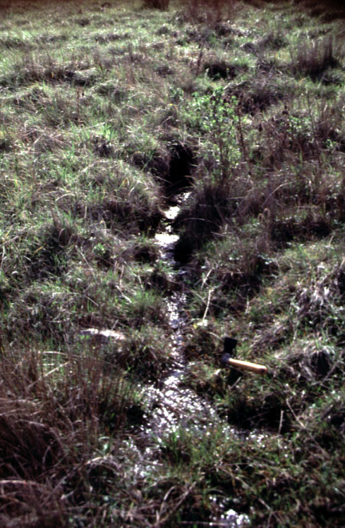
Overland Flow
Erosion by overland flow is rare in forested mountain landscapes because:
rainfall tends to infiltrate into the ground
the ground has substantial erosion resistance due to vegetation
Erosion by overland flow is most common in disturbed or semi-arid landscapes

Slide 16
Erosional Processes
Soil “creep”
Overland flow
Landslides
Glaciers
River incision into bedrock
Bank erosion
Landslides involve the downslope movement of soil and/or rock under the influence of gravity and may be either slow and gradual or rapid and catastrophic.

Slide 17
Landsliding
Rapid, infrequent inputs of large volumes of sediment.
Rates of delivery set by landslide frequency, which is often centuries to millennia at a point.
Landsliding
Soil Creep
Upstream
Input
Stream Reach
Downstream
Output
Bank Erosion

Slide 18
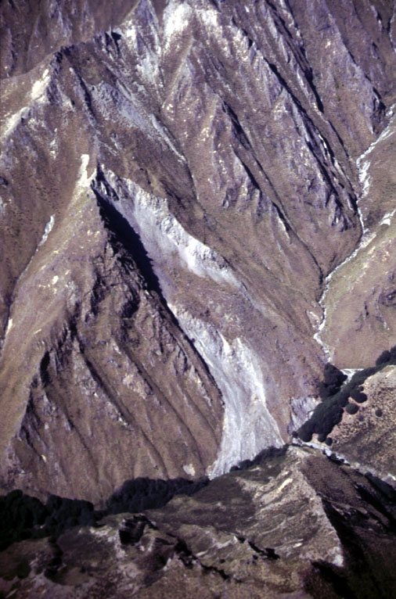
Bedrock landslides
EARTH FLOWS: some internal deformation
typically slow
relatively little water
Earth flow in NZ

Slide 19
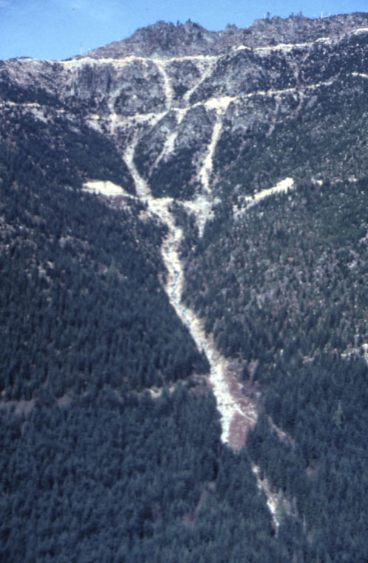
Soil landslides
DEBRIS FLOWS:
lots of internal deformation
rapid
relatively high water content
  fluid-like flow
Failure typically occurs along well-defined shear plane at soil-bedrock interface.
Debris flows along Tolt R

Slide 20
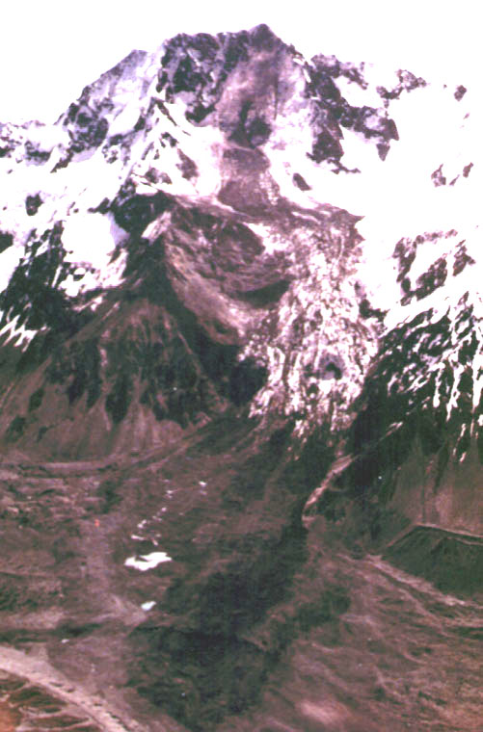
Landslides
Scarp
Bedrock landslides can limit the relief of mountain ranges
Mt. Cook, New Zealand:
  top 10 meters of summit fell away in a massive landslide/avalanche on December 14, 1991.
Runout
zone
Deposit

Slide 21
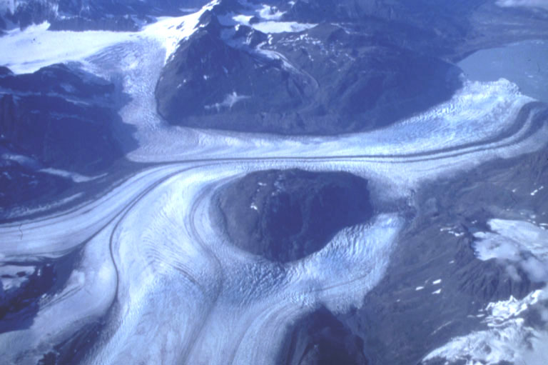
Erosional Processes
Glaciers can both entrain loose surface materials and gouge deeply into bedrock.
Soil “creep”
Overland flow
Landslides
Glaciers
River incision into bedrock
Bank erosion

Slide 22
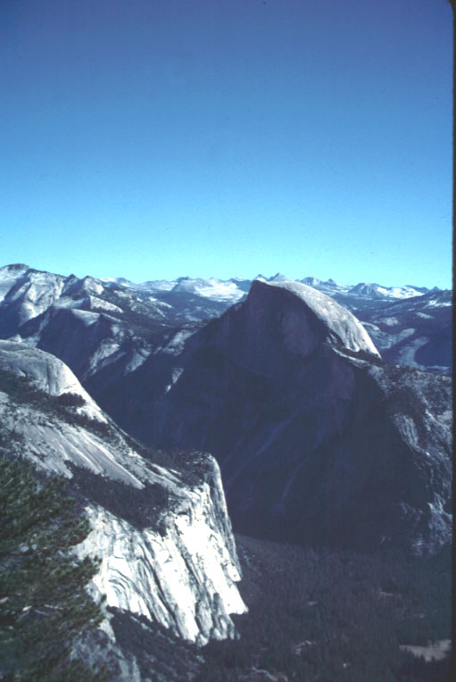
Glacial Erosion
Rapid erosion of material from above perennial snow line.
Rates can exceed
10 mm yr⁻¹.
Processes of erosion and rates depend on temperature, glacier size, precipitation rate, etc...

Slide 23
Erosional Processes
Rivers can carve deeply into bedrock and such incision provides another source of sediment.
Soil “creep”
Overland flow
Landslides
Glaciers
River incision into bedrock
Bank erosion
In the world there is nothing more submissive and weak than water. Yet for attacking that which is hard and strong nothing can surpass it.
- Lao-Tzu, 6th century B.C.

Slide 24
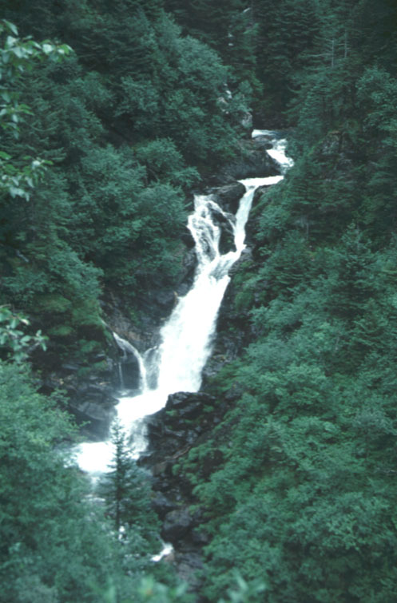
River Incision
Erosion = f (discharge, channel width, slope)
More water in a narrower channel down a steeper slope means faster river incision
Rates of bedrock river incision typically range from <0.01 mm yr⁻¹ to 1 mm yr⁻¹, but can exceed 5 mm yr⁻¹ in extreme topography.

Slide 25
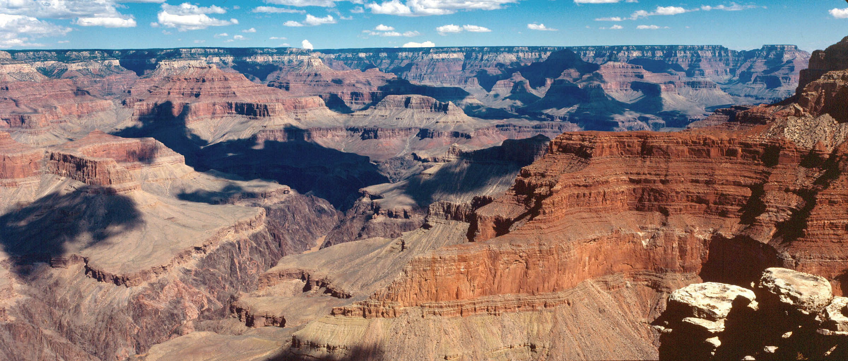
River Incision

Slide 26
Erosional Processes
Soil “creep”
Overland flow
Landslides
Glaciers
River incision into bedrock
Bank erosion
Bank erosion recycles material stored on the valley bottom, typically in the floodplain.

Slide 27
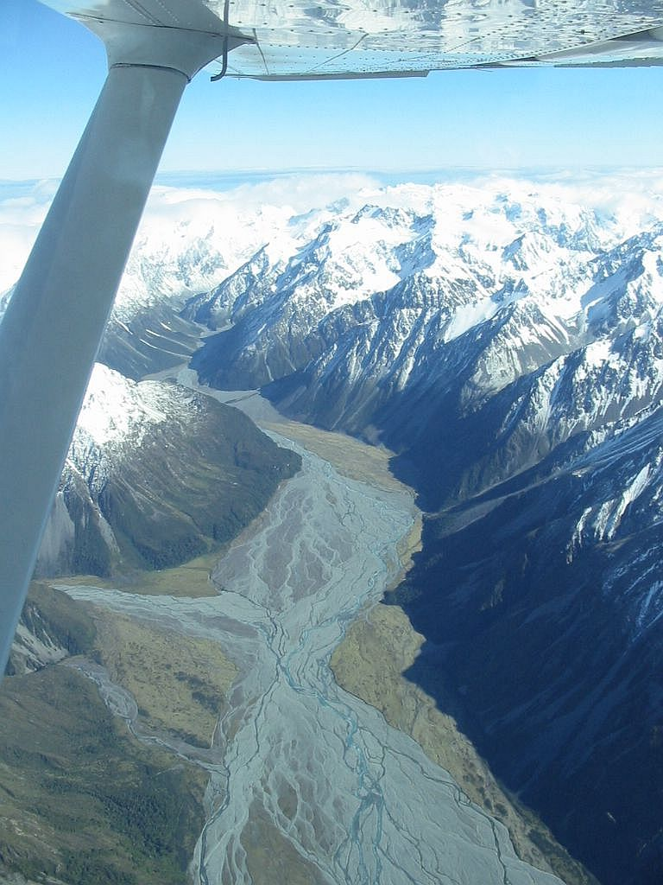
Bank erosion
reworking valley-bottom sediments
entraining sediments delivered by other erosional processes
Rangitata R., NZ

Slide 28
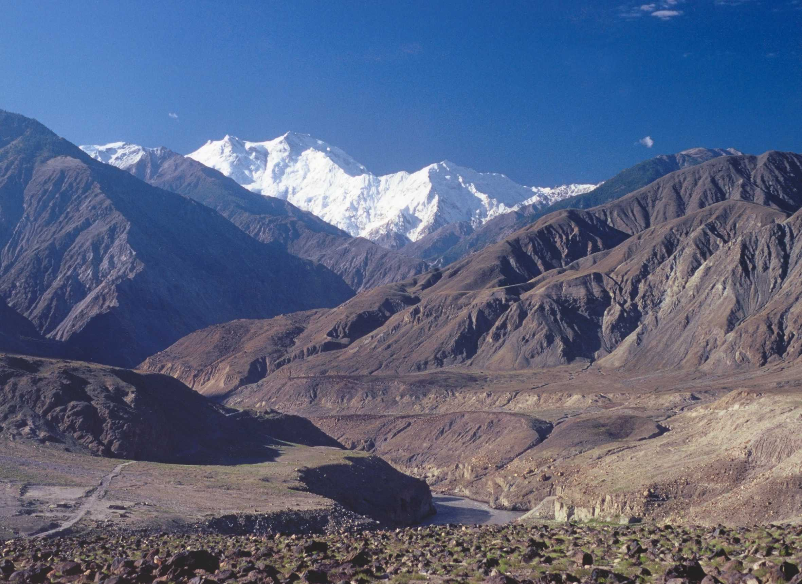
Factors controlling erosion
climate
topography/slope
vegetation
lithology/erodibility
land-use

Slide 29
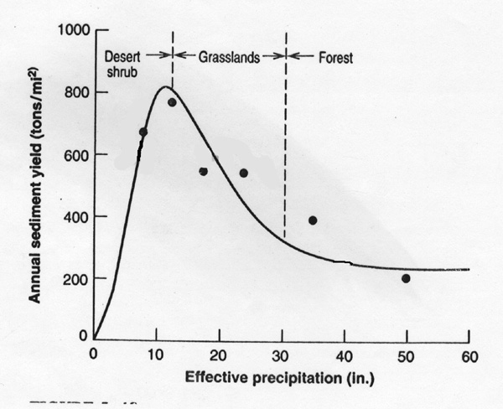
Climate
precip & veg.
sediment yield: total amount of sediment generated by a particular landscape

Slide 30
Slope
Olympic Mountains

Slide 31
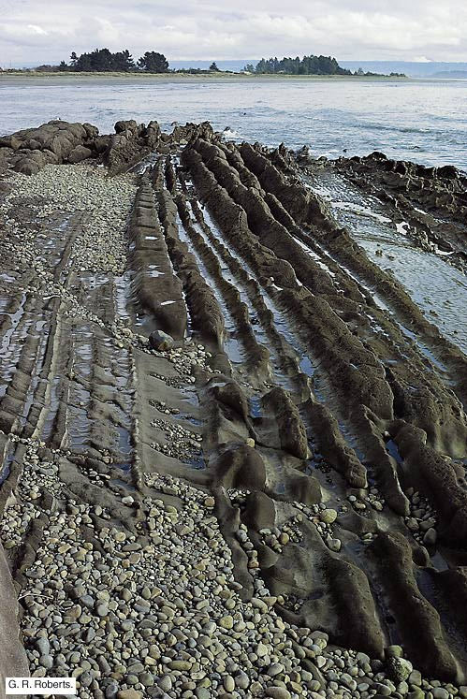
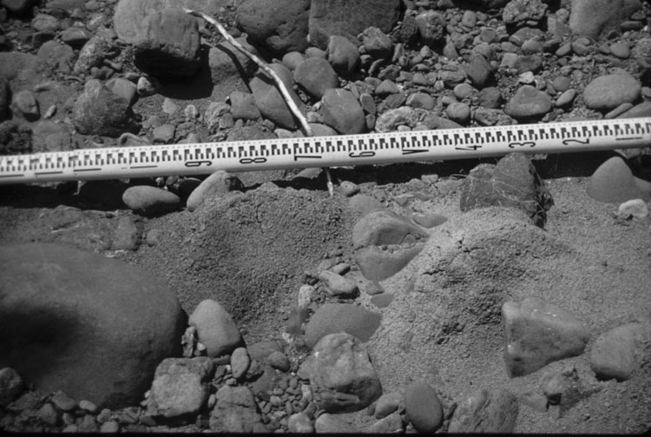
Erodibility
bedrock erodibility ranges over at least 5 orders of magnitude

Slide 32
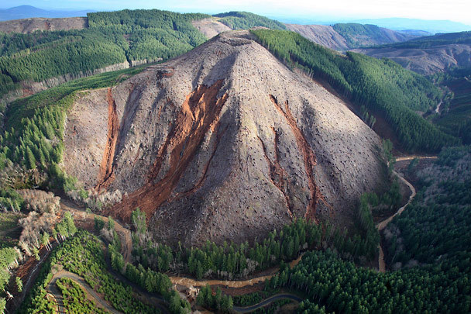
Land-use

Slide 33
Mountains: the big picture
weathering, soil formation & erosion interact
ultimately provide sediment for rivers & beaches…

Slide 34
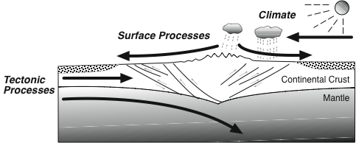
A final thought:
Rivers and beaches are important sediment transfer (material transfer) systems within larger Earth system
remember this context!

