Slide 1
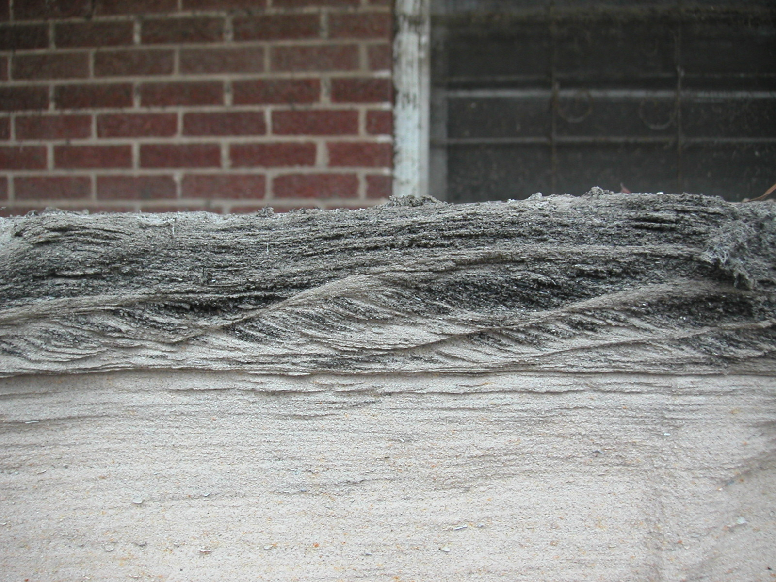
Writing Earth history with continental-margin sedimentary processes
STUPID HUMAN TRICKS Po and Mississippi Rivers
Notes:
Interaction of people with ocean/river

Slide 2
Po River
Drainage basin includes: south flank of Alps, north flank of Apennines
Area = 75,000 km²
(Columbia River = 670,000 km²)
Sediment discharge = ~15 million t/y
(Columbia River = 10 million t/y)
Po sediment yield (production from square meter of land surface) is much greater than Columbia River basin
Notes:
NW italy, venice lagoon to east

Slide 3
Venice
2/27/99
Notes:
Here you can see the delta

Slide 4
Po River
Drains northern Italy
Enters the northern Adriatic Sea, forming delta in late Holocene
Evidence of lobe switching dated in sediments back to Bronze Age
Sedimentation causes northward migration of delta
Sediment began to enter Venice lagoon to north
Filling of lagoon would have eliminated the “natural moat” protecting the Republic of Venice
Therefore, path of Po River altered to a southward location (1599-1604)

Slide 5
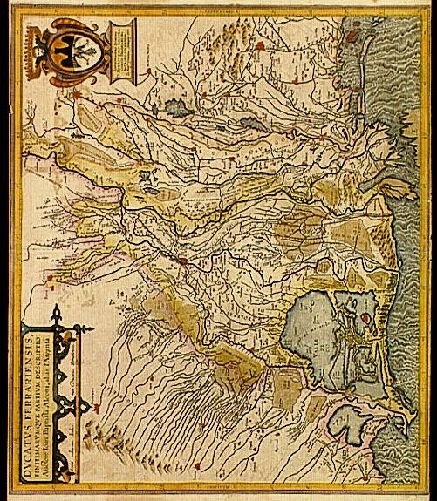
Ancient Po mouth had many distributaries through time, covering a large area

Slide 6
Delta formation

Slide 7
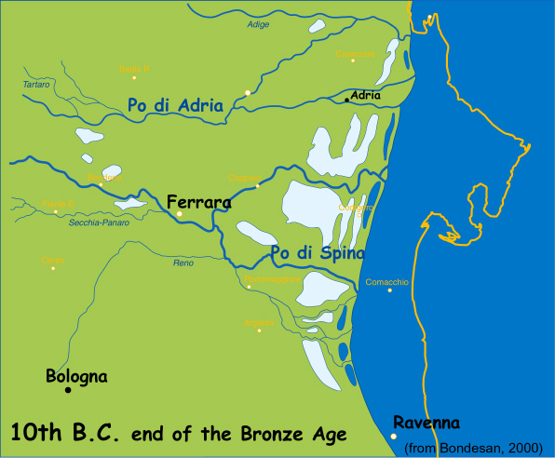
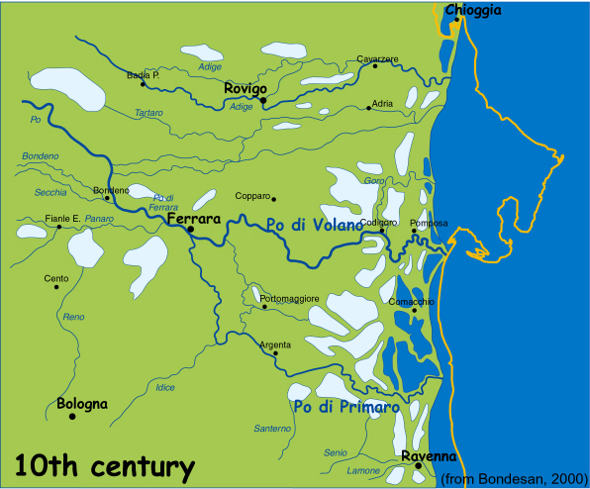
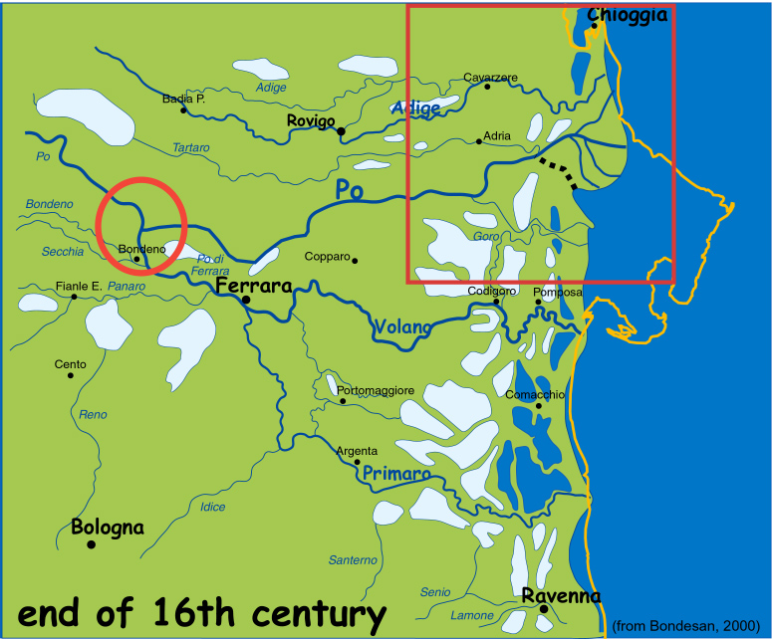
Before human control
Natural rate of coastal progradation 4 m/y from 1000 BC to 1200AD
Seven points of discharge described by Plinio il Vecchio
Notes:
Avulsion in 3rd panel

Slide 8
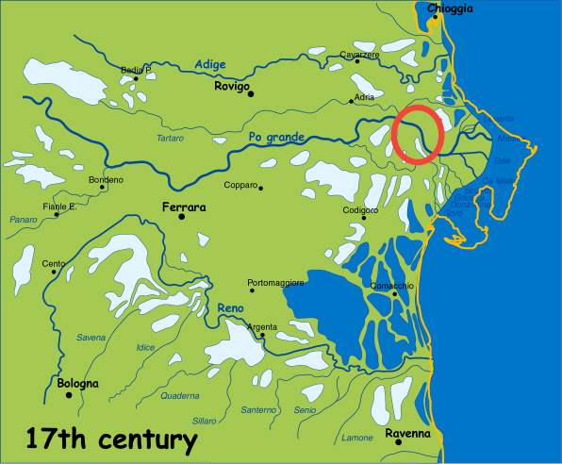
The artificial form of the modern delta
abandonment of Po di Primaro
1152 AD a major natural avulsion
northward shifting of distributary channels
Venice Republic is threatened by the potential infilling of the lagoon
1604 AD digging of a diversionary canal
(Taglio di porto Viro)

Slide 9
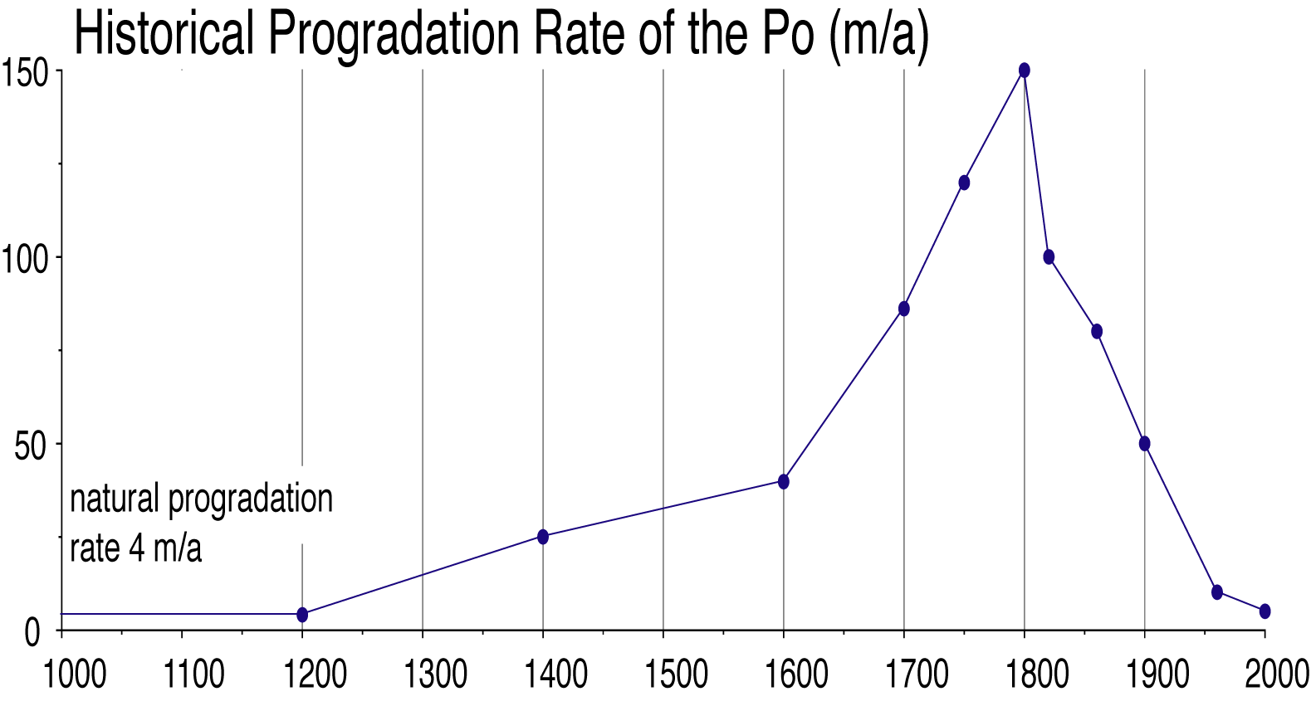
Deforestation
& Mining
Dams &
Diversions
Pastures
to Cropland
Calendar Years

Slide 10
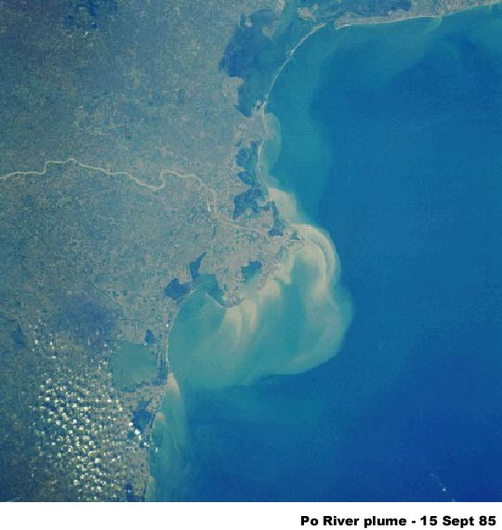
Modern Po Delta
Five distributaries, but only one operates during non-flood conditions
Predominant southward transport and accumulation of sediment, which causes northward migration of delta
Notes:
Cusps are individual distributary channels

Slide 11
Po River today
Sediment supply reduced by dams and mining for construction aggregate
Sediment reaching river is constrained by artificial levees (i.e., does not reach floodplains), and carried to Adriatic Sea
Cuspate delta builds into Adriatic Sea
~50% of sediment discharge
Located far enough south of Venice, sediment carried away
~50% of sediment discharge

Slide 12
Result of human changes to Po River mouth
River manipulation caused fast progradation and delta lobe switching
Rapid accumulation of a large amount of sediment caused by confining the Po discharge to a small area
The present delta is artificially held in position within context of the northern Adriatic oceanographic processes
Natural and artificial subsidence are enhanced by levee construction, which prevents overbank sedimentation
River-bed excavation and river damming in the drainage basin during the last 50 years led to a marked decrease in sediment supply

Slide 13
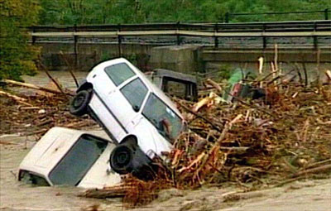
Despite the best intentions of humans...
October 2000 flood
Notes:
100-year storm

Slide 14
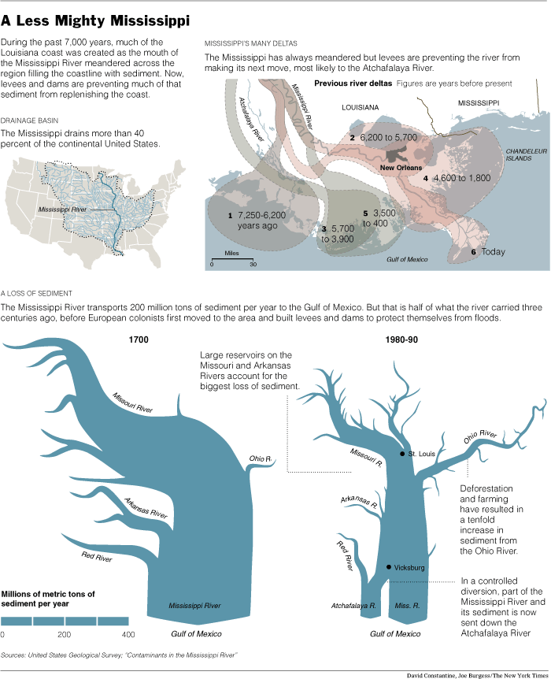
Notes:
Dammin of missouri
400-→200
Agriculture increased ohio’s role
30% allowed to atchafalaya (would take all)

Slide 15
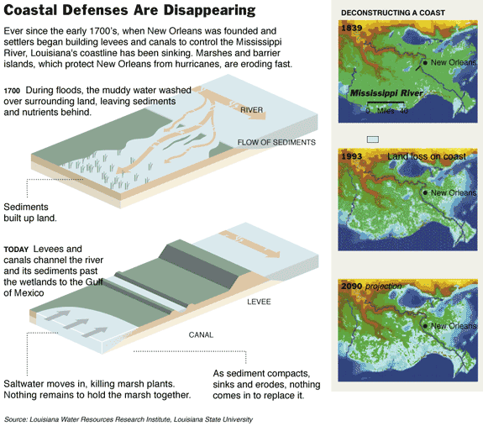
Notes:
Subsidence in absence of nourishment

Slide 16
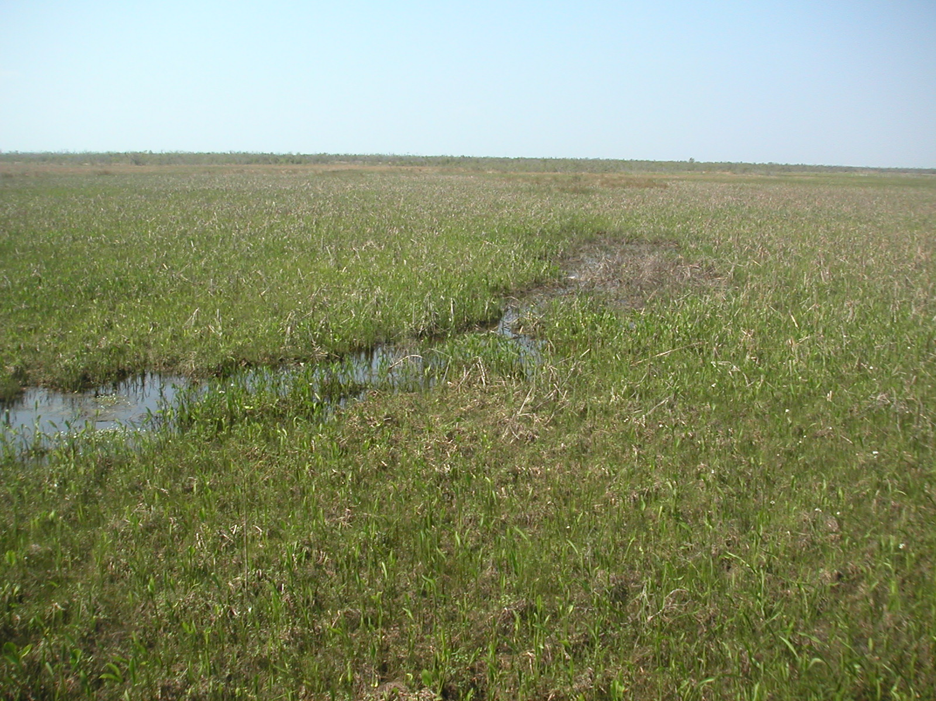

Slide 17
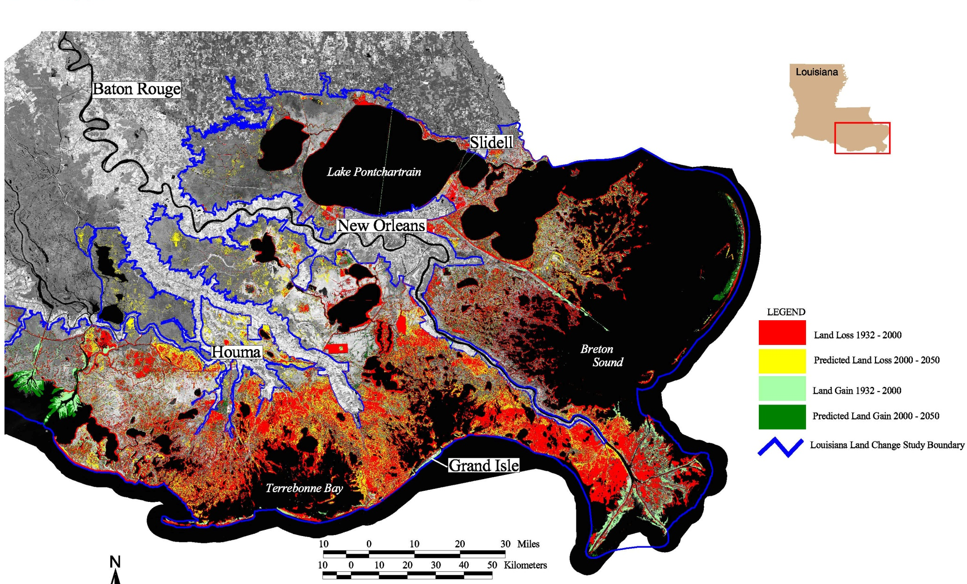

Slide 18
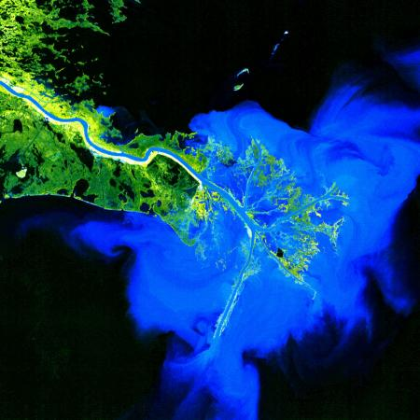
Landsat 1 - Jan 16,1973
Notes:
Bird food delta, proximity to shelf break

Slide 19
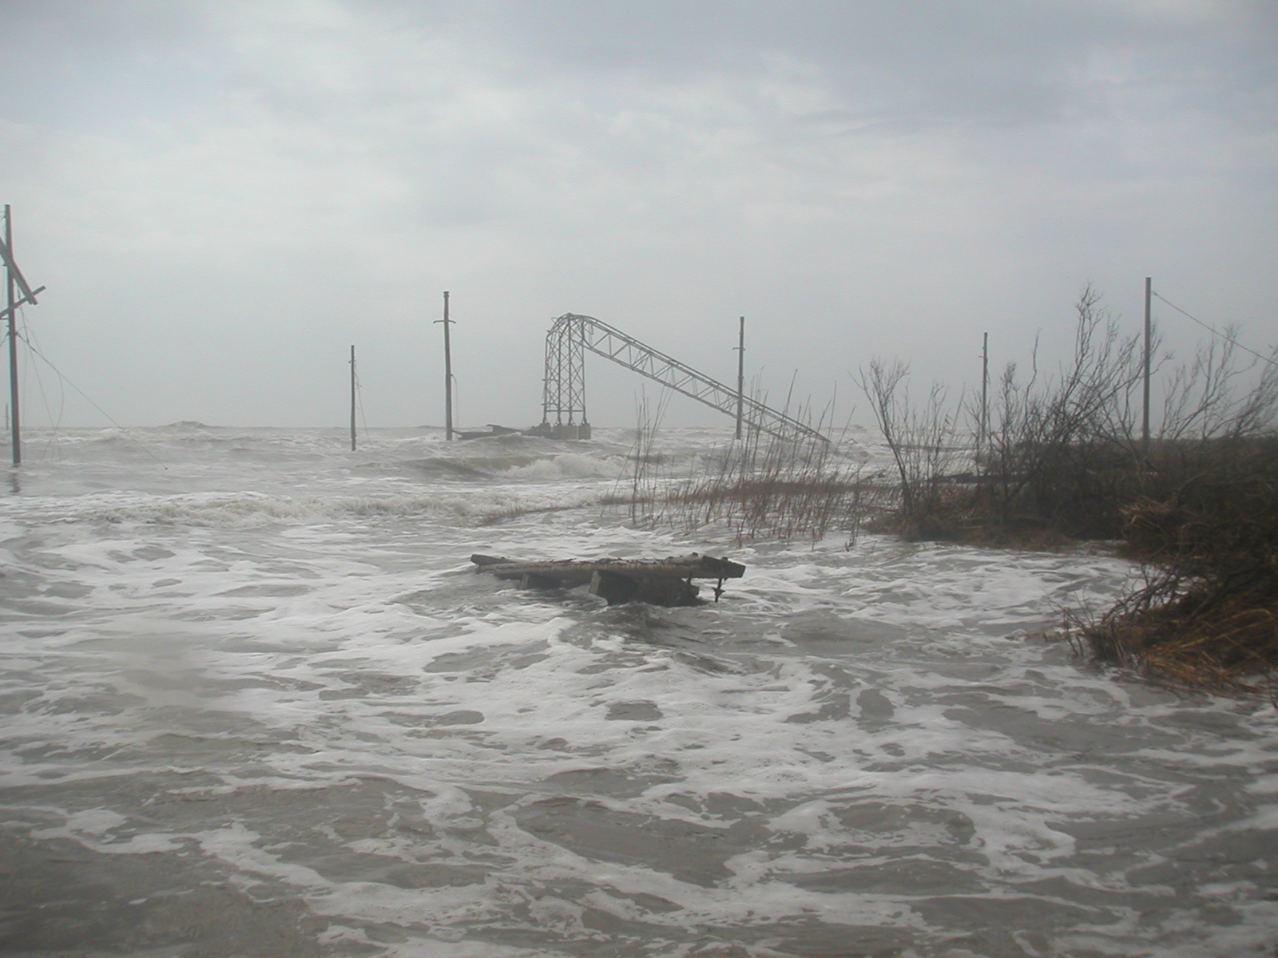
Notes:
March 2006, post katrina, ivan

Slide 20
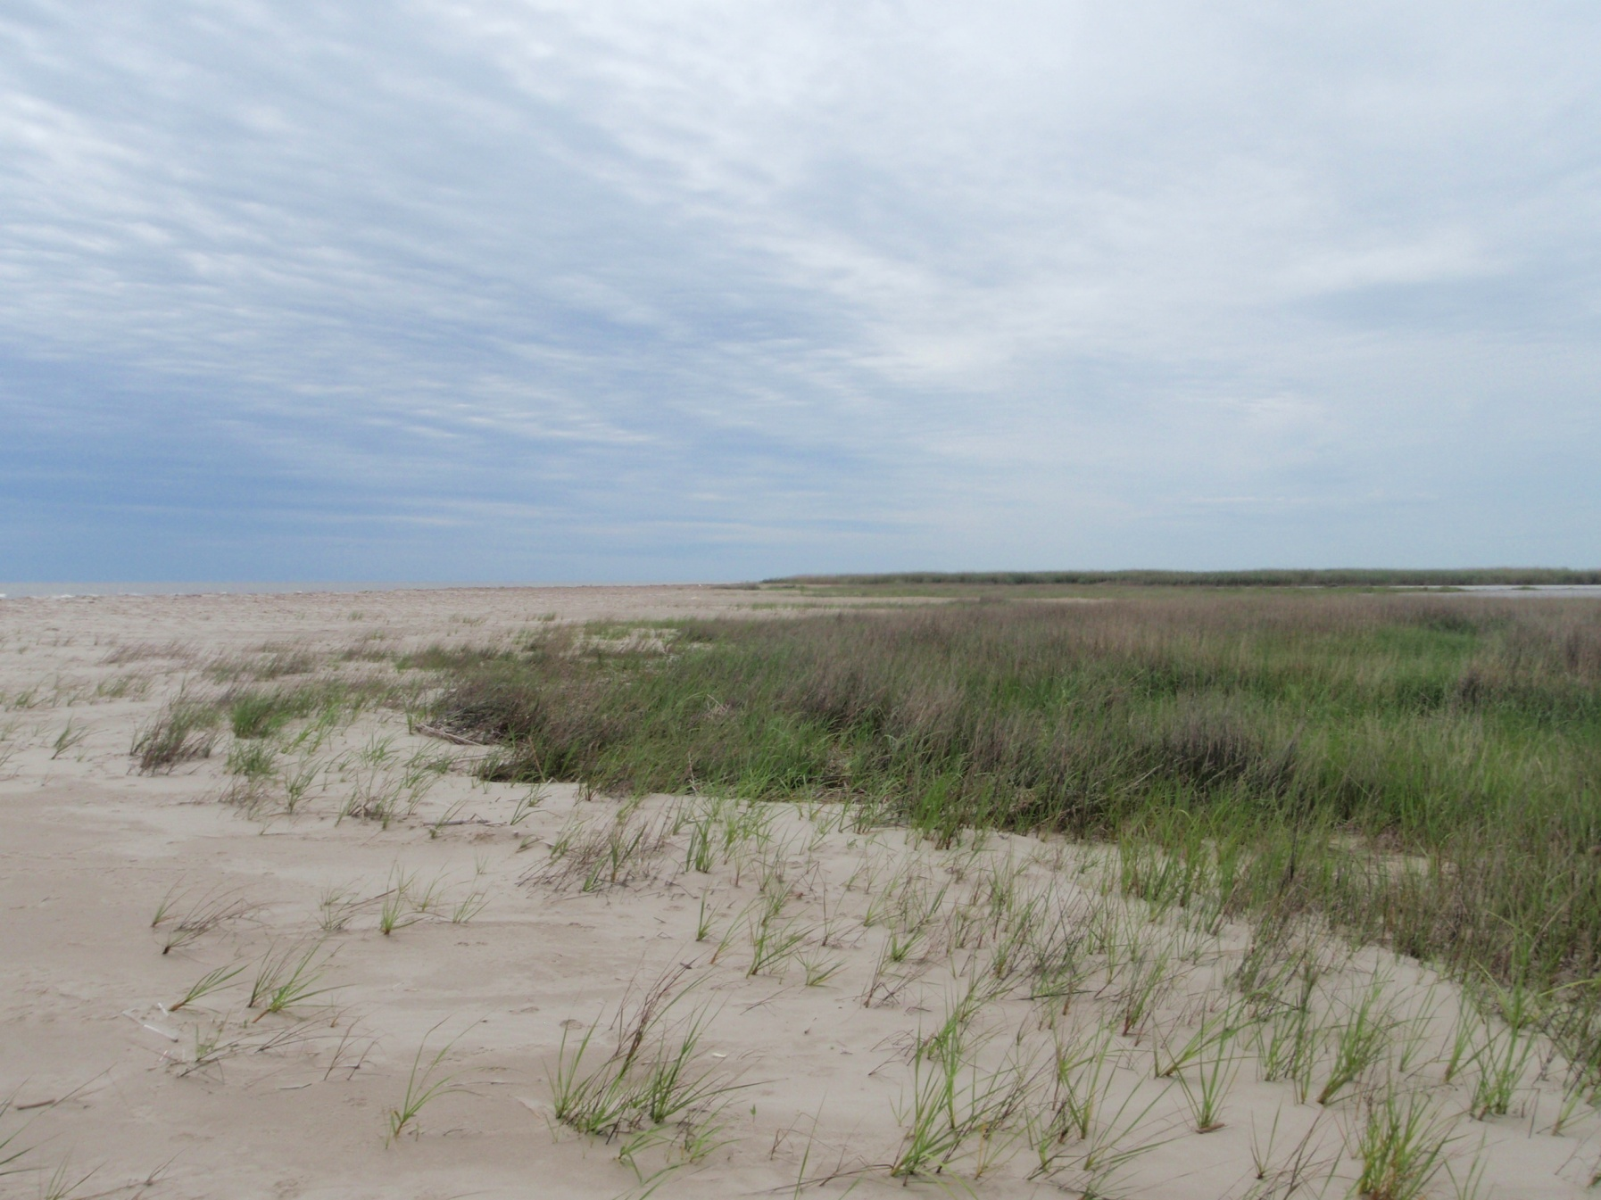

Slide 21
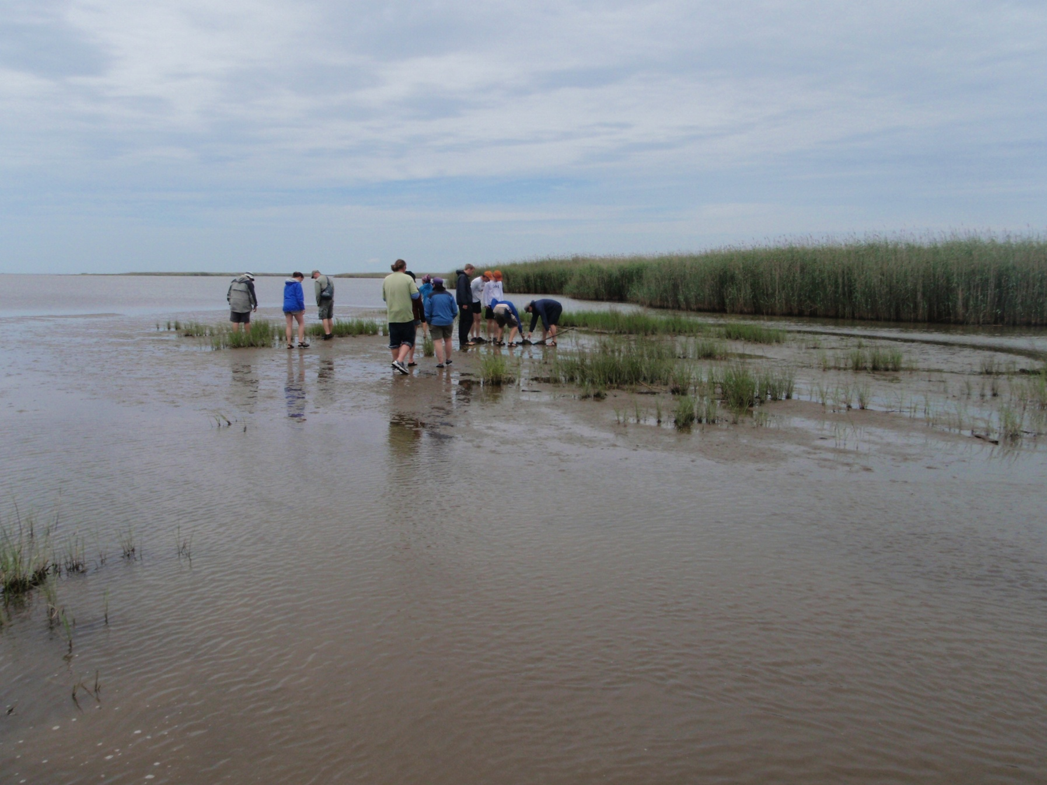

Slide 22
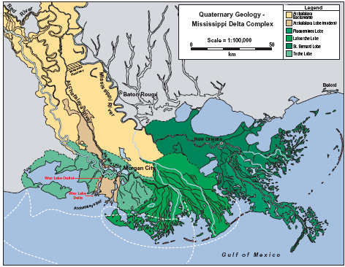

Slide 23
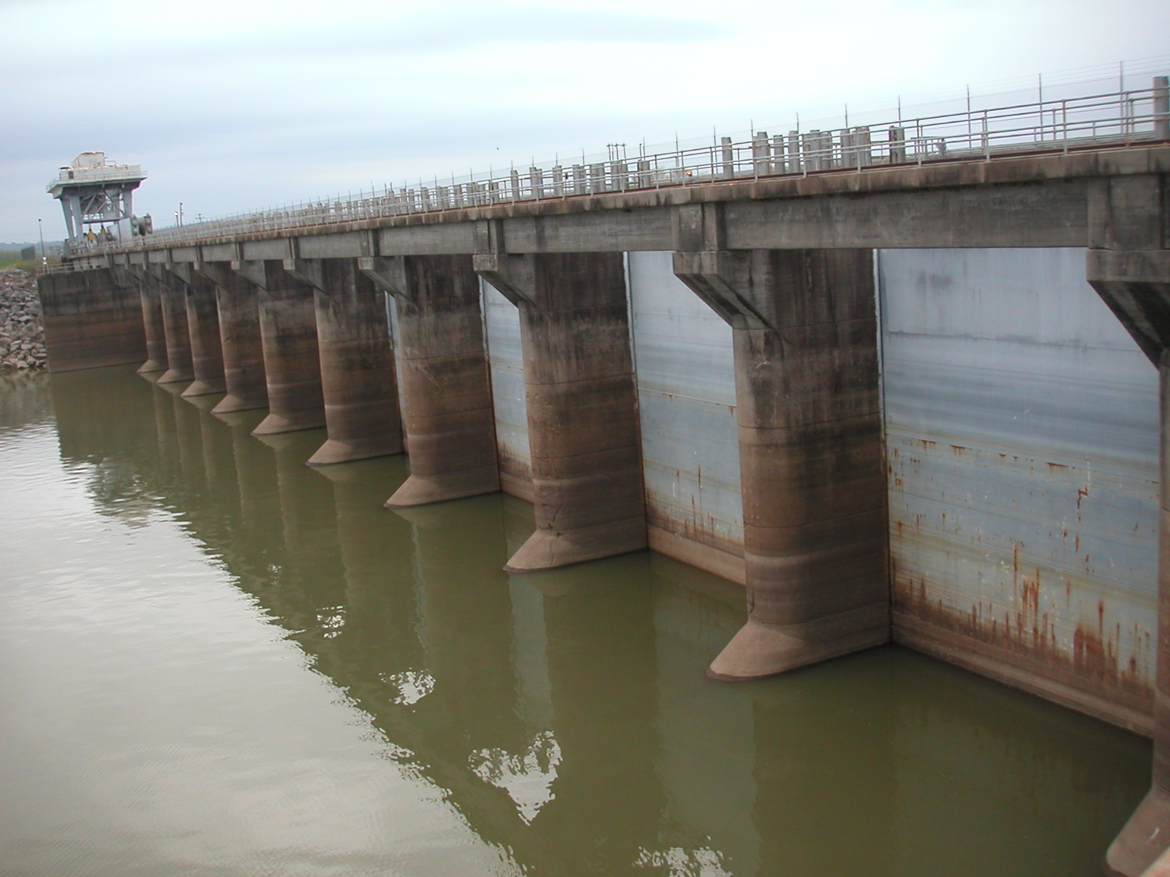

Slide 25
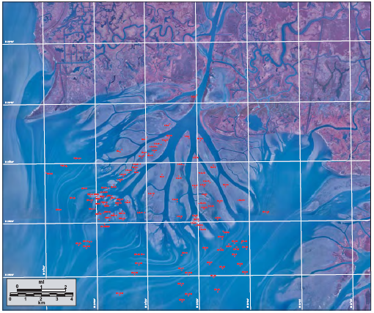

Slide 26
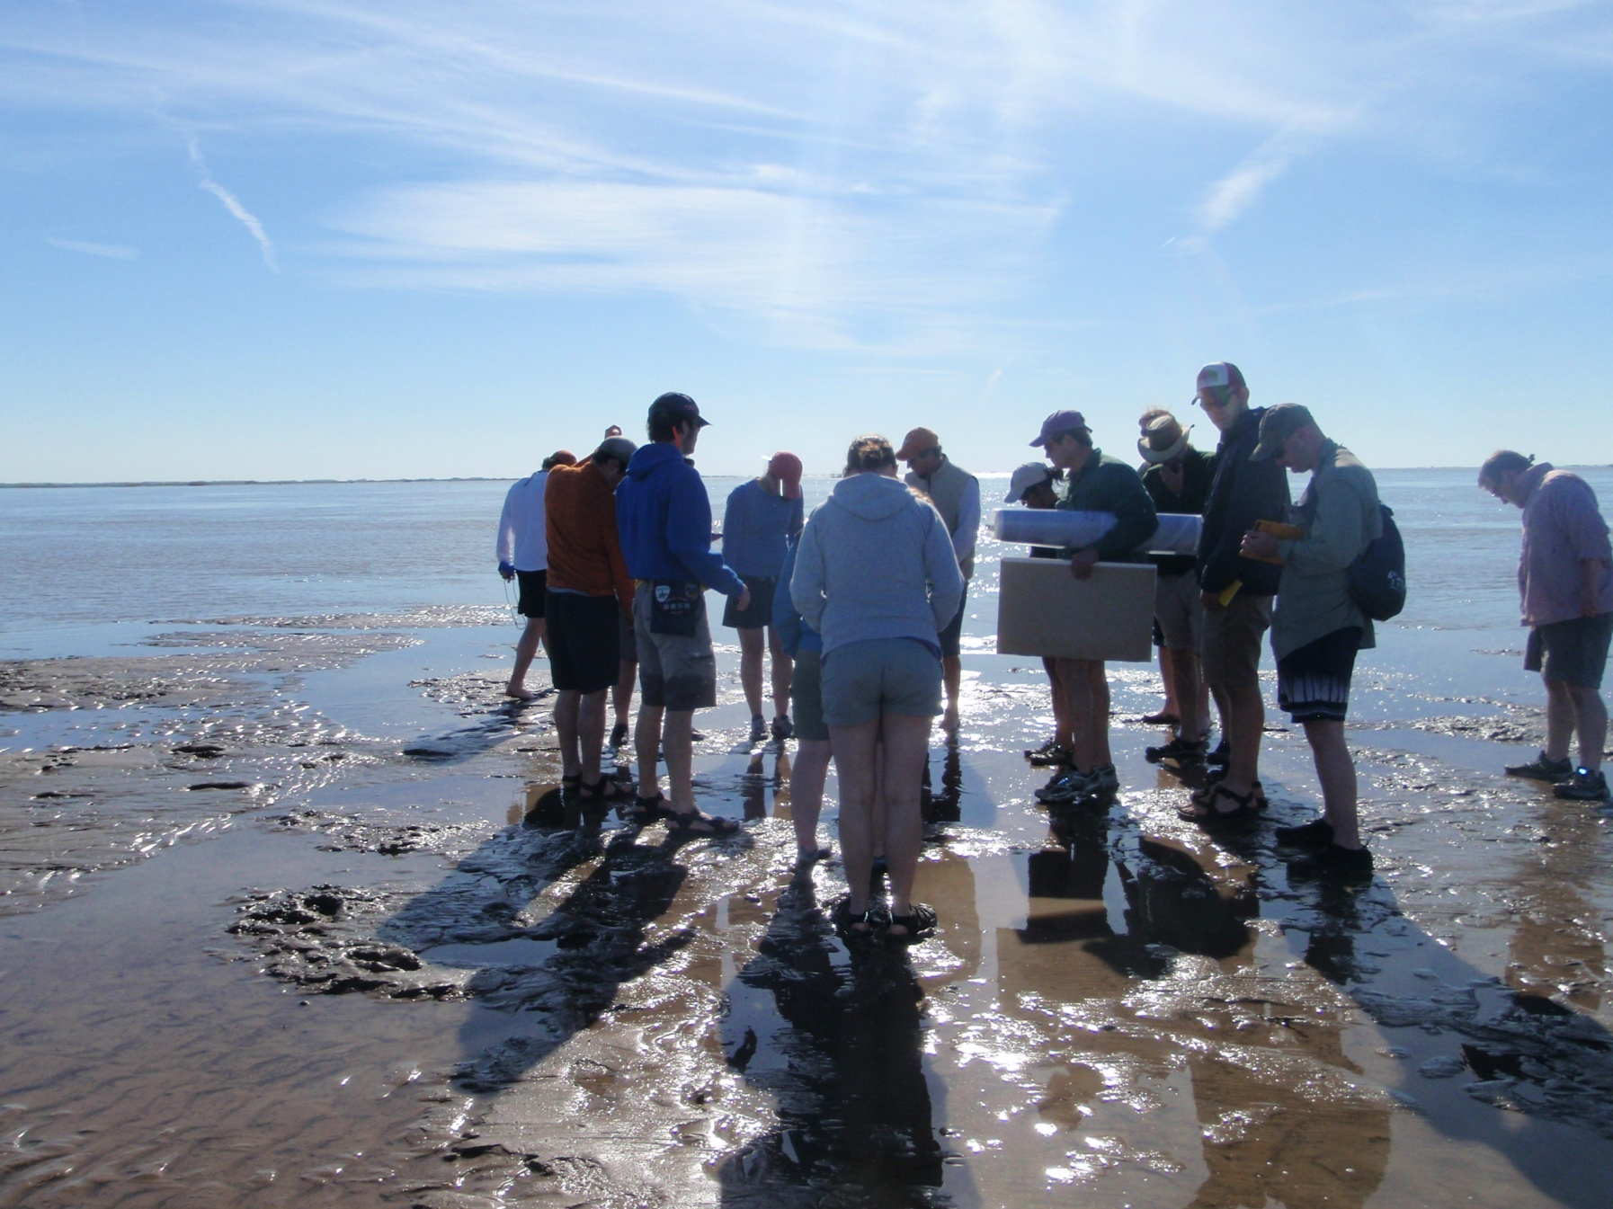

Slide 27
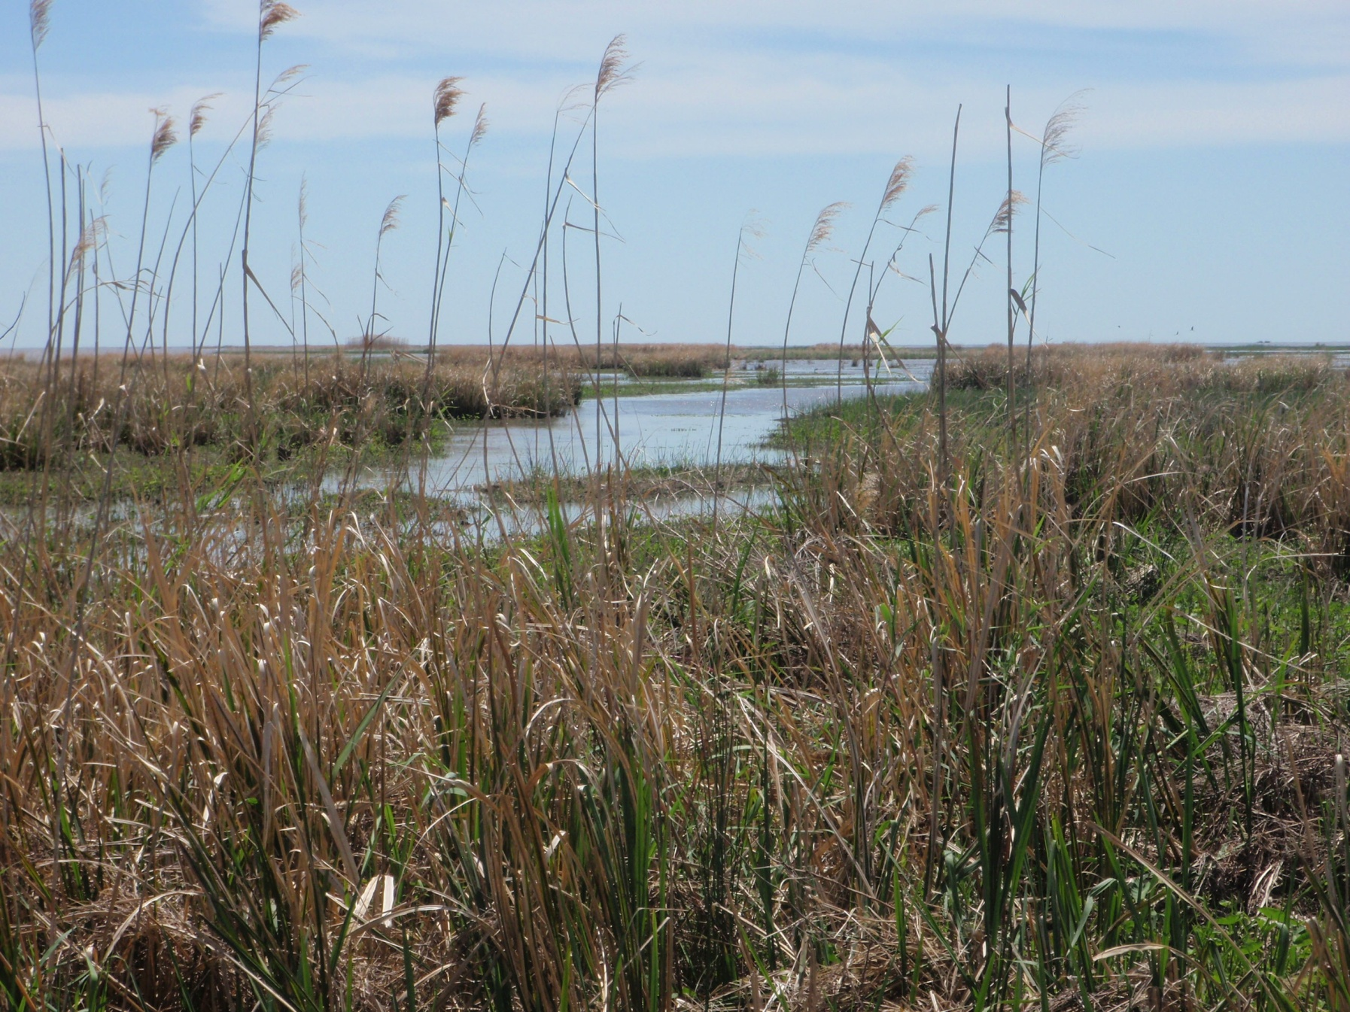
Notes:
From water→shoal→ marsh

Slide 29
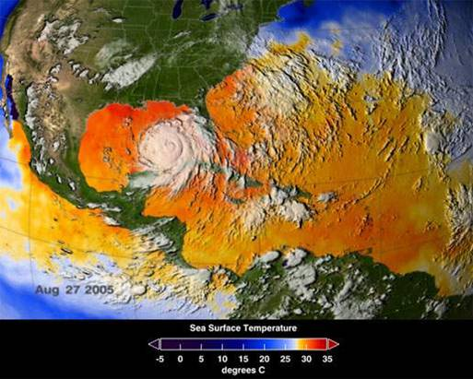

Slide 30
Writing Earth history with continental-margin sedimentary processes

Slide 31
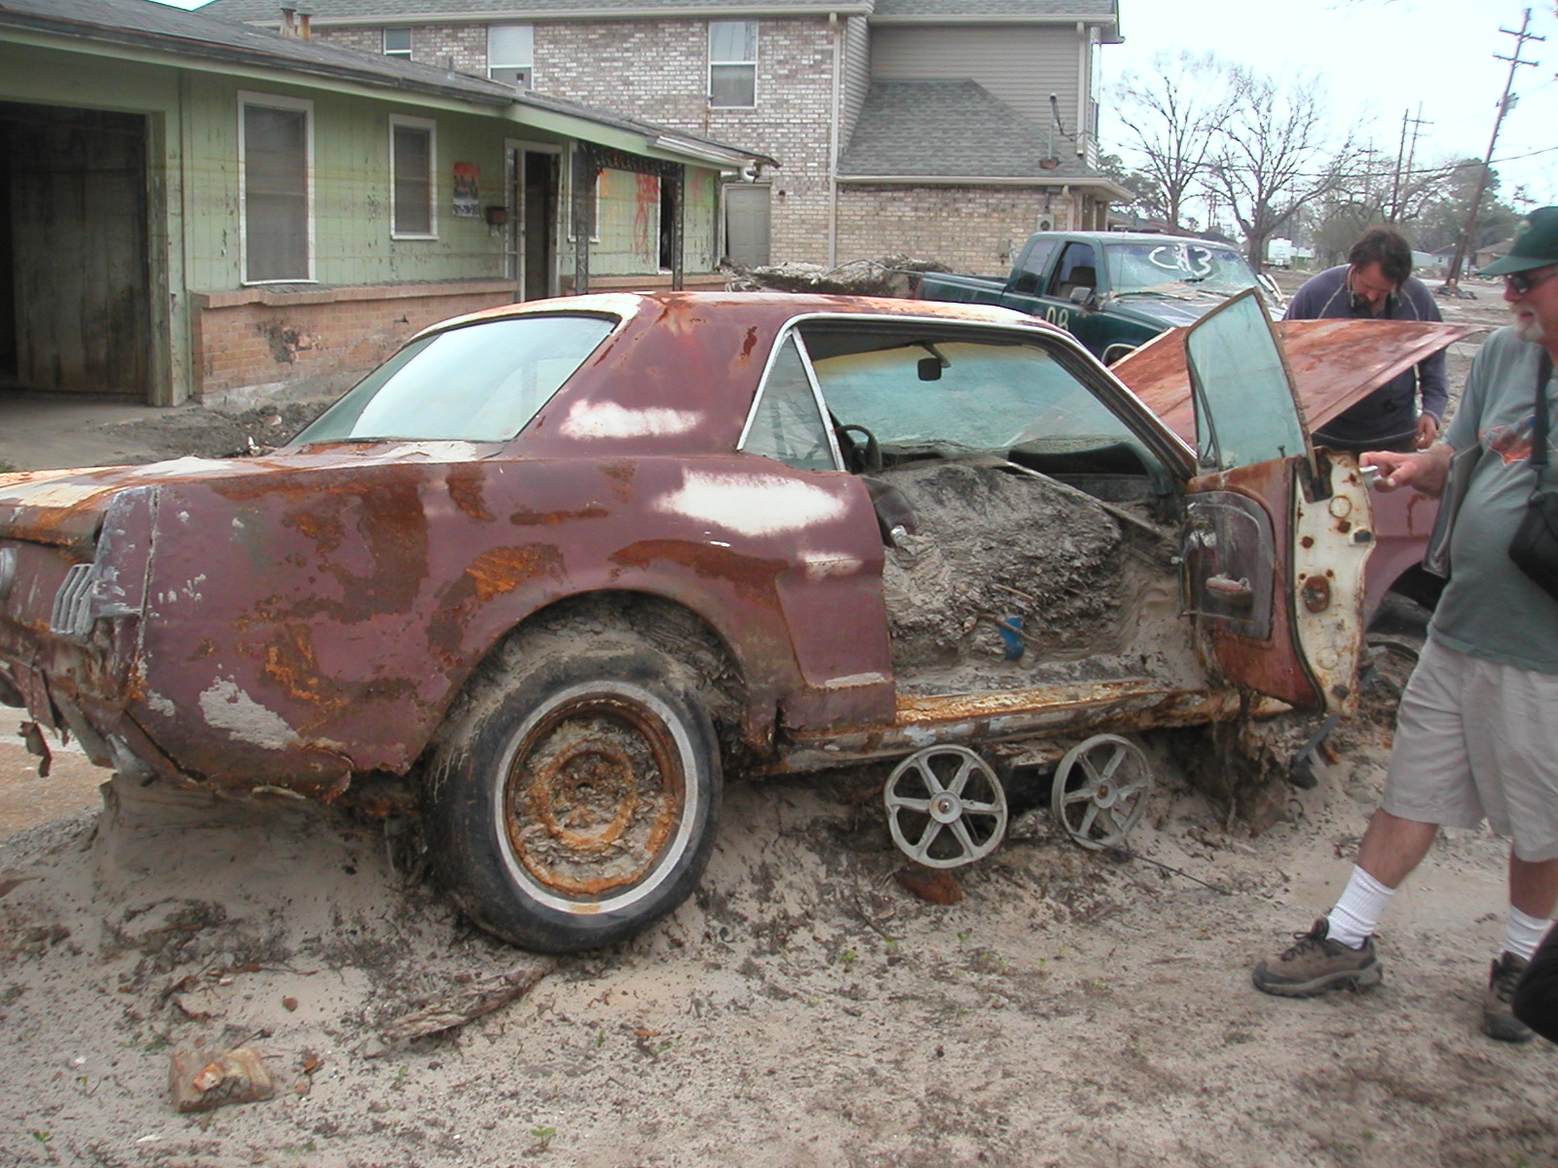

Slide 32
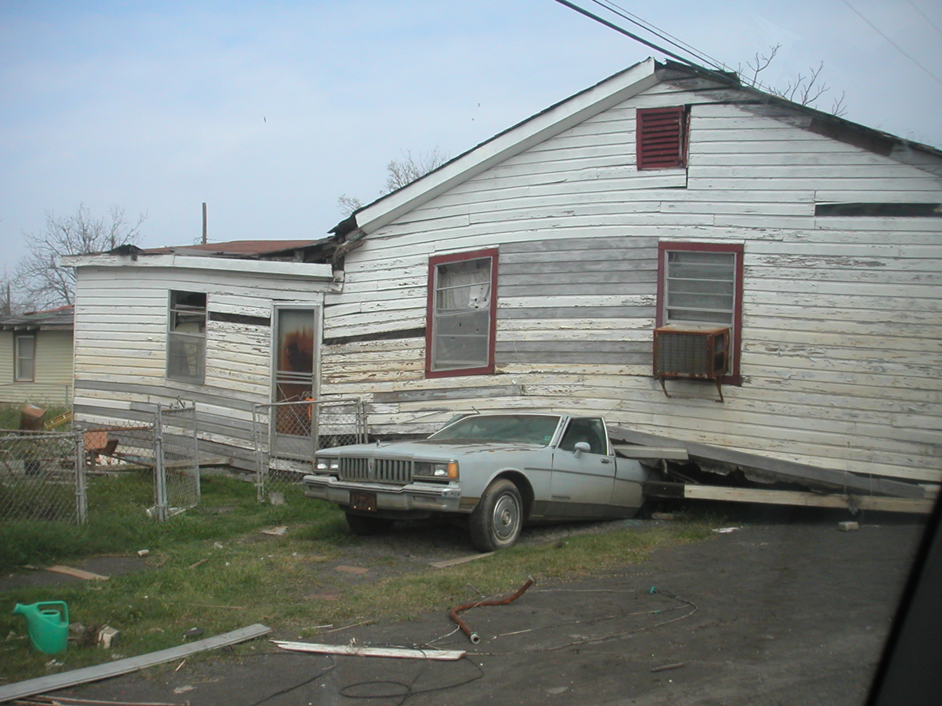

Slide 33
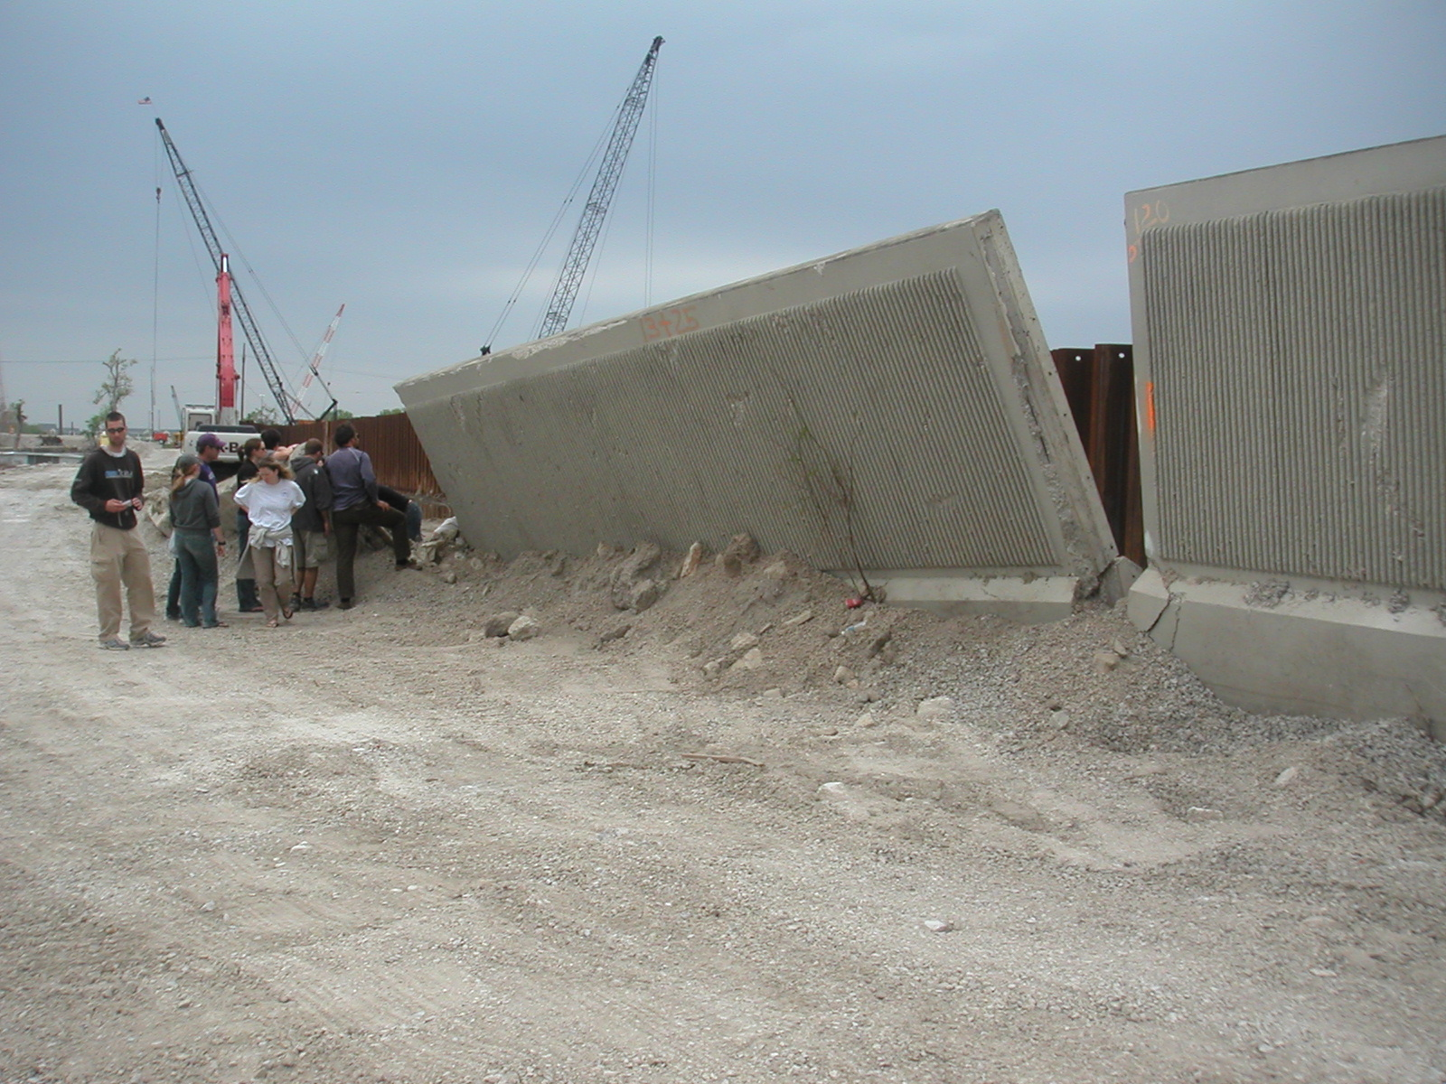
Notes:
Pressure of water in drainage channels resulted in water flow through permeable sands under old levees, leading to catastrophic failures

Slide 34
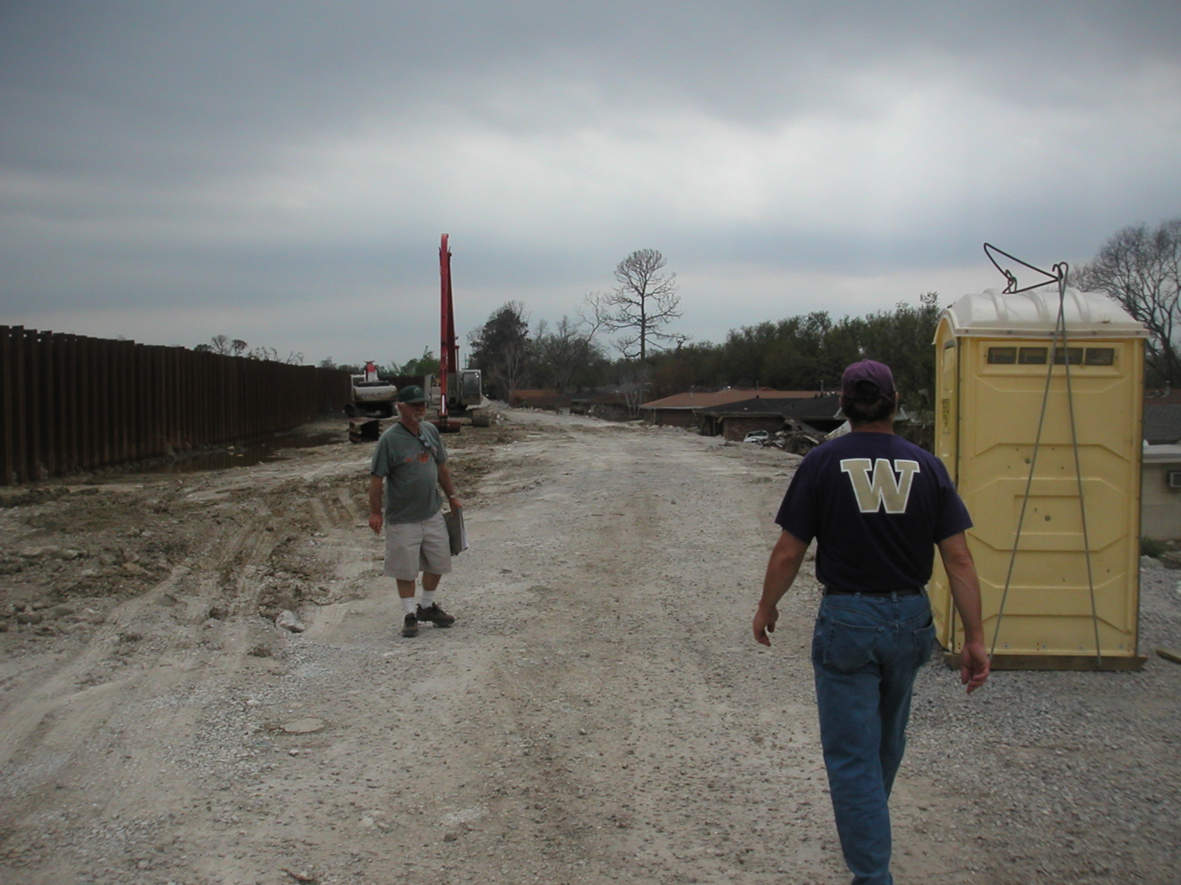

Slide 35
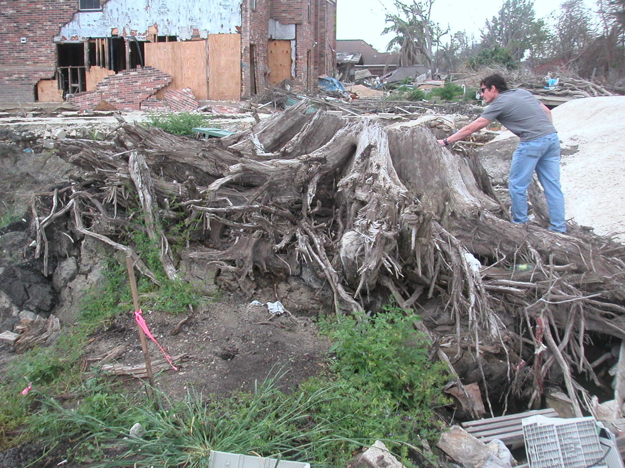
Notes:
Cypress stump, originally grew in swamp – exposed following flooding/removal of fill
We turned swamps into subdivisions

Slide 36
List of some things we did
Dammed river – reduced sediment supply, 400 million t/y to 200 t/y
Prevented lobe switching – eliminated sediment supply to other parts of delta plain
Built artificial levees – reduced nourishment of flood plain
Constrained flow to modern Balize delta – caused delta to build to shelf break, and lose sediment to continental slope
Removed water and natural gas – accelerated consolidation of deltaic sediment and subsidence of land surface
Dredged channel – created depressions that act as sediment traps and pathways for storm surge

Slide 37
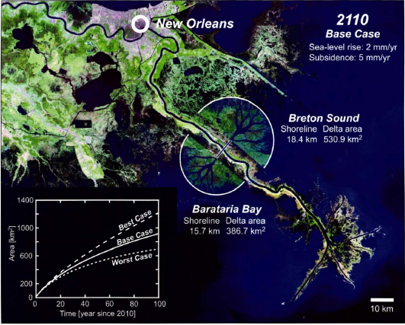
Potential alteration to Mississippi River mouth
to help promote development of wetlands

Slide 38
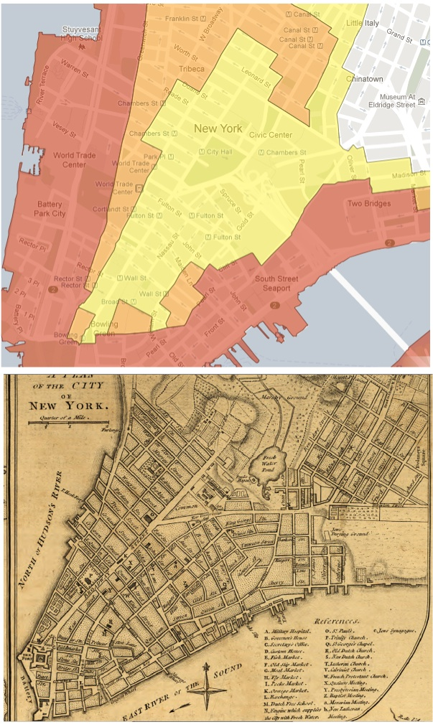
Evacuation map of Manhattan during hurricane Sandy
Highest flood risk (red) is shoreline built since 1776
Additional evacuation zones built on bedrock (no human-induced subsidence)
http://www.manhattanpast.com

Slide 39
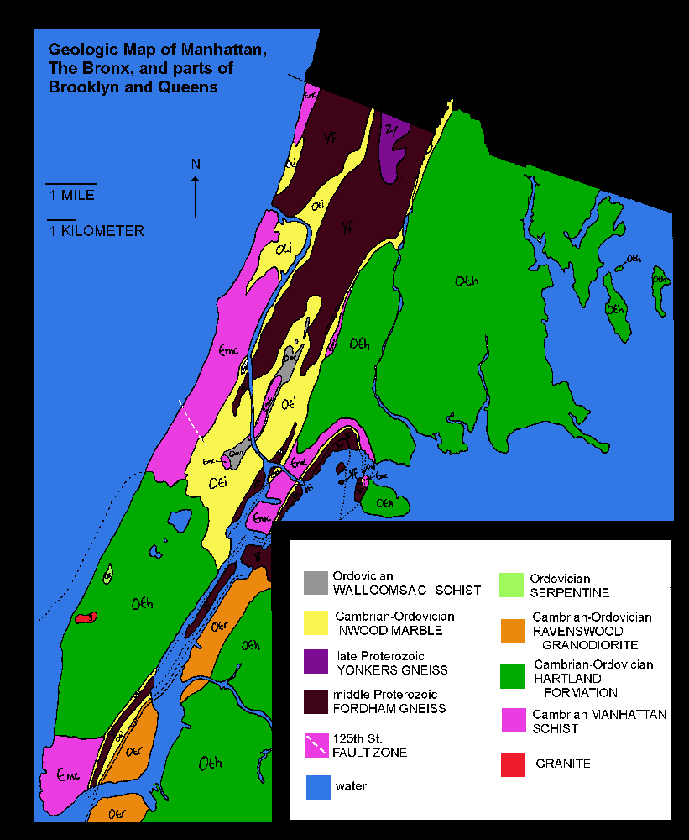

Slide 40
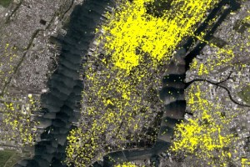
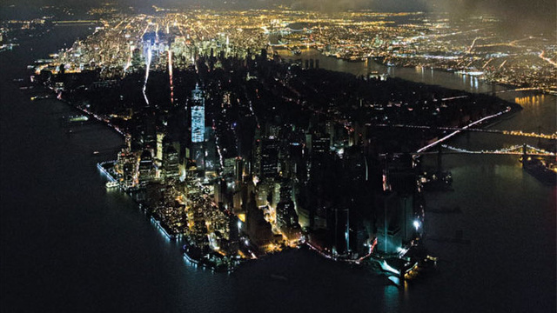
4square check-ins
Power outage

