Slide 1
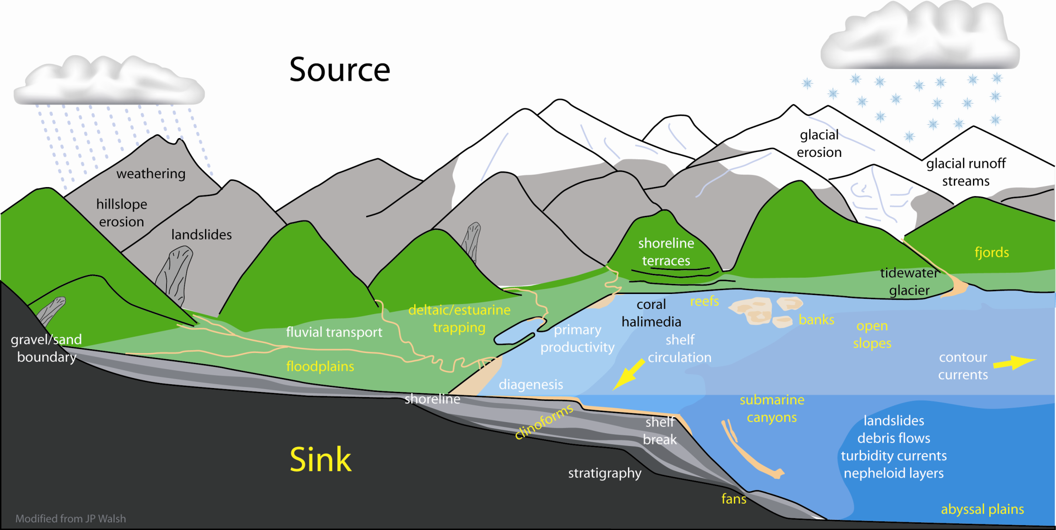
Source-to-Sink Approach to Sediment Dispersal Systems
Putting the Amazon system into a source-to-sink context

Slide 2
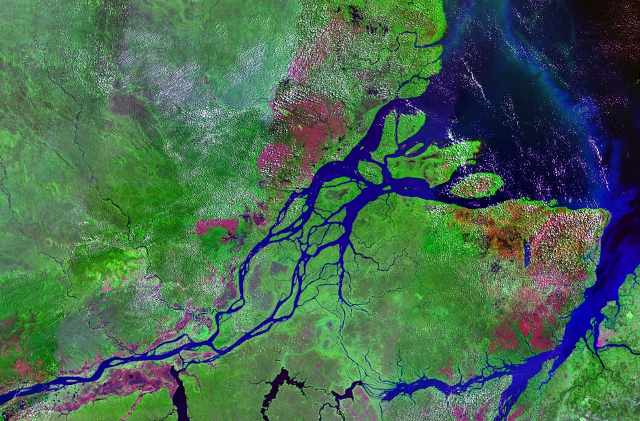
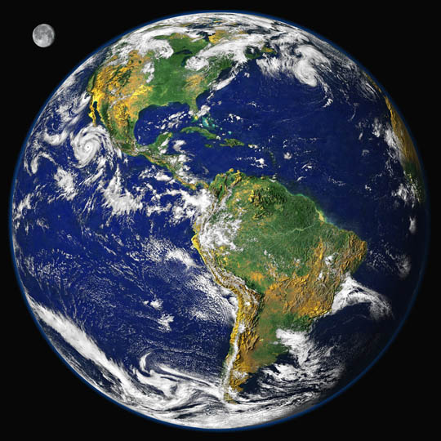
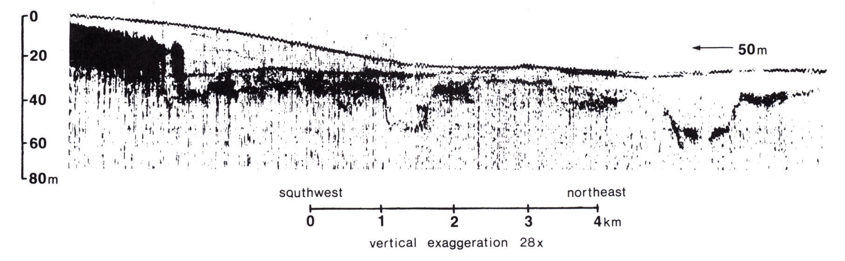
Bigger sediment
supplies have built
thicker deposits on
continental shelves
during the Holocene
the Amazon shelf

Slide 3
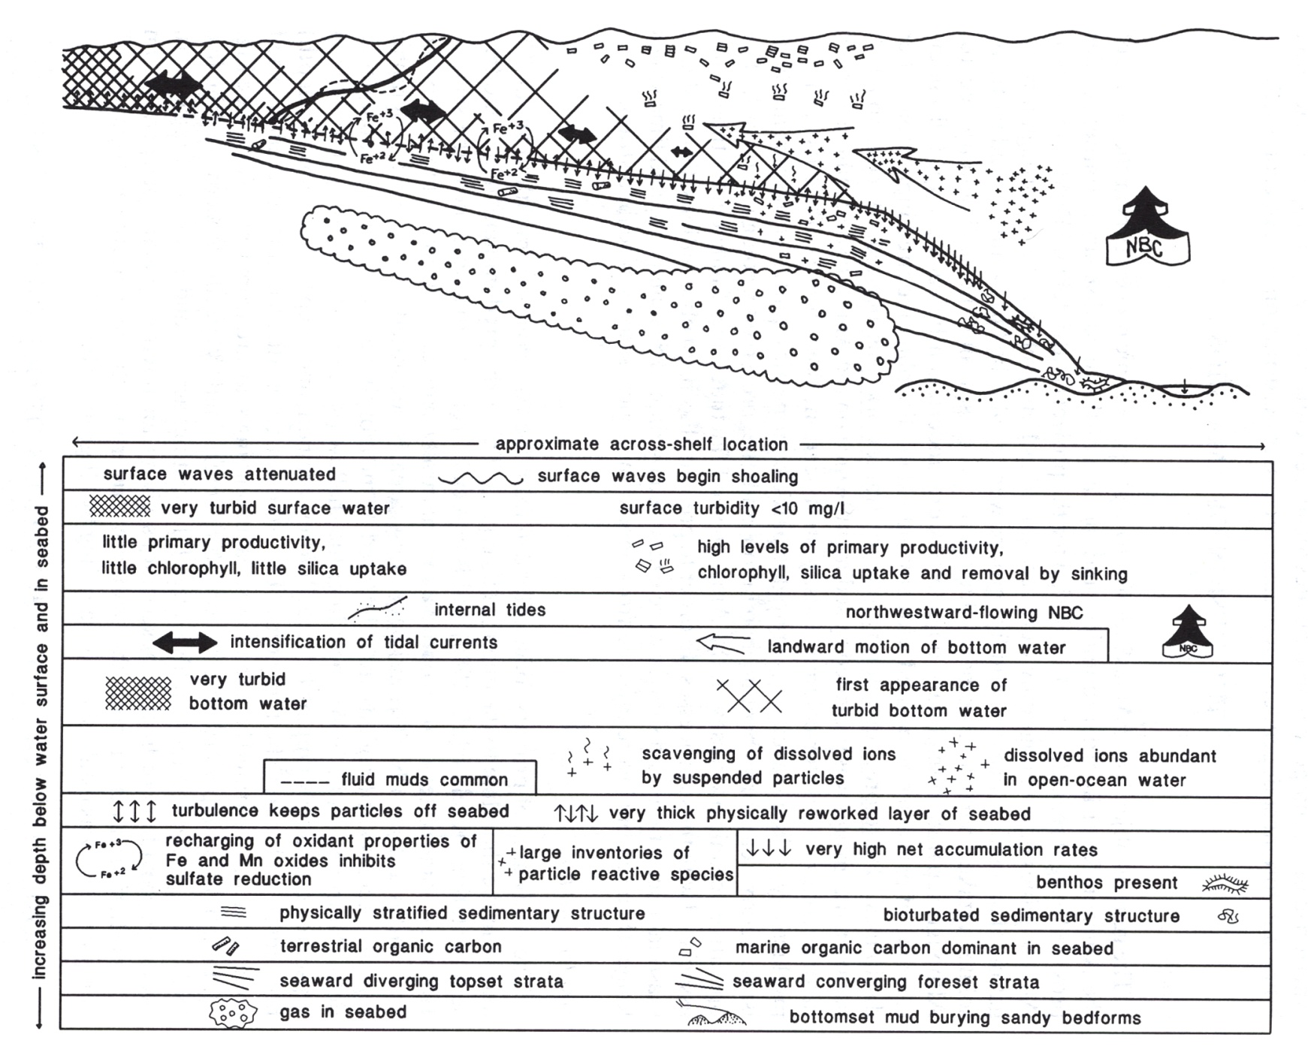
Interdisciplinary Oceanographic Processes on Amazon Shelf

Slide 4
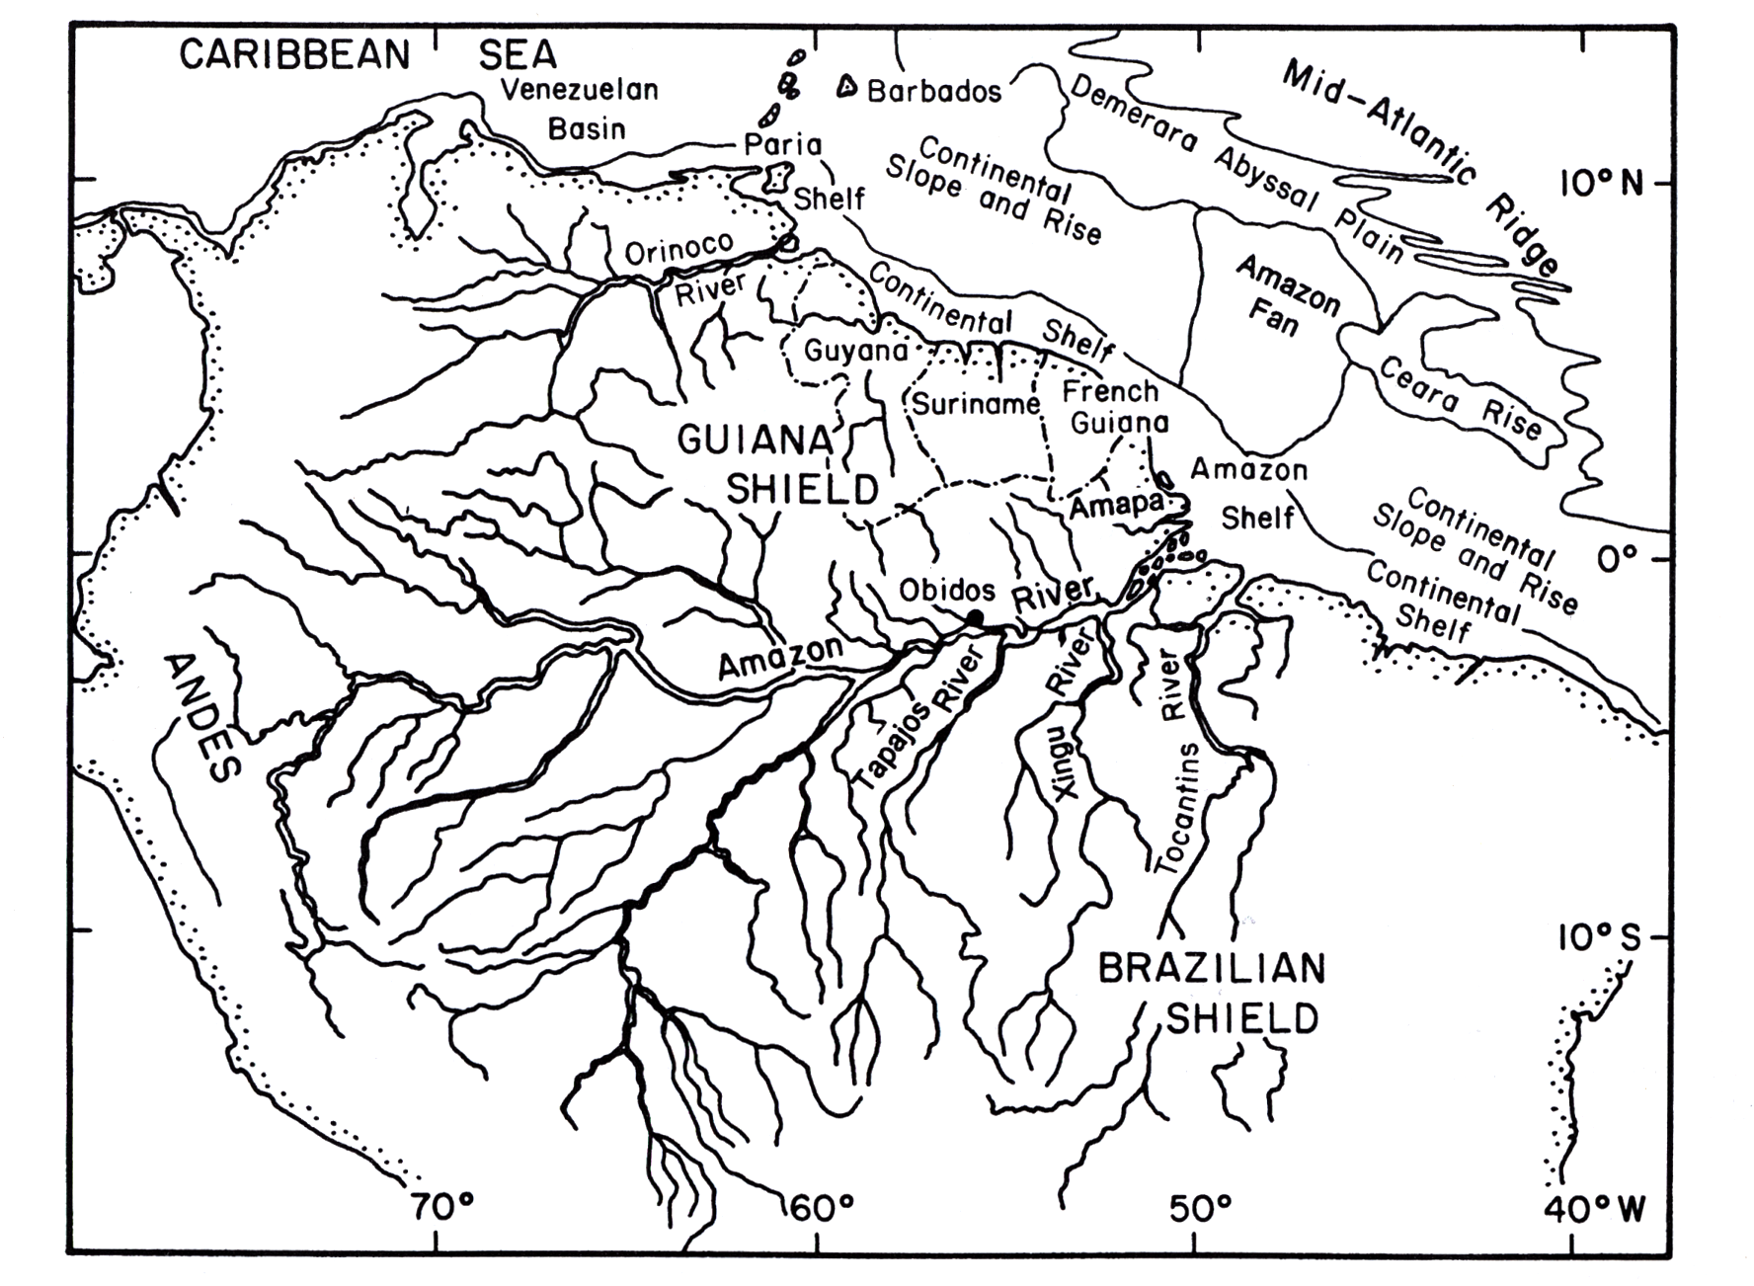
Amazon dispersal system extends 1000s km – land and sea
Tidal river and coast extends 1000 km seaward from Obidos

Slide 6
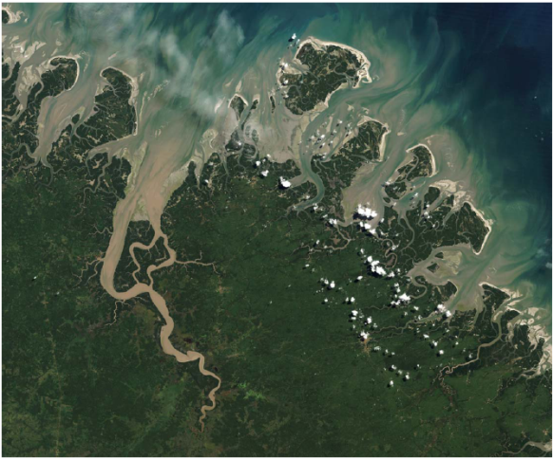
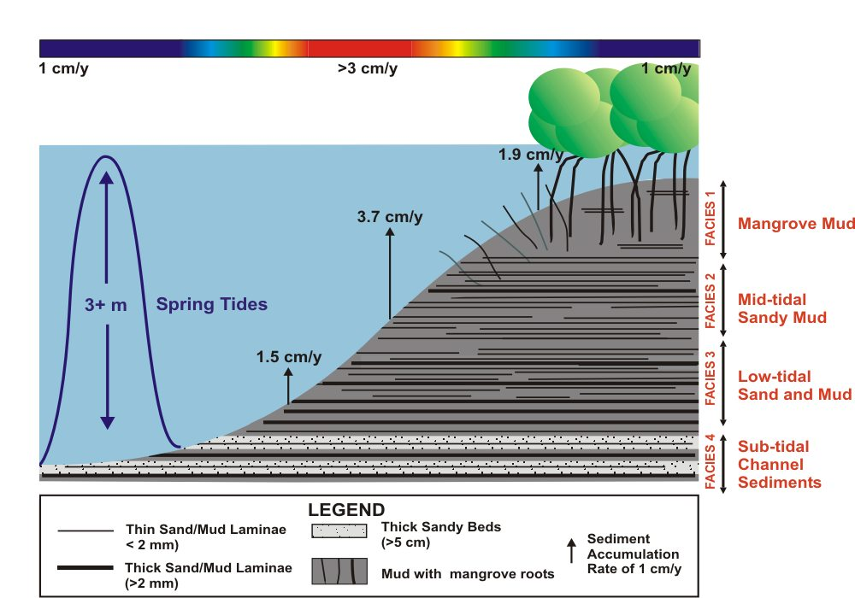
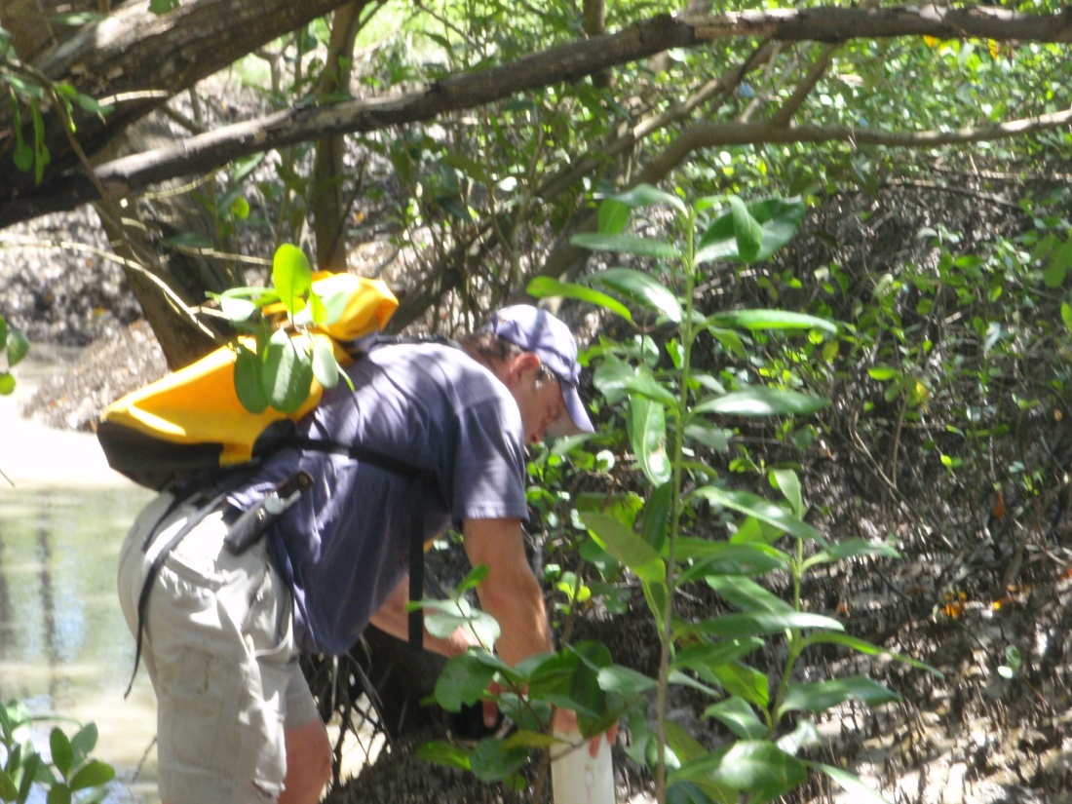
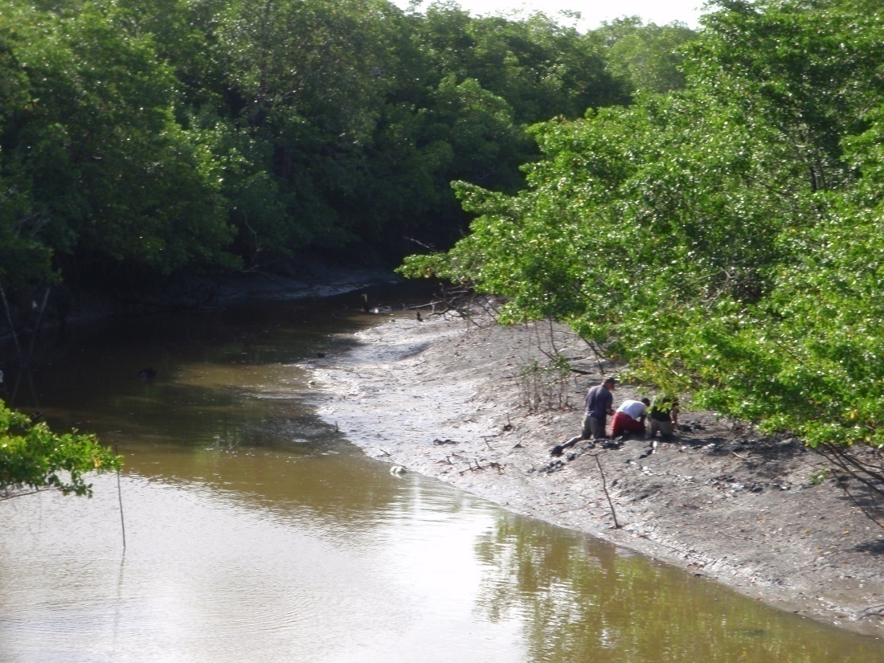
Muddy beaches in
mangrove forests at tropical latitudes

Slide 7
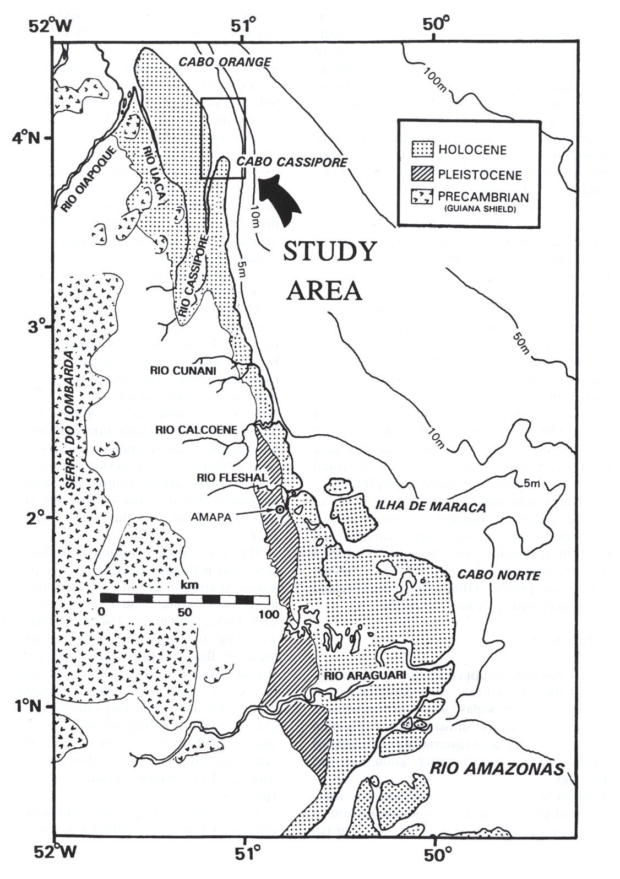
Substantial coastal accretion downstream of river mouth
Coastal erosion along some parts of coast

Slide 8
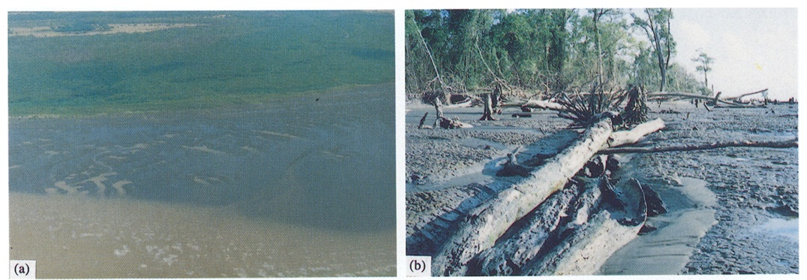
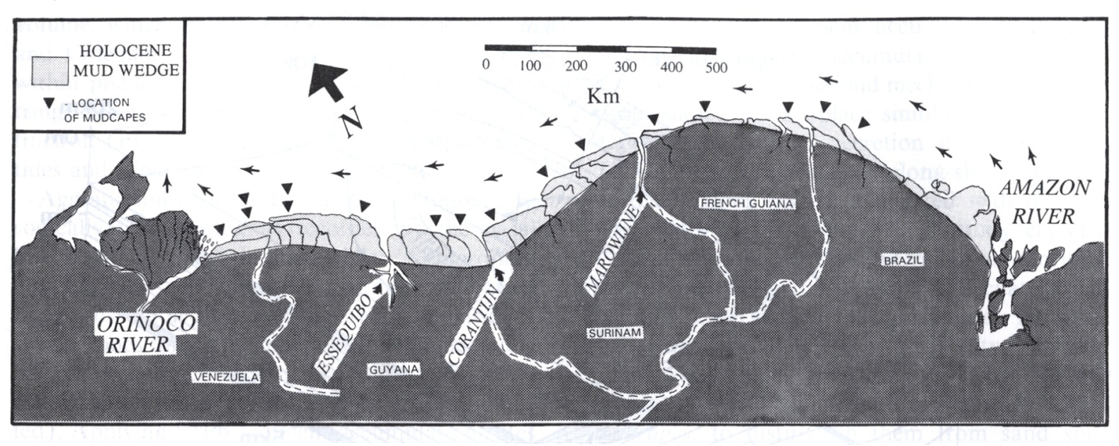
Regions of sediment accumulation and erosion
Mudcapes along northern South America
They extend from Amazon mouth to the Caribbean Sea

Slide 9
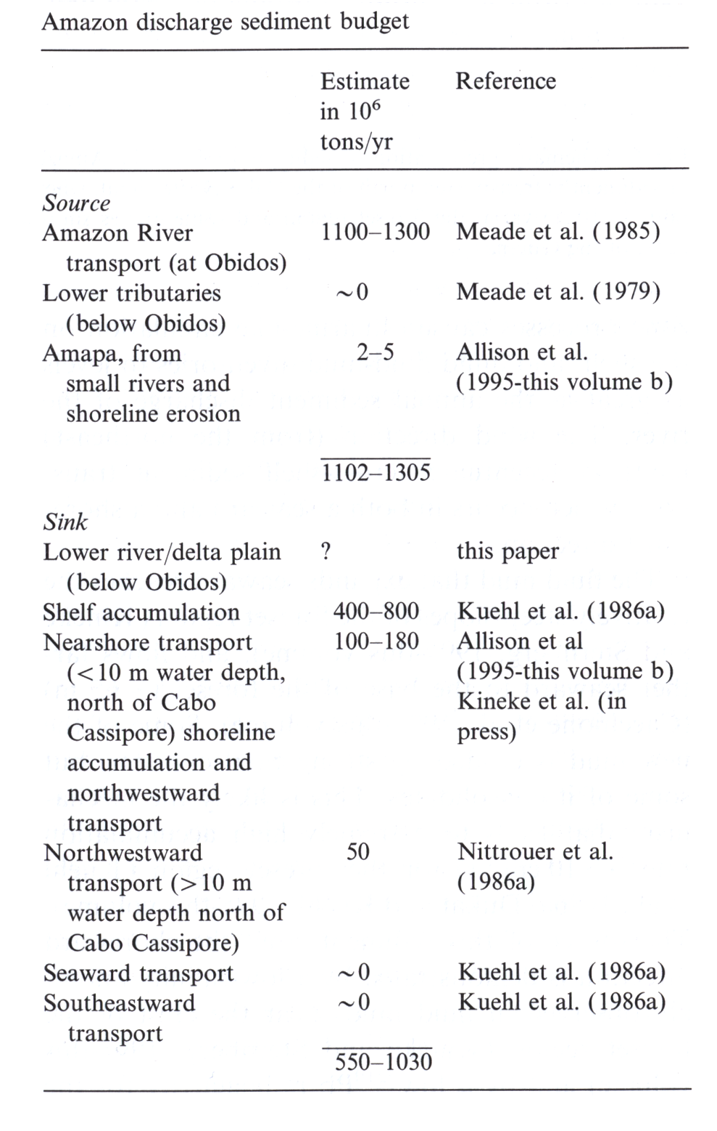
Source ~1200 x 10⁶ t/y
Sink ~800 x 10⁶ t/y
Likely, ~1/3 missing
But large confidence limits
Tidal river is sink?
We know nothing directly about mass accumulation
or PROCESSES

Slide 10
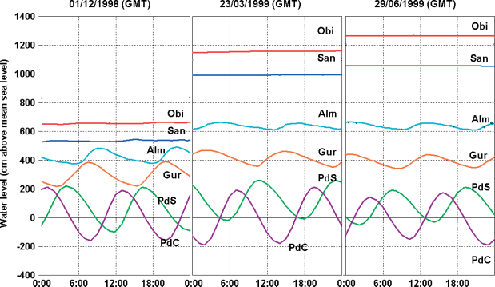
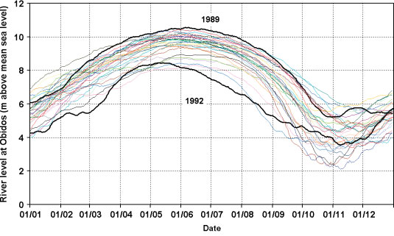
Amazon
tidal
river

Slide 11
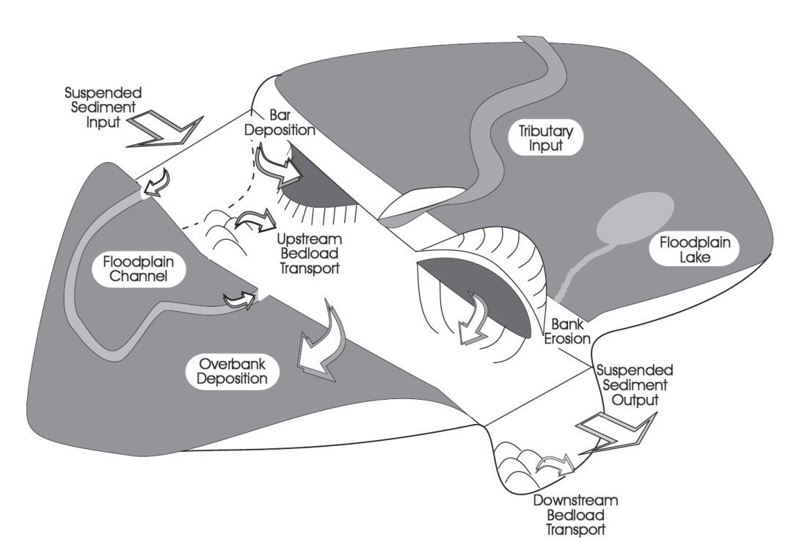
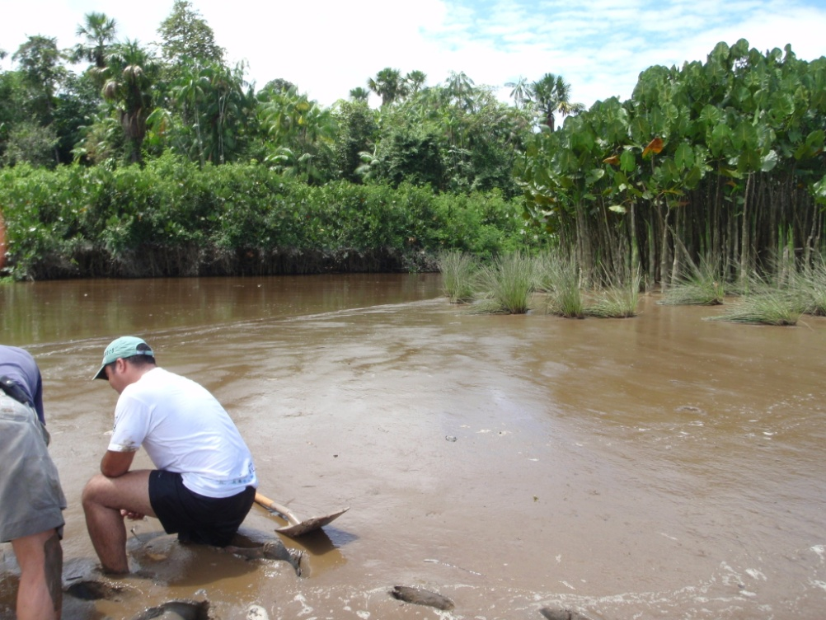
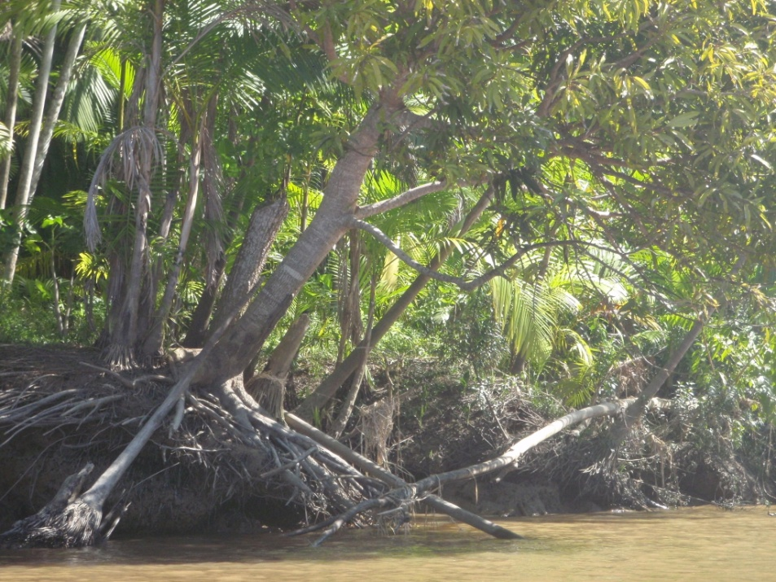
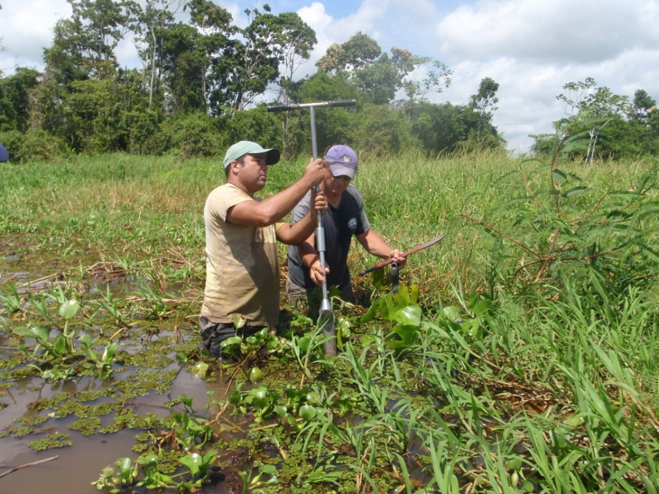
Sedimentary processes in tidal rivers

Slide 13


Slide 14
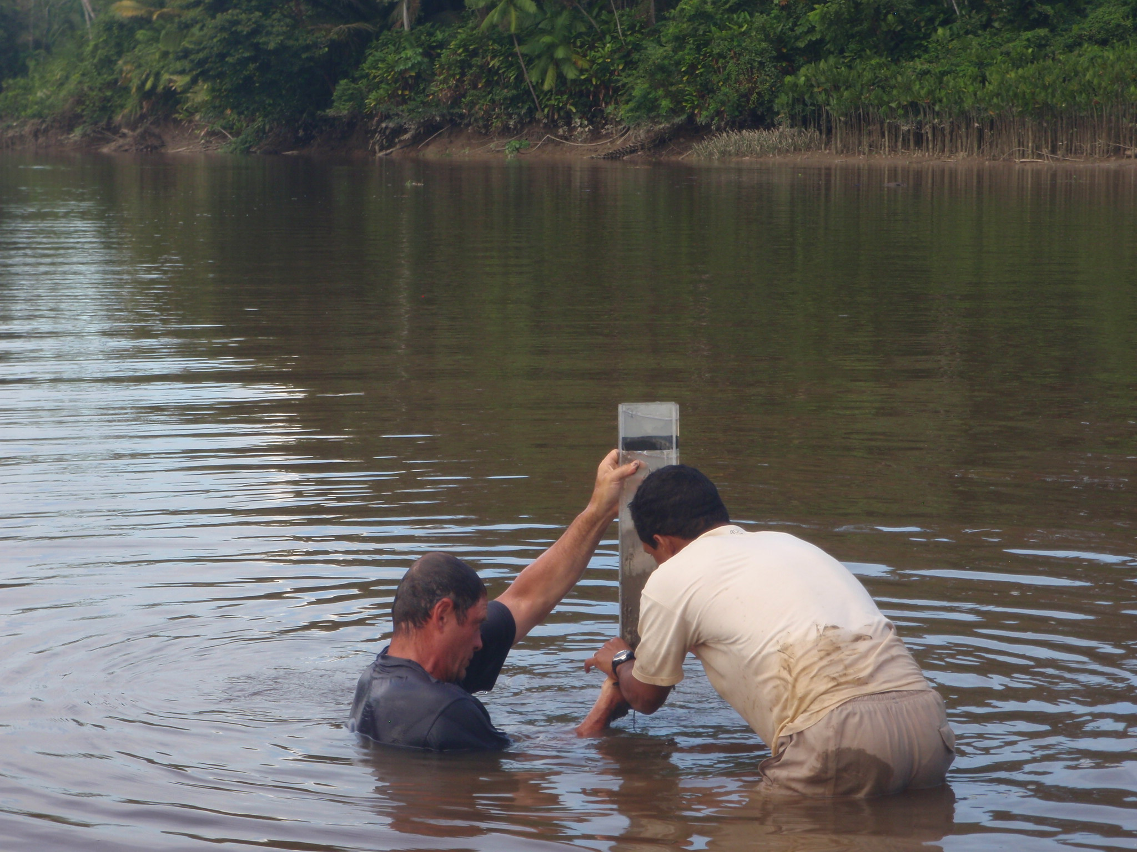

Slide 15
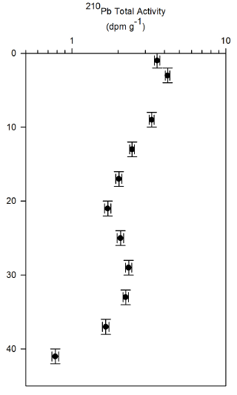
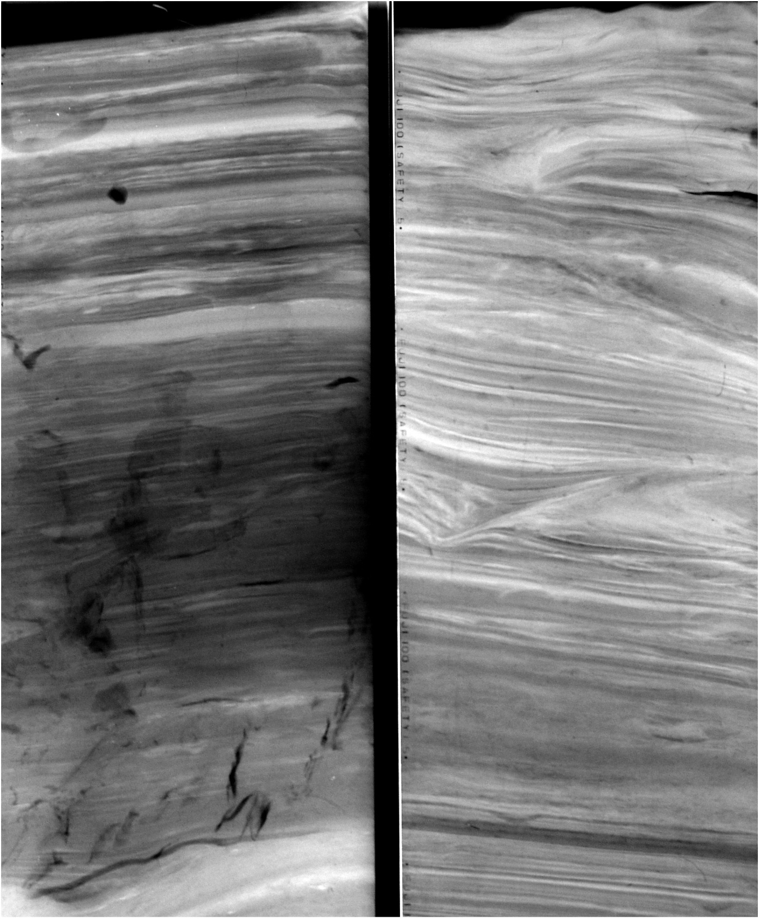
Accumulation of sedimentary
strata in tidal river and mangrove forests
A = 7.1 mm/y
R² = 0.66
Tidal layering
Active sediment accumulation

Slide 16
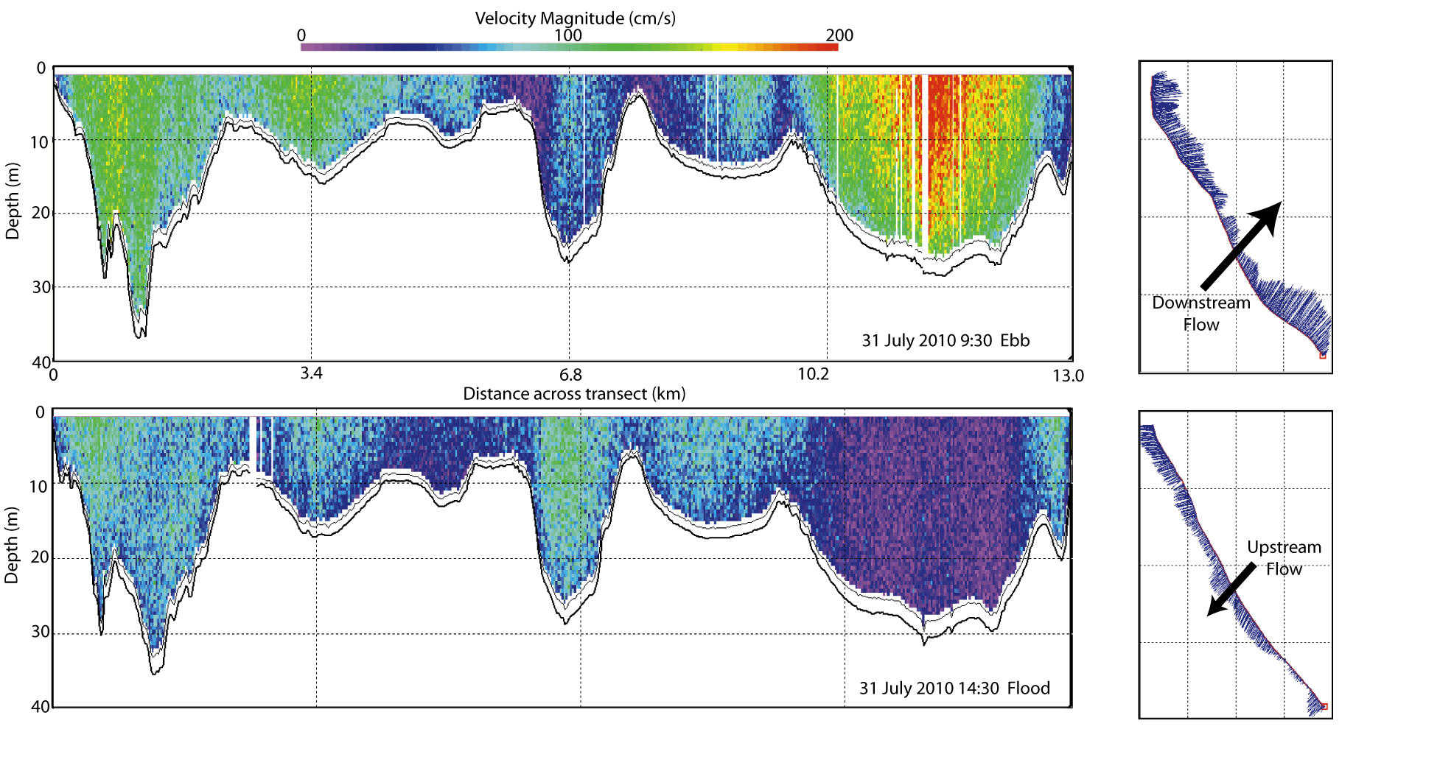
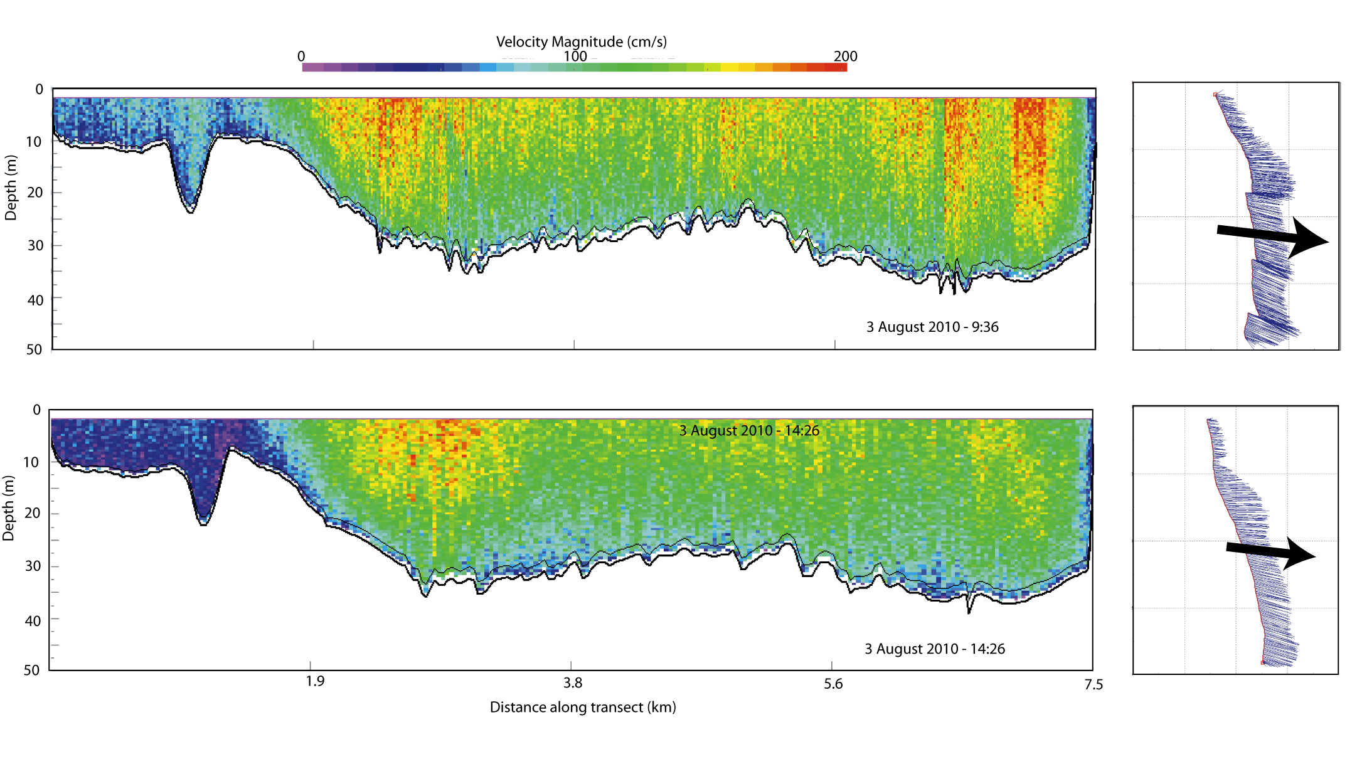
Example Velocity Transects
Mean ~128,000 [m³/s]
Mean ~213,000 [m³/s]
Notes:
Note: top set of figures, discharge is for south fork, and velocity for north fork. Need to calculate river discharge for north fork still.

Slide 17
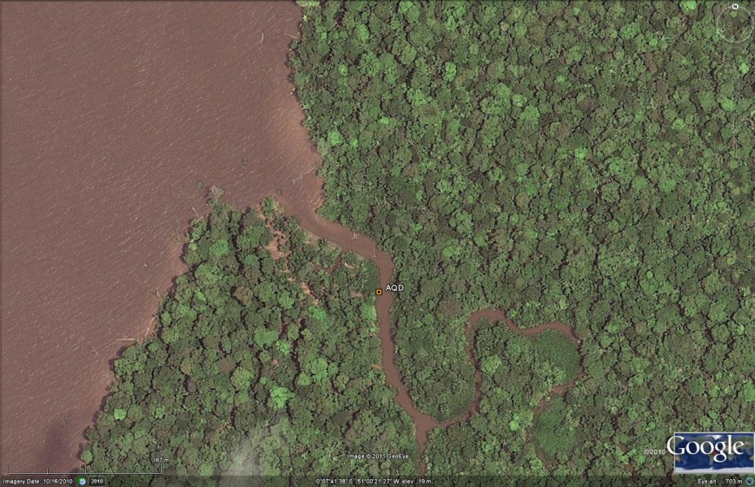
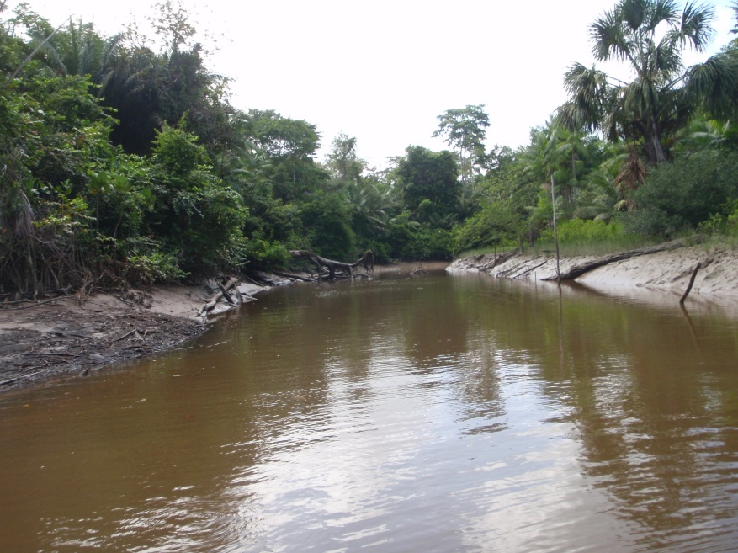
Amazon
River
Peak velocity on ebb despite shallow pressure gradient
AQD4
deployment
location
ebb
170 m
flood
channel width 10-14 m
Highest SSC values associated with temperature gradient at beginning of ebb (short-lived)
Longer-lived elevated SSC associated with peak velocity
Notes:
SSC peak correlated with temperature gradient observed on 3 out of 4 deployments. Potential remote sensing application?

Slide 19
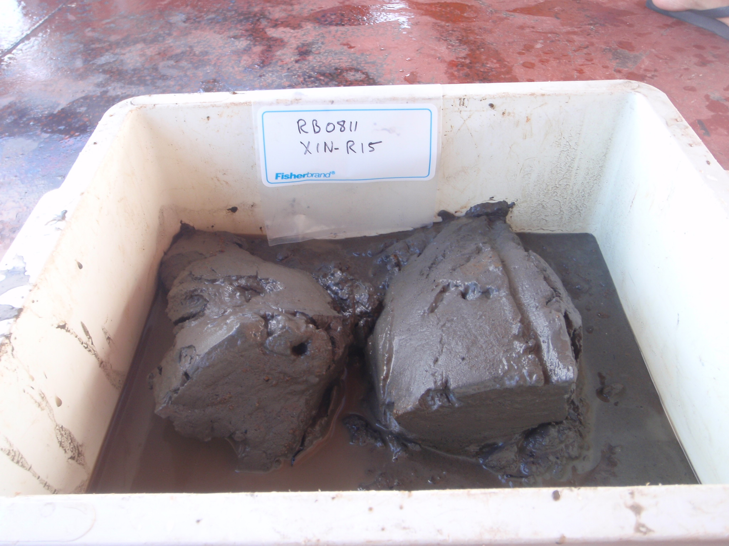
Amazon sediment trapped in mouth of tributary

Slide 20
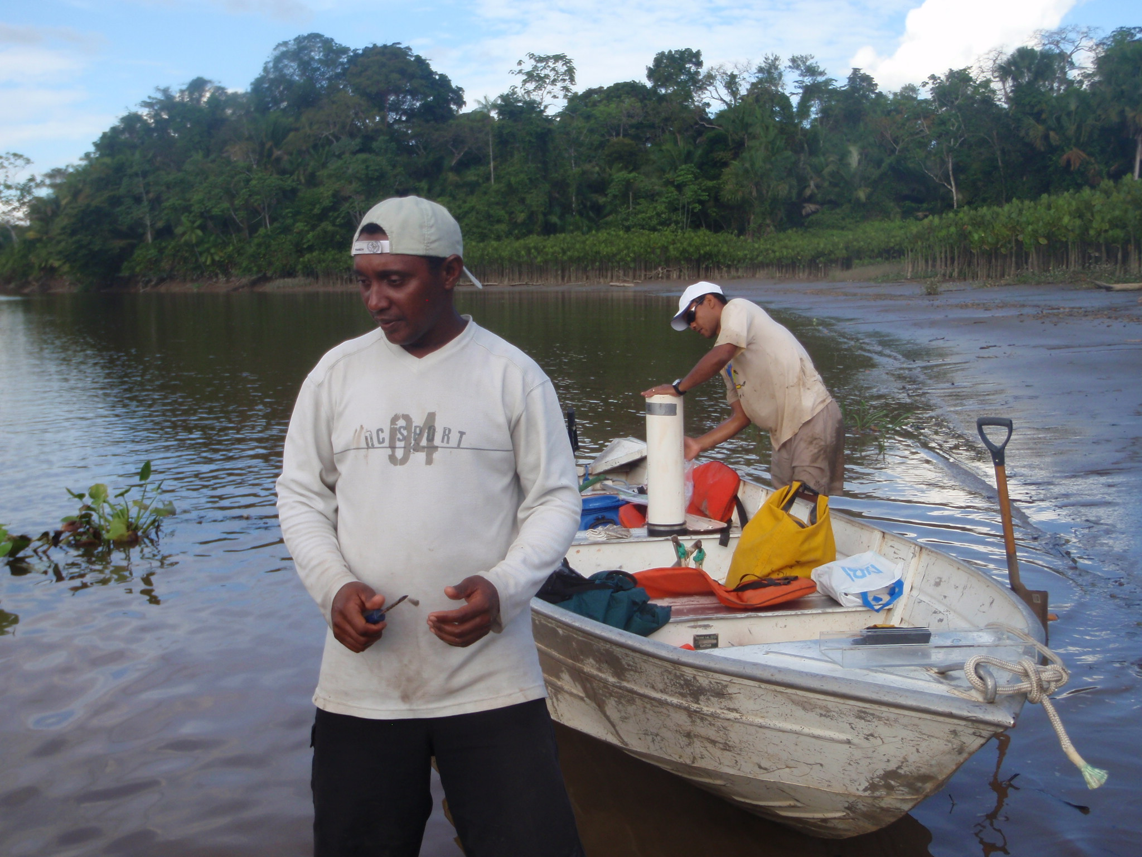

Slide 21
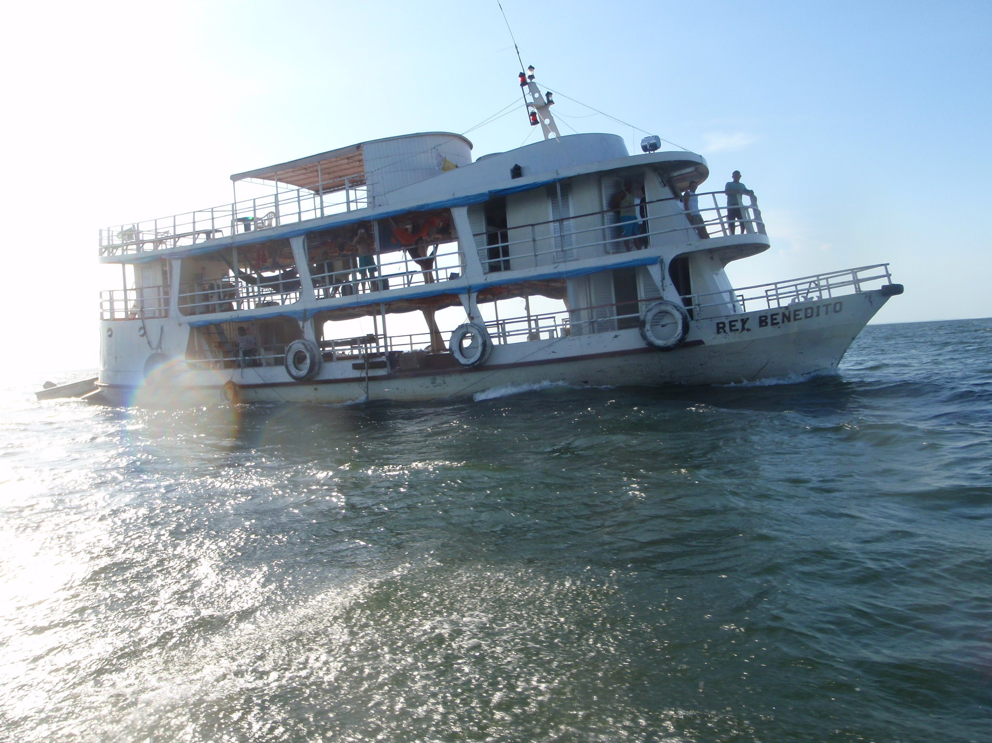

Slide 22
