Slide 1
Sarah’s office hours JHN 432
Wednesday 10/28: 3pm – 5:30 pm
Friday 10/30: 1:30pm – 3:30 pm

Slide 2
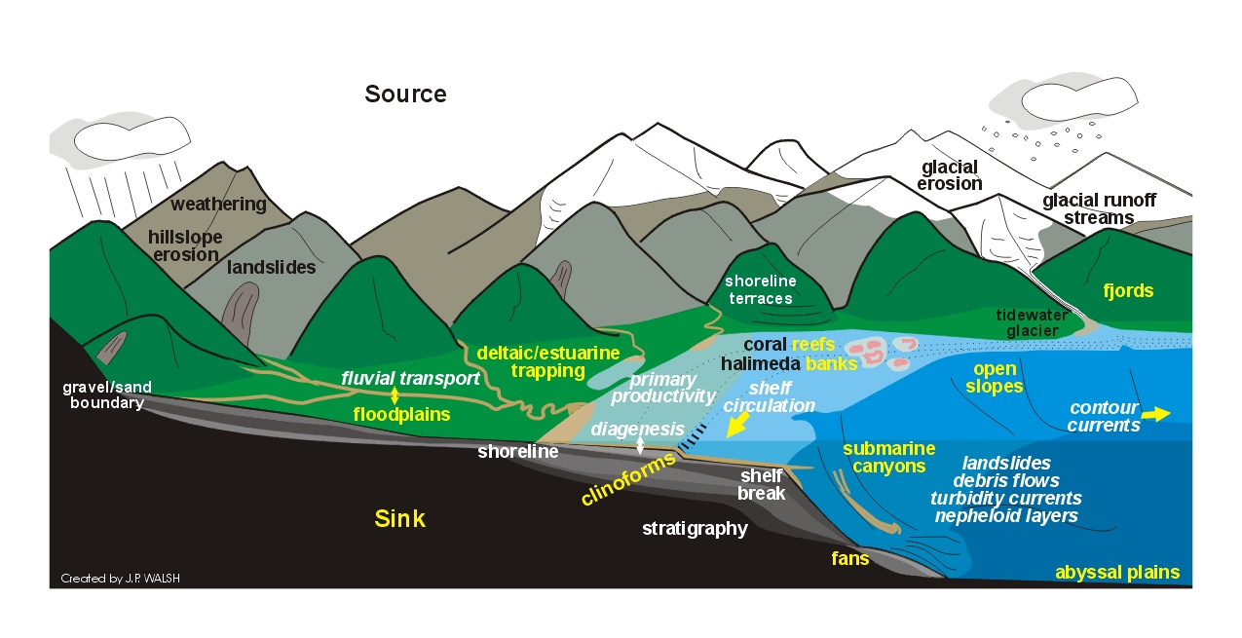
River Material & Sediment Transport

Slide 3
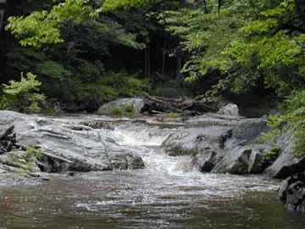
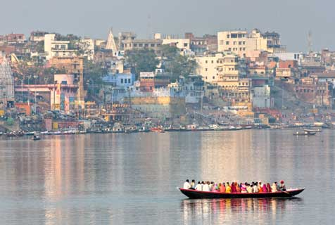
Rivers vs. Streams
stream and river can be used interchangeably;
a stream is a small river

Slide 4
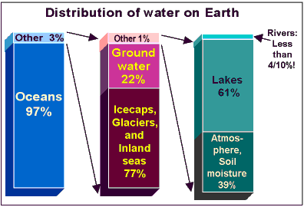
Distribution of Water on Earth
Rivers represent a tiny fraction of Earth’s water
only 3% of water on land
of that, 99% in inland seas, ice & groundwater
Notes:
The amount of water in rivers at any one time is tiny in comparison to other storage volumes. Only 3% of the world’s total water occurs on land. The largest volumes of water found occur in ice caps and glaciers (2.8%), groundwater (0.61%), lakes (0.009%), the atmosphere (0.001%), and in rivers (0.0001%).

Slide 5
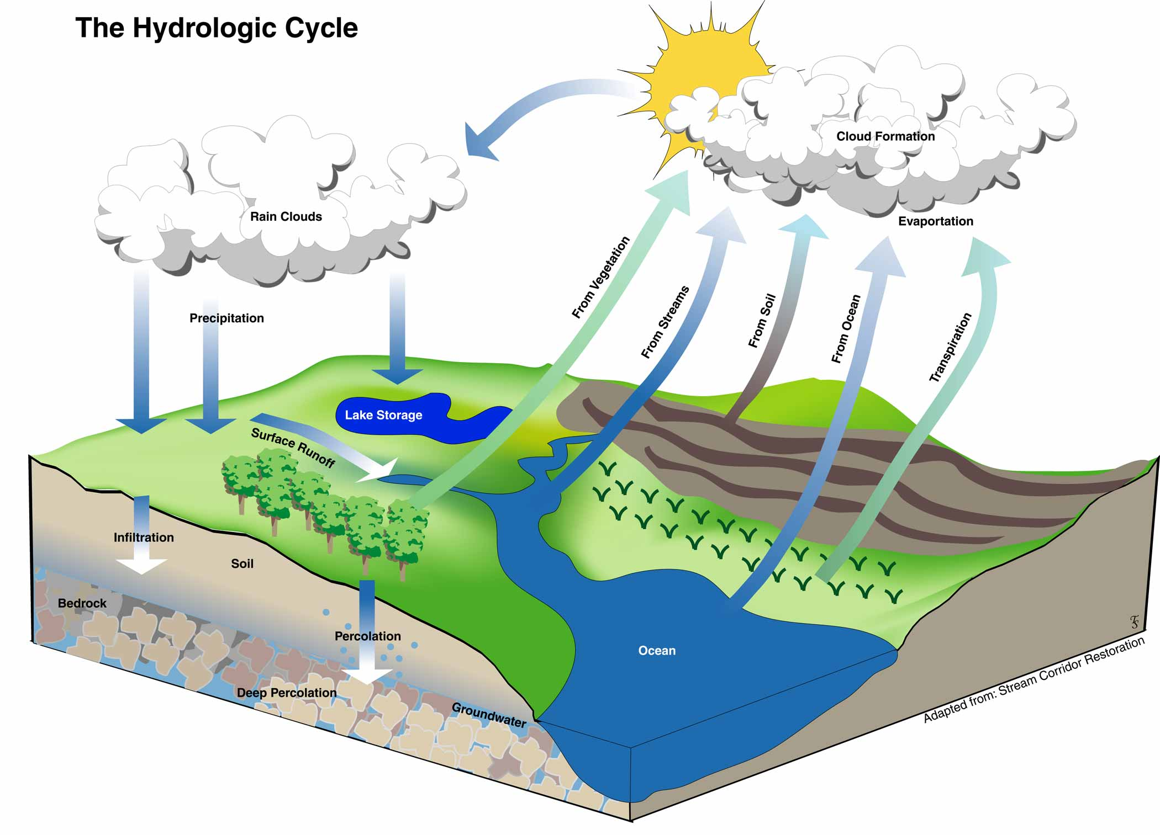
Hydrologic Cycle (water cycle)
Precipitation: rainfall and snow
Infiltration: groundwater system
Evaporation: return of water to atmosphere
Runoff: surface water system
runoff = precipitation – (infiltration + evaporation)

Slide 6
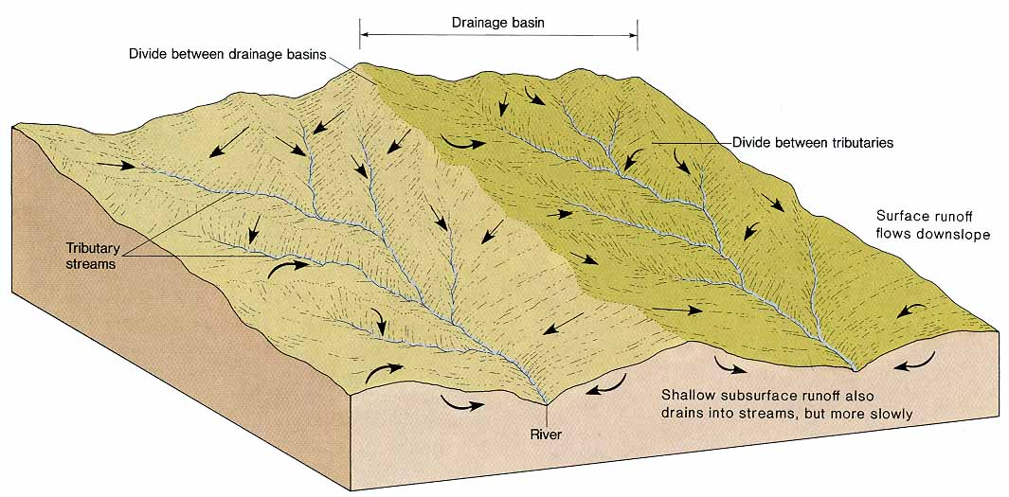
Stream Systems
Each stream drains a specific portion of the landmass, this is called the watershed or drainage basin
Drainage basins are separated by drainage divides
Drainage divides may be distinct (mountain ridges) or much more subtle

Slide 7
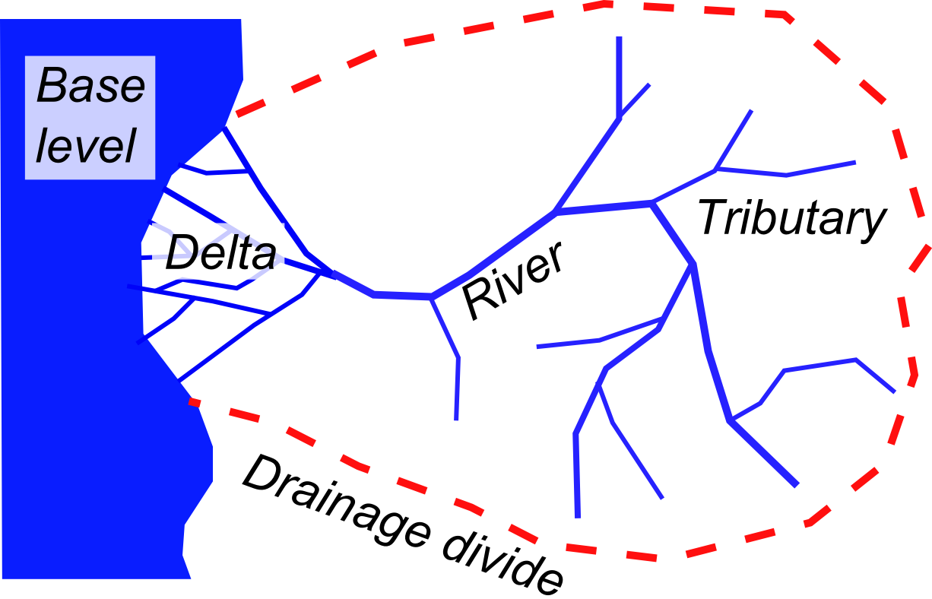
Stream Systems
Anatomy of a drainage basin

Slide 8
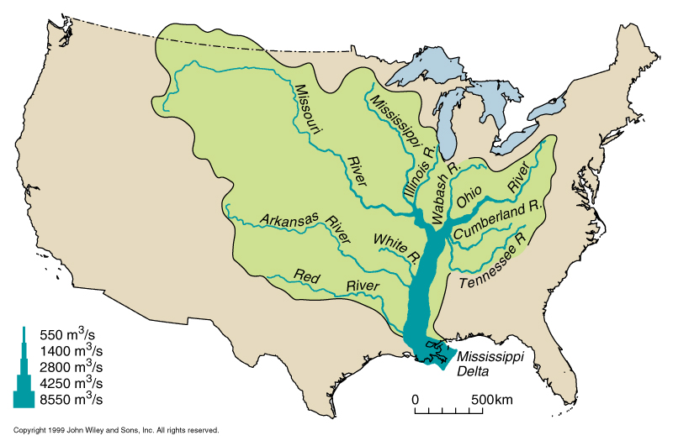
Stream Systems
Tributaries are any smaller streams that feed larger
streams within a drainage basin.

Slide 9
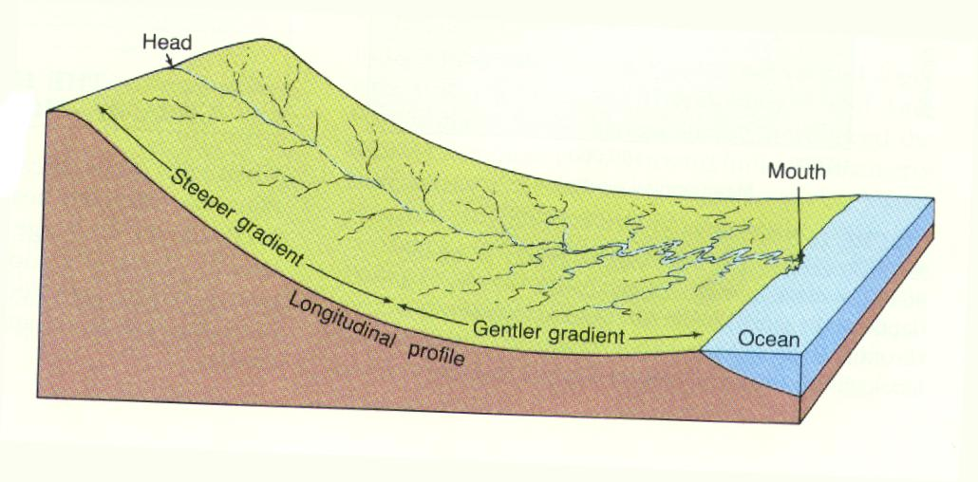
Base Level
Base level it the level below which a river or stream cannot incise
What happens if base level changes?

Slide 10
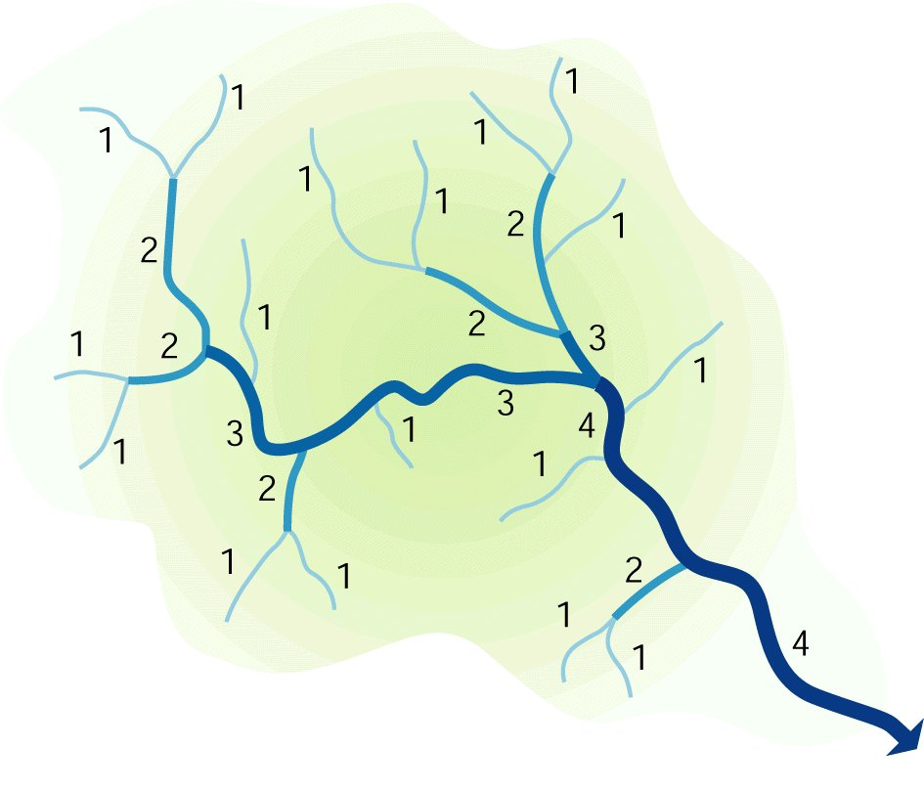
Stream Order
A method of classifying or ordering the hierarchy of natural channels.
Stream order correlates
well with drainage area,
but is also regionally
controlled by
topography & geology.
Notes:
Stream order helps to conceptually organize the streams in a watershed.
As streams increase in order, they also increase in length, exponentially;
World-wide, about 70-75% of stream miles occur as headwater (first order) streams.

Slide 11
Some Definitions
A stream (or river) is a body of water that:
Flows downslope along a clearly defined natural passageway
Transports particles and/or dissolved substances (load)
The passageway is called the stream’s channel
The quantity (volume) of water passing by a point on the stream bank in a given interval of time is the stream’s discharge
A stream’s discharge may vary because of changes in precipitation or the melting of winter snow cover.
In response to varying discharge and load, the channel continuously adjusts its shape (and location).

Slide 12
More Definitions
gradient or slope
rise over run, meters per kilometer [S]
cross-sectional area
width x average depth, expressed in square meters [A]
velocity of waterflow
expressed in meters per second [V]
discharge
expressed in cubic meters per second [Q]
load
expressed as kilograms per cubic meter
dissolved matter generally does not affect stream behavior

Slide 13
Cross sectional area
width [W] & depth [D]
A = W x D
W
D
W
Flat terrain W >> D
D
Steep terrain W ~ D

Slide 14
Discharge (Q)
Cross sectional area times the average velocity
Q = A x V
Q = W x D x V
Cubic feet per second (cfs) or cubic meters per second (cms)
V
depth
width

Slide 15
Downstream Evolution
Due to tributary contributions, discharge increases downstream but how do W, D, and V adjust to the increasing discharge?
Q = W D V
Longitudinal profile
height
distance

Slide 16
Downstream Evolution
Due to tributary contributions, discharge increases downstream but how do W, D, and V adjust to the increasing discharge?
Q = W D V
Discharge?
height
distance

Slide 17
Downstream Evolution
Due to tributary contributions, discharge increases downstream but how do W, D, and V adjust to the increasing discharge?
Q = W D V
Width?
height
distance

Slide 18
Downstream Evolution
Due to tributary contributions, discharge increases downstream but how do W, D, and V adjust to the increasing discharge?
Q = W D V
Depth?
height
distance

Slide 19
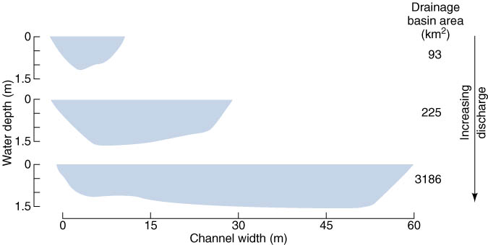
Cross-Sectional Shape
The ratio of channel width to channel depth generally increases down stream.

Slide 20
Downstream Evolution
Due to tributary contributions, discharge increases downstream but how do W, D, and V adjust to the increasing discharge?
Q = W D V
Velocity?
height
distance

Slide 21
Downstream Evolution
Due to tributary contributions, discharge increases downstream but how do W, D, and V adjust to the increasing discharge?
Q = W D V
Slope
Discharge
Velocity
Width
height
Depth
distance

Slide 22
Downstream Evolution
Due to tributary contributions, discharge increases downstream but how do W, D, and V adjust to the increasing discharge?
Q = W D V
Traveling down a typical stream from its head to its mouth:
Discharge increases
Gradient decreases
Stream cross-sectional area increases
Width to depth ratio increases

Slide 23
Long profile
rise
elevation
Gradient =
=
run
distance
i.e.: ft/mi or m/km
rise
run

Slide 24
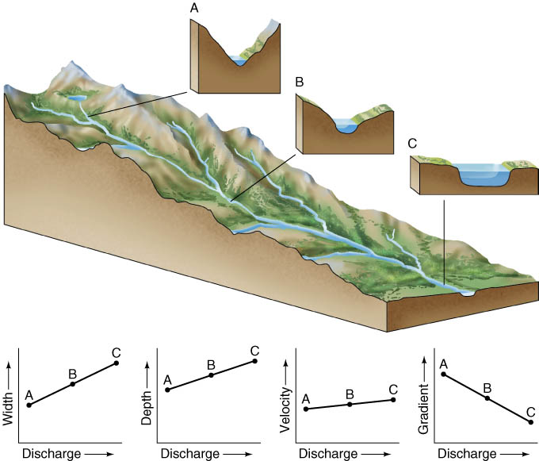
Where does a stream move fastest?

Slide 25
Where does a stream move fastest?

Slide 26
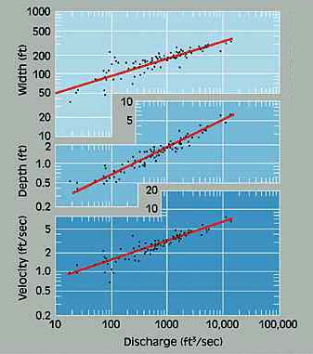
Headwater streams move slowest
Mouth of stream moves fastest
Deeper stream move faster than shallow streams –
less resistance from the stream bed

Slide 27
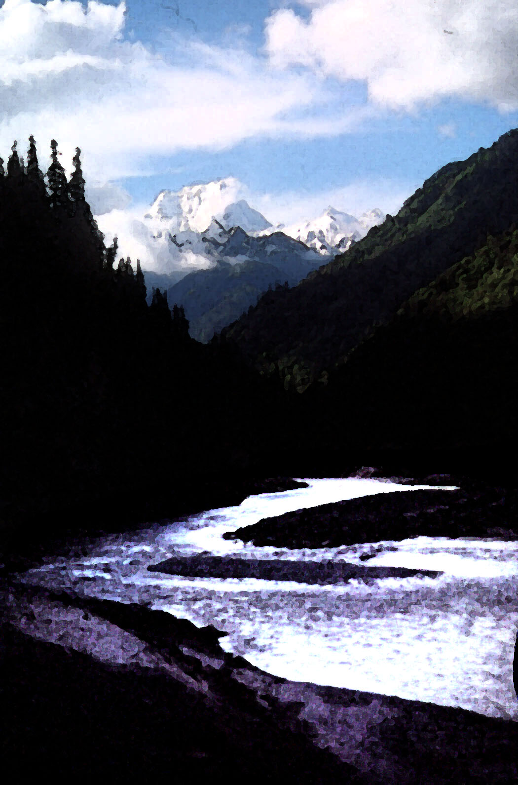
Field data generally indicate that channel width, depth, and velocity vary approximately as the square root of discharge
W ~ a(Q)^{1/2}
where a is some multiplier…

Slide 28
Velocity Determination: Float Method
Inexpensive and simple
Measures surface velocity
Basic idea: measure the time that it takes an object to float a specified distance downstream

Slide 29
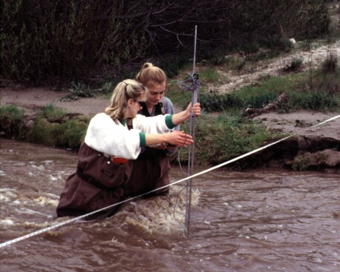
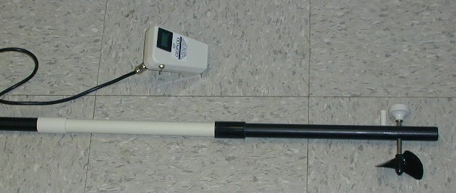
Discharge Measurement
0.6D
D
- Velocity measurements V

Slide 30
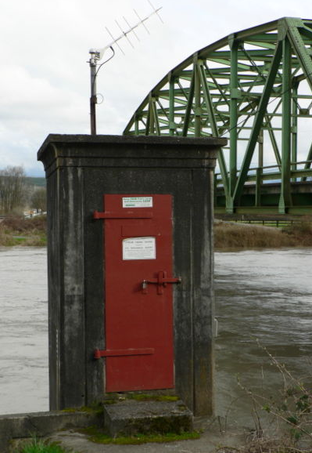
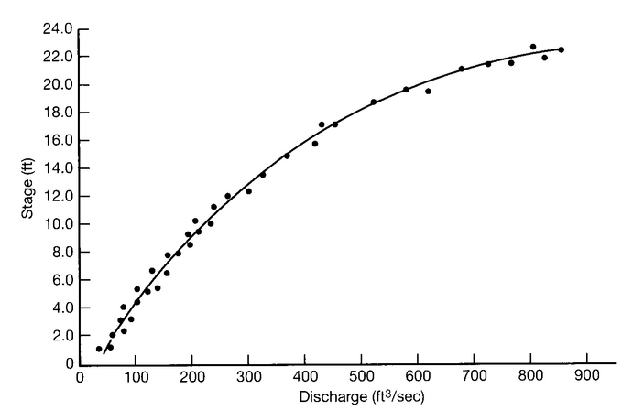
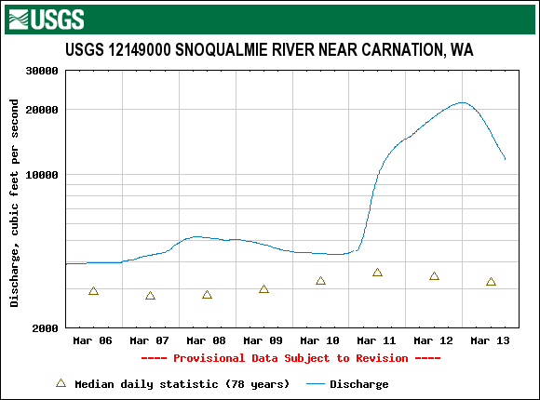
Stage & Rating Curves
River levels are typically measured as a stage (height)
Stage must be converted to discharge via a rating curve

Slide 31
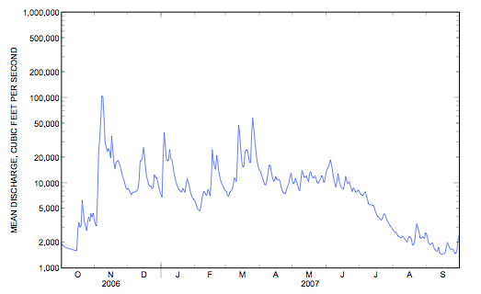
Hydrographs
stream discharge is not constant with time
discharge varies with:
seasonal climate variation
Snohomish R. near Monroe

Slide 32
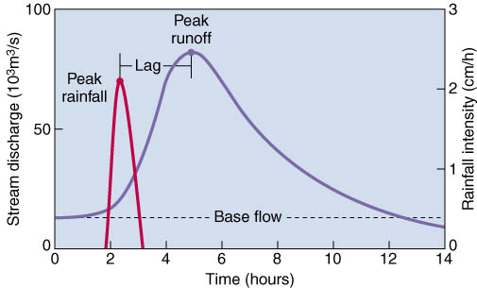
Hydrographs
stream discharge is not constant with time
discharge varies with:
seasonal climate variation
individual rainfall events – note lag between rainfall peak & Q peak
schematic
storm
hydrograph

Slide 33
Floods
A flood occurs when a stream’s discharge becomes so great that it exceeds the capacity of the channel, therefore causing the stream to overflow its banks.
Geologists view floods as normal and expected events.
Recurrence interval: the average time between floods of a given size.
A flood having a recurrence interval of 10 years is called a “10-year flood.”

Slide 34
Floods
Magnitude-frequency balance
High magnitude = low frequency
High frequency = low magnitude

Slide 35
Flood Frequency
Bankfull flood occurs on average about every 1 to 2 years
100 year flood occurs on average about every 100 years.
Notes:
However, technically the 100 yr flood is actually the flood with a 1% chance of occurring in a given year…

Slide 36
Floods
With an increased discharge and velocity during a flood, a channel can carry a greater load.
As discharge falls, the stream is unable to transport as much sediment.
At the end of the flood it returns to (approximately) its pre-flood dimensions.

Slide 37
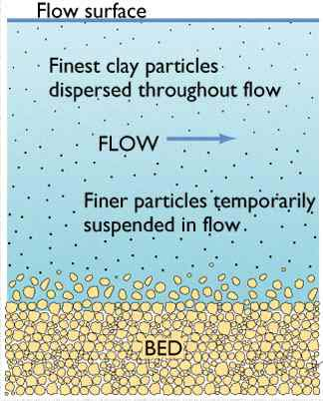
Carrying the Load
The material transported by a river is called its load.
There are three basic classes of load:
Dissolved load: the invisible load of dissolved ions (e.g. Ca, Mg, K, HCO3)
Suspended load: sediment that is fine enough to remain in suspension in stream (size depends on velocity and turbulence)
Bed load: sediment rolling, bouncing, and creeping along the river bed

Slide 38
Bed Load
The bed load generally constitutes between 5 and 20 percent of the total load of a stream.
Particles move discontinuously by rolling or sliding at a slower velocity than the stream water.
The bed load may move short distances by saltation (series of short intermittent jumps).

Slide 39
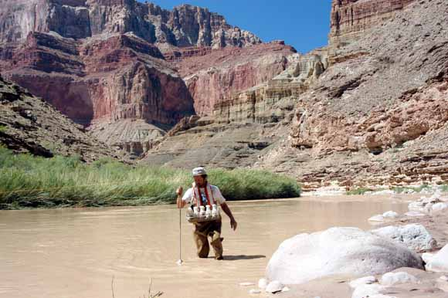
Suspended Load
Particles tend to remain in suspension when upward moving currents exceed the velocity at which particles of silt and clay settle toward the bed under the pull of gravity.
They settle and are deposited where velocity decreases, such as in a lake or in the oceans.

Slide 40
Dissolved Load
All stream water contains dissolved ions and anions
The bulk of the dissolved content of most rivers consists of seven ionic species:
Bicarbonate (HCO3-)
Calcium (Ca++)
Sulfate (SO4--)
Chloride (Cl-)
Sodium (Na+)
Magnesium (Mg++)
Potassium (K+)
Dissolved silica as Si(OH)4

Slide 41
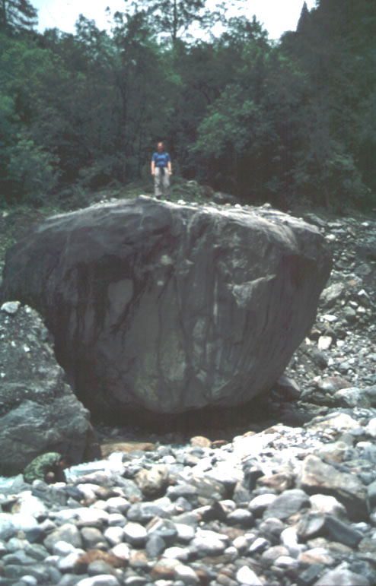
Sediment Size
Boulders > 256 mm
Cobbles 80 mm - 256 mm
Gravel 2 mm - 80 mm
Sand 0.05 mm - 2 mm
Silt 0.002 mm - 0.05 mm
Clay < 0.002 mm

Slide 42
Downstream Changes in Particle Size
The size of river sediment normally decreases in size downstream
boulders in mountain streams → silt and sand in major rivers
2 primary reasons:
coarse bed load is gradually reduced in size by abrasion
coarser, heavier materials generally settle out first…

Slide 43
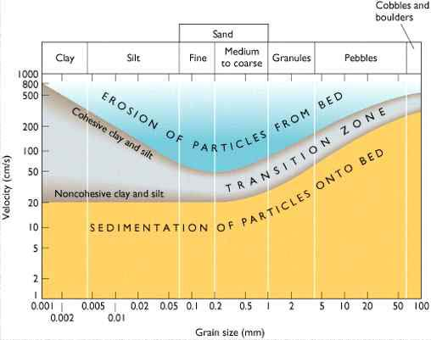
The ability of a stream to pick up particles of sediment from its channel and move them along depends on the velocity of the water.
gravel

Slide 44
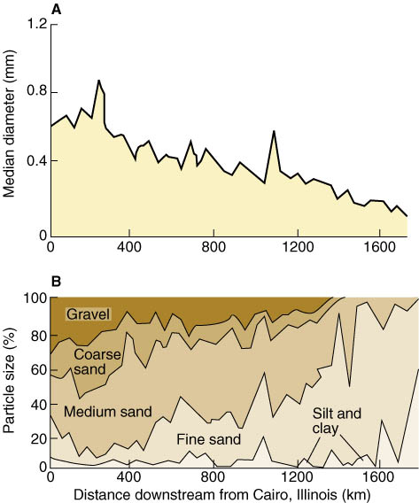
When a river eventually reaches the sea, its bed load typically consists mainly of sand and silt.

