Slide 1
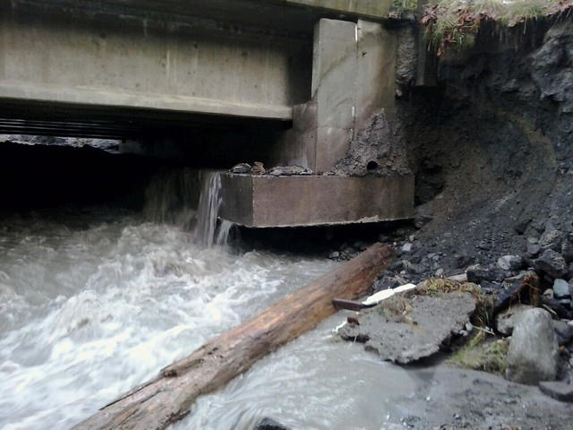
River response
11/19/2015
Notes:
Hwy 2 Bridge, Nov 19th, 2015, 4 days later open again

Slide 2
climate
catchment
vegetation
sediment& wood inputs
riparian
veg.
fast
hydrology
flow
obstructions
channel morphology
rate of change
geology
gradient
valley form
slow

Slide 3
Channel response
Climate and catchment vegetation are external geographic controls
Water supply, sediment, and wood can change immediately (i.e., one flood)
Basin geology, slope, and valley shape change much slower
climate
catchment
vegetation
sediment& wood inputs
riparian
veg.
fast
hydrology
flow
obstructions
channel morphology
rate of change
geology
gradient
valley form
slow

Slide 4
Lane’s balance
$$Q_{s}×D_{50}\sim Q_{w}×S$$
Q_{s} = sediment discharge
D₅₀ = sediment size (diameter of 50th percentile)
Q_{w} = water discharge
S = water slope
Fun fact: The equation is Lane’s, but the drawing geomorphologists refer to is Borland’s

Slide 5
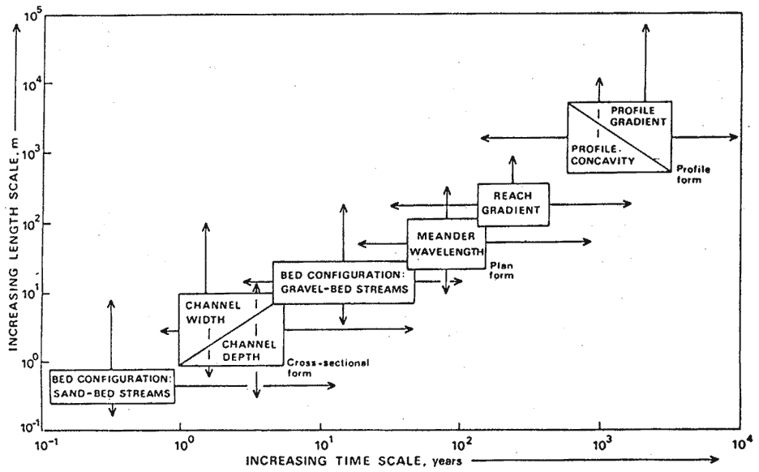
Time scales of channel response

Slide 6
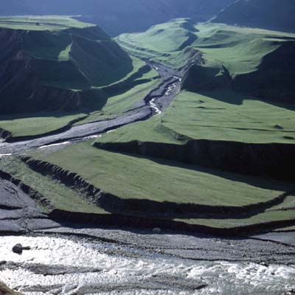
River terraces (again)
Over long timescales, these adjustments leave distinctive landforms behind
Fill terraces
Strath or bedrock terraces

Slide 7
Terrace types
Fill terraces
Alluvium only, bedrock buried
Strath
terraces
Erosion & planation into bedrock with thin gravel cap
Fill terraces: represent large scale aggradation to the extent that much of the valley gets buried in sediment
Strath terraces: small phases of aggradation but largely erosion into bedrock and deepening of valley (requires some rock uplift to keep changing base level)

Slide 8
Case studies
Long term, geologic disturbance:
Big Sheep Creek – Rivers & Tectonics
Clearwater River – Rivers & Global Climate Cycles & Mountain Building
Land use interactions:
Skokomish River – Rivers & Lithology & Land Use
NF Skokomish River – Rivers & Dams
Seattle Urban Streams – Rivers & Land Use

Slide 9
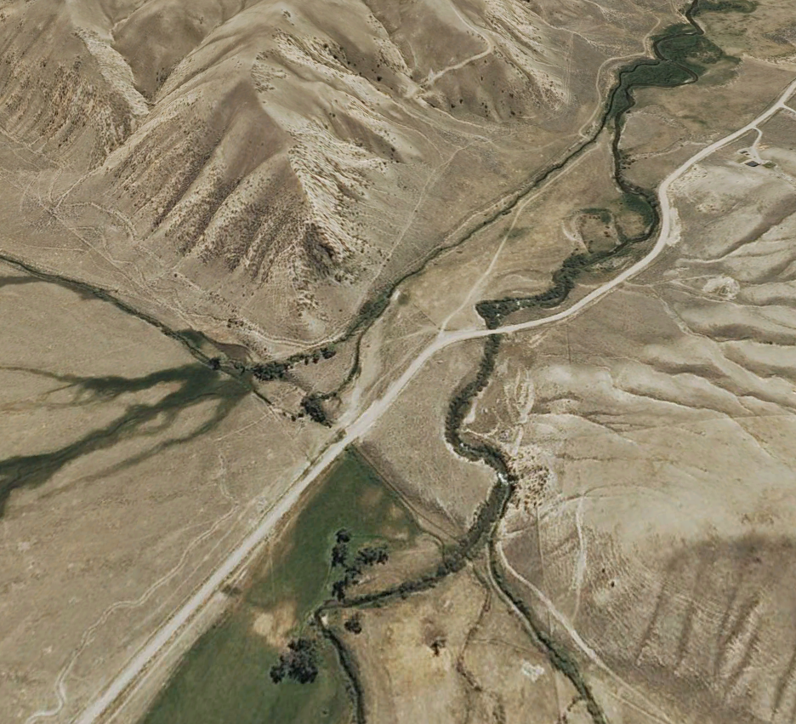
Big Sheep Creek, SW Montana
Red Rock fault is active, and ruptures every few thousand years, uplifting the land to the upper right.
What does this do to the stream?
Irrigation canal
Red Rock fault scarp
Big Sheep Creek
Road

Slide 10
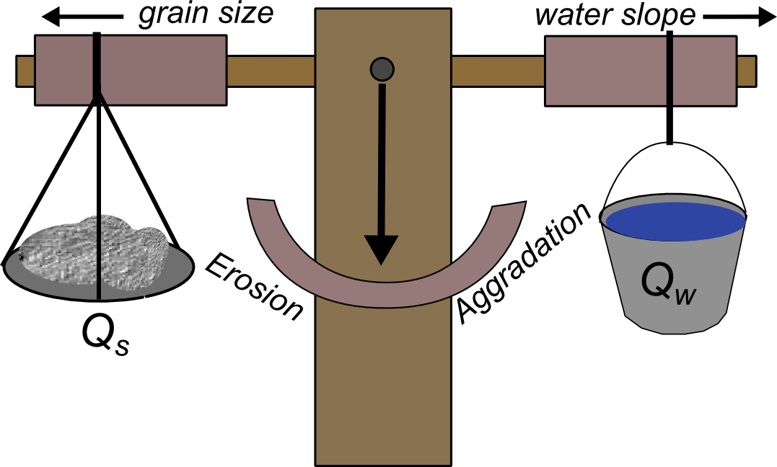
Big Sheep Creek
S increases at the fault scarp
This increases erosion
But the increased S keeps moving upstream!
$$Q_{s}×D_{50}\sim Q_{w}×S$$

Slide 11
Big Sheep Creek
The steepened zone (knickpoint) will concentrate erosion and start to erode back…moving the knickpoint up the river!
Knickpoint
Fault

Slide 12
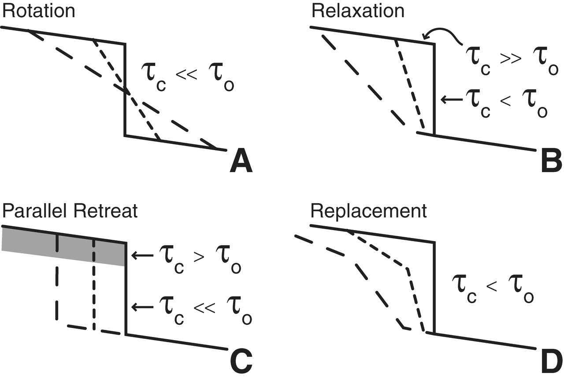
Big Sheep Creek
There are several styles of knickpoint retreat, depending on lithology
Importantly, knickpoints are a way for rivers to propagate a disturbance upstream!
Water flow

Slide 13
Big Sheep Creek
What happens when we erode rivers downwards?
Terraces get created through floodplain abandonment.

Slide 14
Big Sheep Creek
Even the old alluvial fans are terraces – these mounds are part of an old alluvial fan deposit that is now 30 m above it’s valley.

Slide 15
Big Sheep Creek
Other effects:
1. Meanders cutoff as river steepened
2. Knickpoints that haven’t propagated upstream are still present and will drive more terrace abandonment as they erode.
1
1
2
2

Slide 16
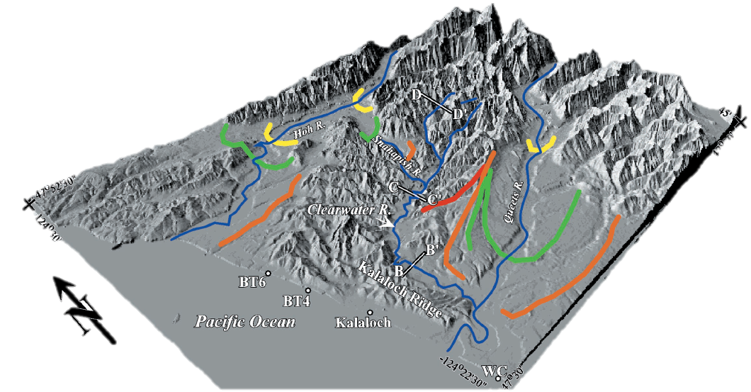
Clearwater River
Glaciated headwaters:
Pazzaglia & Brandon, 2001; Wegmann & Pazzaglia, 2002

Slide 17
Clearwater River
Extensive fill terraces!
Qt3: 65-60 ka
Qt2: 140-125 ka
Dates are consistent with the previous glaciations:
Why?
Pazzaglia and Brandon, 2001

Slide 18
Clearwater River
$$Q_{s}×D_{50}\sim Q_{w}×S$$
Glaciers increased the Q_{s} and likely D₅₀ which tipped the scale in favor of aggradation!
Input was so rapid that Q_{w} and S couldn’t adjust fast enough

Slide 19
Clearwater River
But below the large fill terraces are Holocene (<10 ka) strath terraces!
How did these form?
Wegmann and Pazzaglia, 2002

Slide 20
Clearwater River
Q_{s} dropped after deglaciation
BUT: slow uplift had caused S to slowly increase
With the drop in Q_{s}, the high S value started to dominate the balance
Leading to incision and strath terraces!
$$Q_{s}×D_{50}\sim Q_{w}×S$$

Slide 21
Clearwater River and Big Sheep Creek

Slide 22
The realm of land use interactions with rivers!
or: stupid human tricks

Slide 23
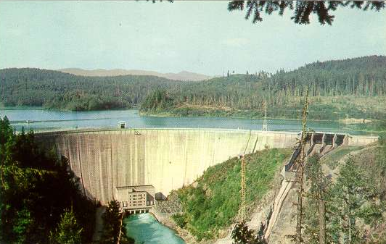
Dams
Trap water and sediment in reservoirs behind them
Less/no sediment transport from these dams
Water is released in regulated flows
Less water for sediment transport

Slide 24
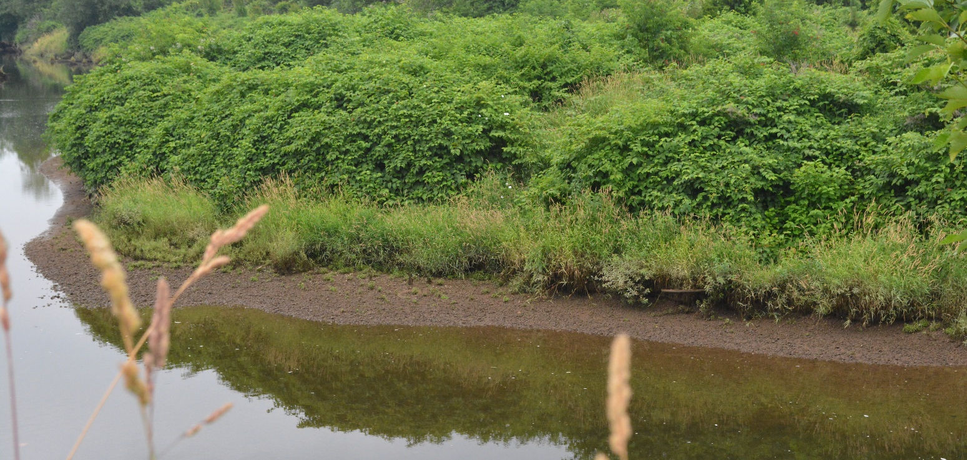
Dams
Dams may be managed to have higher water flows at certain times of the year for ecological reasons, e.g. salmon runs
However, this can have unexpected consequences for other biota
On the Willamette River in Oregon, the high flows for salmon help reed canary grass colonize on bars early. The invasive grass is then outcompeting cottonwoods, which are important species for gravel bar to floodplain conversion

Slide 25
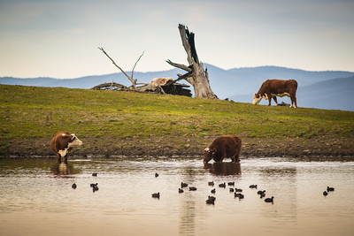
Ranching/farming
Similar impacts as logging due to clearing the land of large vegetation and annual harvest
Cows:
With access to streams, they degrade/erode banks
Weight can cause larger slump erosion in wetland streams
Fine sediment enters river and river geometry altered.

Slide 26
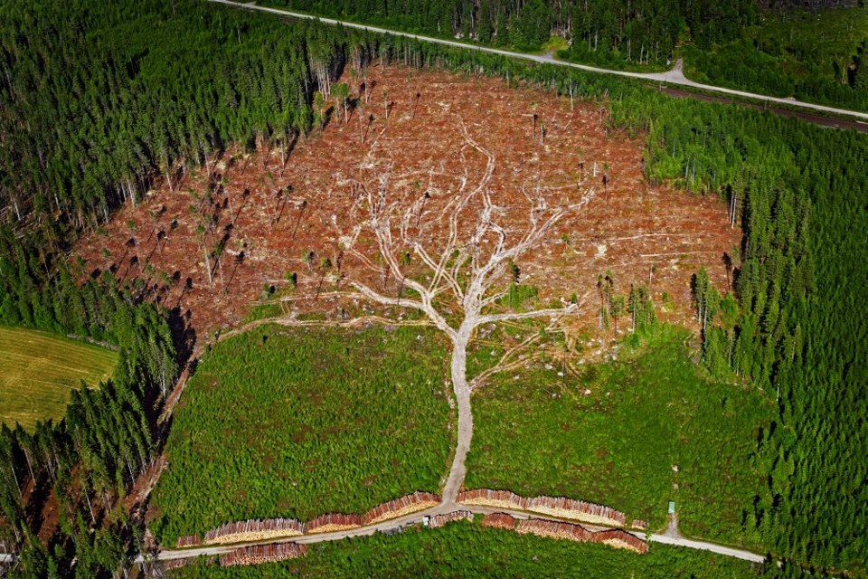
Logging
Removes trees over a wide area
Less trees = less root cohesion to hold soil together
→ More erosion
Less trees = less evapotranspiration (ET)
→ More runoff
→ More erosion
Increased erosion leads to more sediment in rivers and streams, and more rapid sediment/water delivery

Slide 27
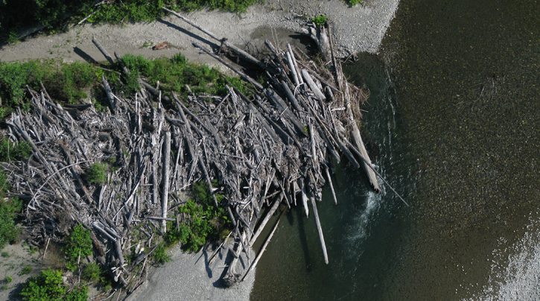
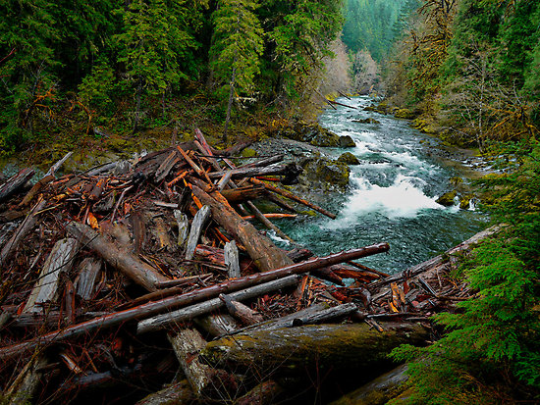
Large woody debris
Logging and agriculture are also going to affect the size and type of large woody debris in the river.
Why is large woody debris important in rivers?
Forms shady refuge for salmon and other biota
Larger pieces of wood can alter flow patterns, even altering the river planform

Slide 28
Large woody debris to floodplain

Slide 29
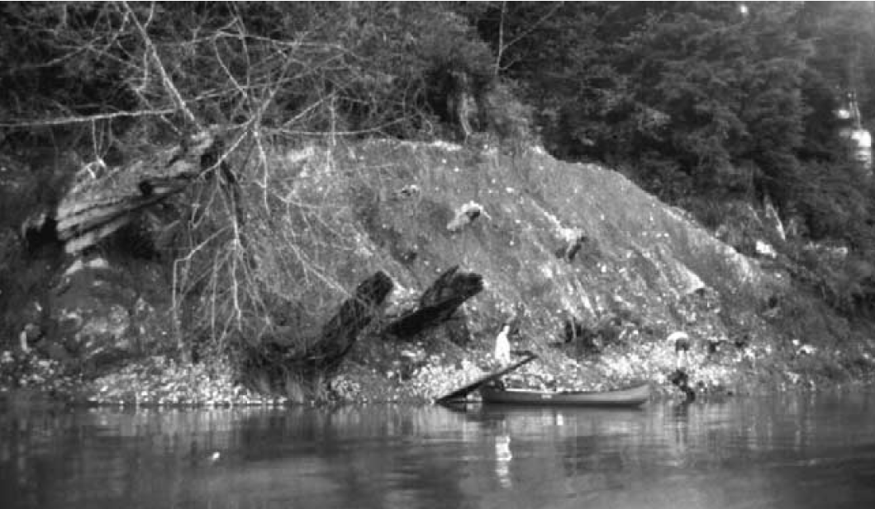
Large woody debris
Without old growth forests, logs can’t mature to sizes big enough to form stable jams
Stable islands previously by log jams don’t form
One reason we think anastomosing channels aren’t common anymore
Stable log jam buried under 4 m of sediment, Queets River. (Montgomery and Abbe, 2006)

Slide 30
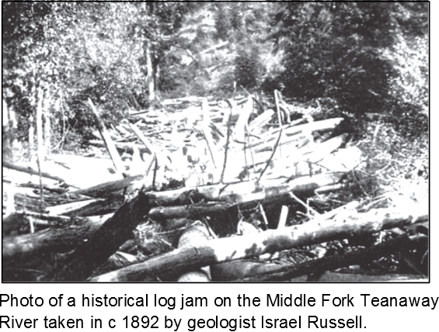
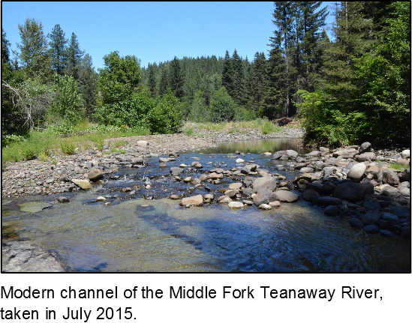
Large woody debris
With the loss of stable large woody debris:
Less stable islands in the river
Floodplain has less stable island hard points incorporated in, which reduces floodplain bio-diversity
Rivers tend to be single channel meandering or braided rather than anastomosing
Loss of sediment storage in bars created by LWD
More rapid movement of sediment downstream
Enhanced erosion of the bed due to sediment storage loss

Slide 31
Case studies
Long term, geologic disturbances:
Big Sheep Creek – Rivers & Tectonics
Clearwater River – Rivers & Global Climate Cycles & Mountain Building
The realm of land use interactions:
Skokomish River – Rivers & Lithology & Land Use
NF Skokomish River – Rivers & Dams
Seattle Urban Streams – Rivers & Land Use

Slide 32
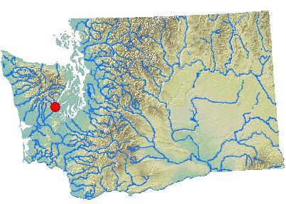
Skokomish River
Upper basin deforested in late 1800’s through present
Underlain by loose and large till deposits

Slide 33
Skokomish River
So what happened?
Logging?
Till as “bedrock”?
$$Q_{s}×D_{50}\sim Q_{w}×S$$
Increased Q_{s}
Increased Q_{s}
→ Aggradation!

Slide 34
Skokomish River
Bare hillslopes from logging
Glacial sediment
Dry river from excessive aggradation!!

Slide 35
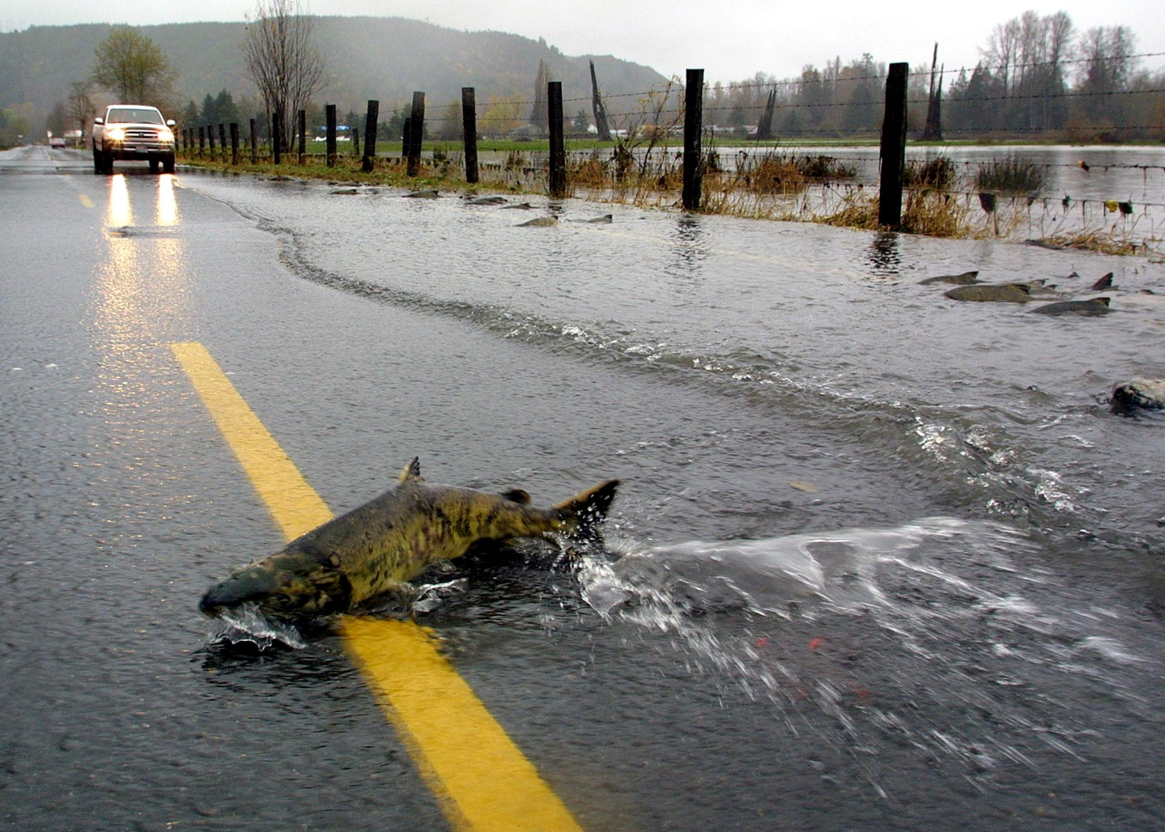
Skokomish River
Elevated river beds mean bankfull is easier to reach and overtop…it also means the river wants to avulse into the lower elevation floodplains…where people live!

Slide 36
Skokomish River
As sediment supply & flux (Q_{s}) increased, it was left on the bed of the river, building up the channel. Further confinement of the channel caused all the build up to localize, exacerbating the problem.
Stover and Montgomery, 2001

Slide 37
Skokomish River
At the same place where the bed built up, we see directly how floods of the same size start to reach higher and higher, overtopping the bank more often and creating more damage.
Stover and Montgomery, 2001

Slide 38
Skokomish River

Slide 39
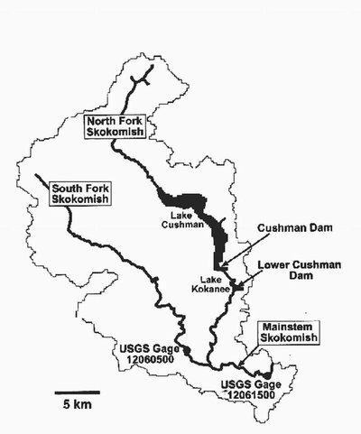
NF Skokomish Rivers & Dams
Same region as the mainsteam Skokomish, but now there’s a dam!

Slide 40
NF Skokomish
What does the dam do?
↓ Q_{w}
↓ Q_{s}
BUT: Lake Cushman already existed, so Q_{s} stays the same
$$Q_{s}×D_{50}\sim Q_{w}×S$$

Slide 41
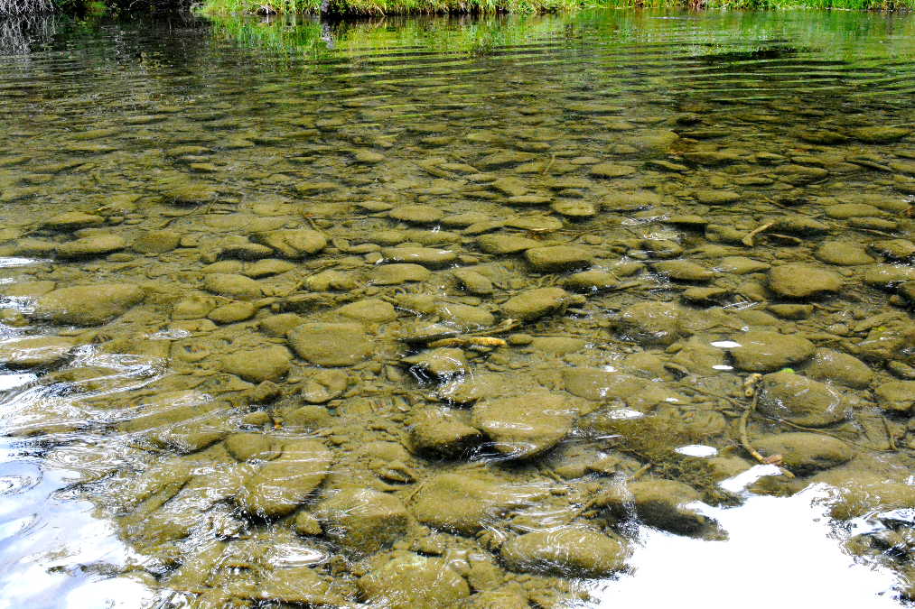
NF Skokomish
A decrease in water supplied means less water to transport sediment
Sediment that does get transported tends to be smaller
This creates “armoring” of the bed

Slide 42
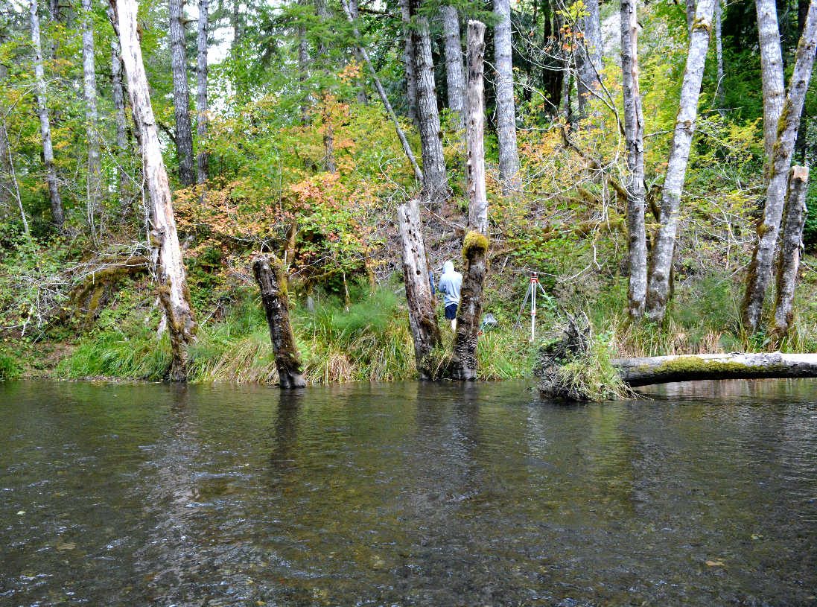
NF Skokomish
Why is armoring bad?
Reduces sediment transport
Can exacerbate an aggraded system (no ability to erode)
River aggradation drowned trees by the streamside, and now the armored bed can’t erode back down

Slide 43
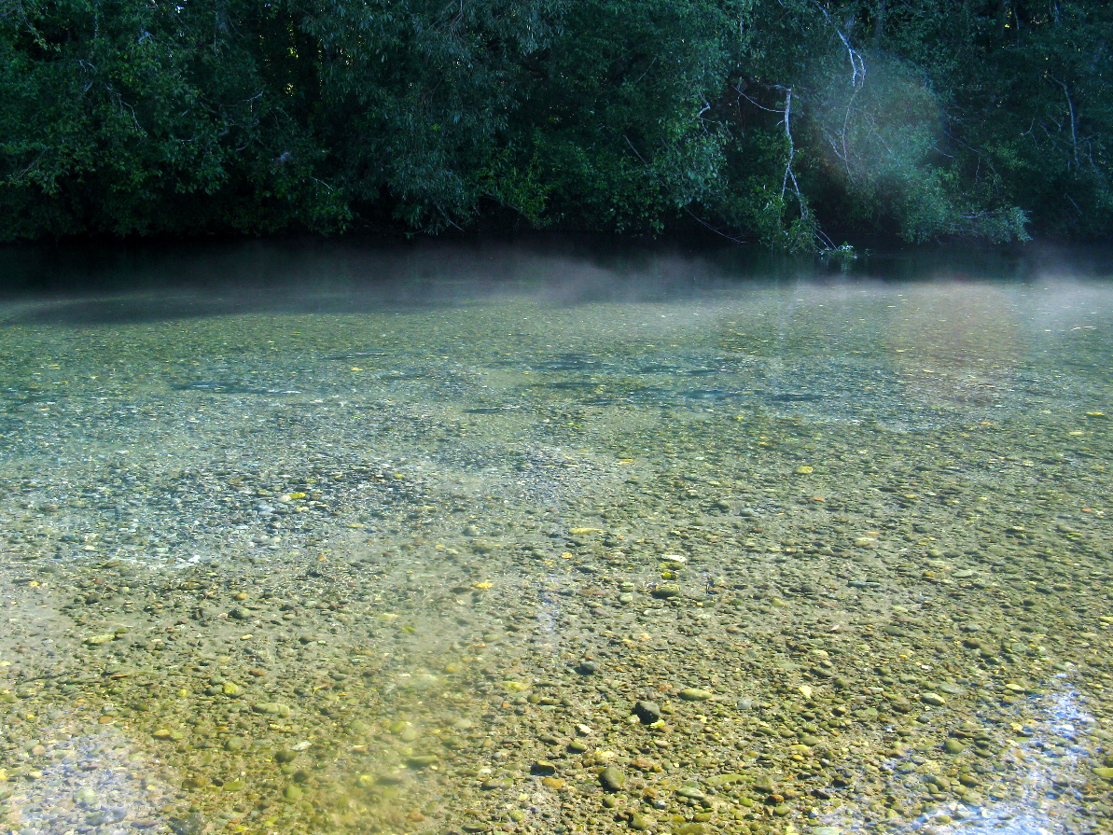
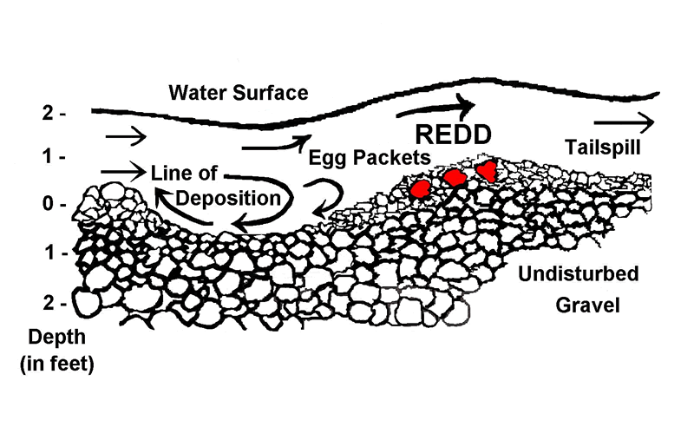
NF Skokomish
Why is armoring bad?
Reduces sediment transport
Can exacerbate an aggraded system (no ability to erode)
Makes it harder to move the sediment!
Salmon
Skokomish River

Slide 44
NF Skokomish River

Slide 45
Seattle Urban Streams
Increased urbanization changes the routing of water to the streams.
Instead of draining through the subsurface, precipitation is rapidly routed to streams via paved surfaces.
river response
Moscrip & Montgomery, 1997

Slide 46
Seattle Urban Streams
Funneling the water is increasing the discharge in urban streams…often to 2x what is should be for a given recurrence interval!
As the percent of the basin urbanized increases, the increase in discharge increases.
Moscrip & Montgomery, 1997

Slide 47
Seattle Urban Streams
$$Q_{s}×D_{50}\sim Q_{w}×S$$
Now Q_{w} increases, which will increase erosion rates
Incised streams with lots of fast moving water & sediment, carrying pollutants!

Slide 48
Seattle Urban Streams
Unnamed stream/storm drainage in Sammamish created a large gully from increased water flows.
Photos from Dan Vogt
ESRM 311/ SEFS 507

Slide 49
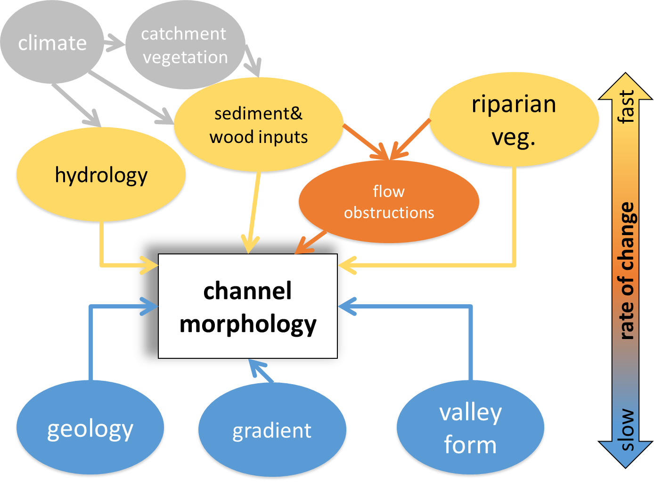
River response
If we change one of these variables, the river is going to reflect that: aggradation, incision, armoring, etc.

Slide 50
River response
Given enough time, the Lane Balance will point down, somewhere between erosion and aggradation.
$$Q_{s}×D_{50}\sim Q_{w}×S$$

Slide 51
River response
BUT: what if the response is to something un-natural? If the response is negatively impacting the ecosystem?
That’s when we can turn to: RIVER RESTORATION (next Tuesday)

